Slide 1
July 2023
Nutrition
NEWSLETTER
Inside:
Brought to you by:
Grilled Squash Salad by Judy Doherty, MPS, PC II
Two Melon Mint Salad, by Judy Doherty, MPS, PC II
Which Burger Do You Choose for Sodium?, Lynn Grieger, RDN, CDCES, CHWC, CPT
Which Burger Do You Choose for Protein?, Lynn Grieger, RDN, CDCES, CHWC, CPT
Which Burger Do You Choose for Fat?, Lynn Grieger, RDN, CDCES, CHWC, CPT
Which Burger Do You Choose?, Lynn Grieger, RDN, CDCES, CHWC, CPT
Functional Spotlight: Green Coffee, Lynn Grieger, RDN, CDCES, CHWC, CPT
Choose More Blue Foods, by Lynn Greiger, RDN CDCES, CHWC
Choose More Blue Foods, by Lynn Greiger, RDN CDCES, CHWC
Earlier Meals Mean Better Blood Sugar Control by Lisa Andrews, MEd, RD, LD
Mediterranean Diet Improves Mental Health, by Lisa Andrews, MEd, RD, LD
Handout: Control Blood Pressure, MEd, RD, LD

Slide 2
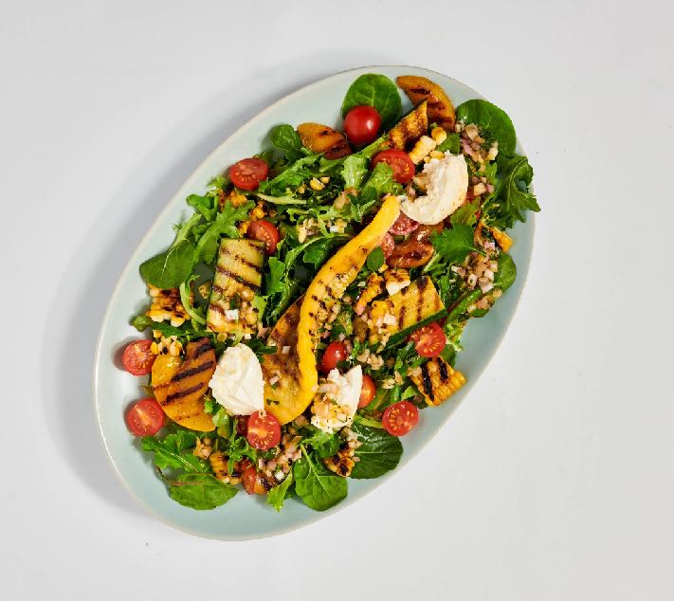
Grilled Summer Squash and Peach Salad
Here is a salad made by grilling vegetables and placing on dressed greens with burrata cheese. It is a light meal or a delicious side dish for summer.
Ingredients:
1/2 cup olive oil
2 lemons, zest, and juice
1.5 tablespoons red wine vinegar
1 tsp honey
2 tablespoons diced red onion
1 clove of garlic, minced
1 tablespoon fresh chopped basil
2 zucchini squash, sliced lengthwise in 1/2 inch slices
2 yellow summer squash, sliced lengthwise in 1/2 inch slices
2 peaches, cut in halves, pits removed
2 ears of corn, husked
4 cups assorted mixed greens
2 small burrata cheese balls, cut in quarters
1 cup cherry tomatoes, rinsed and stems removed, cut in half
Directions:
Heat a grill to medium-high heat or about 400 degrees. You could also grill the items in a grill pan on the stove.
Make the dressing in a medium-sized mixing bowl, mixing the olive oil, lemon juice, red wine vinegar, honey, onions, herbs, and seasonings.
Place the squash, peaches, and corn in a baking pan. Drizzle them with a little of the dressing.
Place foil on the grill and grill everything until the vegetables are tender, about 7-9 minutes. You can turn them over halfway. Remove from the grill. Once the corn is cool, remove the kernels from the cob.
Arrange the salad: Toss the lettuce with the rest of the dressing and place it on a platter, followed by the grilled veggies, burrata cheese, and fresh cherry tomatoes. Top with more fresh herbs.
Serves 3-4. Each 1 cup serving: 335 calories, 28 g fat, 4 g saturated fat, 21 mg cholesterol, 33 mg sodium, 21 g carbohydrate, 3 g fiber, 3 g protein.

Slide 3
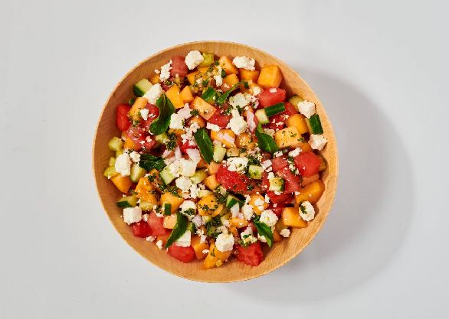
Two Melon Mint Salad
Ingredients:
2 tablespoons olive oil
1 tablespoon rice wine vinegar
1 tsp honey
Juice and zest of 2 limes
Black pepper to taste
2 cups cubed fresh cantaloupe
2 cups fresh cubed seedless watermelon
1 cup diced cucumber
1/4 cup crumbled feta cheese
2 tablespoons chopped red onions
1 bunch fresh mint: chop 1.5 tablespoons and use the rest for garnish
Directions:
Mix the olive oil, vinegar, honey, lime juice and zest, and pepper in a large mixing bowl.
Add the cubed melons, cucumber, red onions, chopped mint, and toss.
Arrange in a bowl. Top with crumbled feta cheese.
Top with whole mint leaves. Chill until ready to serve up to 4 hours.
Nutrition Facts:
Serves 4. Each serving: 102 calories, 6 g fat, 1.5 g saturated fat, 5 mg cholesterol, 88 mg sodium, 11 g carbohydrates, 1 g fiber, 8 g sugar, 1 g protein

Slide 4
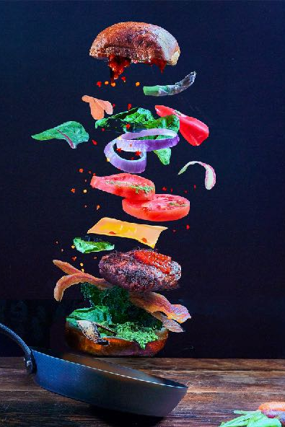
So Many Burgers – Which One to Choose?
When your focus is to reduce sodium:
We need small amounts of sodium for good health, but Americans typically consume 2-3 times more sodium than optimal. Reasons to reduce sodium include lowering the risk of high blood pressure, reducing blood pressure levels, and reducing the risk of heart attack and stroke. 90% of the sodium we consume comes from salt (a combination of sodium and chloride), and the bulk of our salt tends to come from packaged and processed foods – hello, burgers! The American Heart Association recommends no more than 2,300 mg of sodium per day and an ideal limit of less than 1,500 mg per day for most adults, especially for those with high blood pressure. Reducing sodium by 1,000 mg daily can improve blood pressure and heart health.
The 2 lowest sodium burger choices:
100% beef patty (no added salt): 90mg sodium
100% ground chicken patty (no added salt): 125mg sodium
The 2 highest sodium burger choices:
Burger King Crispy Chicken: 820mg sodium
Impossible Burger: 370mg sodium
Our suggestion:
Choose a 100% beef burger on a whole grain bun and top it with lettuce and tomato for a lower sodium option.
If you prefer vegetarian or vegan burgers, read the food labels carefully, as some contain very high amounts of sodium.
Craving a burger? In today’s world, we have many burger options: traditional beef burgers, poultry or seafood burgers, vegan burgers made from legumes and grains, and burgers created in a lab. We break down which burger to choose based on your individual goals.
When your focus is to reduce calories:
Enjoying a lower-calorie meal with a burger often means replacing fries with a salad. Go one step further and choose one of these options:
Costco salmon patty: 170 calories
Impossible Chicken Patty OR 100% ground chicken patty: 180 calories
Written By Lynn Grieger, RDN, CDCES, CHWC, CPT

Slide 5
So Many Burgers – Which One to Choose?
When your focus is protein:
Proteins are the major structural component of all cells, including muscle, body organs, hair, and skin, and an important part of a strong immune system. Amino acids are the building blocks of protein, and the combination and amount of amino acids in different foods determine the quality of the protein. A food that contains all 9 of the amino acids essential for human health is considered a complete protein.
All animal proteins are complete proteins; the only plant foods containing complete proteins are soy, quinoa, pistachios, hemp seeds, and chia seeds. All plants contain some amino acids, and eating various plant foods throughout the day ensures that we consume the amino acids we need for health.
Our picks for burgers with high-quality protein:
100% beef patty
100% ground chicken patty
“Fake meat” plant-based burgers from Impossible Burger and Beyond Burger contain varying types and amounts of essential amino acids, and although they contain similar amounts of protein per ounce to animal proteins, there is some research that suggests the protein in these burgers is not quite as high quality as animal protein. That doesn’t mean you can’t enjoy one of these burgers; just be sure to consume a wide variety of protein sources throughout the day (soy, legumes, nuts, seeds) so that you meet your body’s amino acid needs. More traditional veggie burgers, unless made with soy, quinoa, pistachios, hemp seeds and/or chia seeds also are not complete protein sources.
Written By Lynn Grieger, RDN, CDCES, CHWC, CPT

Slide 6
So Many Burgers – Which One to Choose?
When you’re looking for healthy sources of fat:
Red meat is well known for containing saturated fat, the type of fat that is highly associated with cardiovascular disease. The American Heart Association recommends limiting saturated fat to no more than 5-6% of total calories. For someone consuming 2000 calories per day, that’s no more than 120 calories, or 13 grams, of saturated fat per day. For someone consuming 1400 calories, the goal is no more than 70 calories, or 8 grams of saturated fat per day. Typically plant-based burgers contain very low amounts of saturated fat, but Impossible Burgers and Beyond Burgers contain more saturated fat than you might expect. For comparison:
100% beef patty: 15gm saturated fat
Beyond Burger: 5gm saturated fat
Impossible Burger: 6gm saturated fat
Our picks for burgers low in saturated fat:
Salmon patty (bonus – it’s high in heart-protective monounsaturated fats as well as low in saturated fat)
100% ground chicken patty
Our suggestion: Read food labels carefully for the amount of saturated fat in various plant-based burgers because there is a wide variation.
When your focus is the environment:
It’s probably not a surprise that plant sources of protein have far less impact on the environment than animal proteins (unless you’re talking about insect proteins and yes – there are companies actively working on developing burgers using insects as the protein source). According to the U.K. climate change website Carbon Brief meat and dairy industries create 7.1 gigatons of greenhouses gases annually—that’s 14.5% of total man-made emissions. But beef is by far the biggest offender, generating 60 kilograms of greenhouse gas emissions per kilogram of meat produced—that’s more than twice the emissions of the next most polluting food, lamb. Another way meat contributes to climate change is via the destruction of forests and other habitats to make way for pasture, and for the growing of fodder to be eaten by cattle. If you’re looking for ways that you personally can impact the environment, switching to plant-based burgers is one of the biggest. According to the Sierra Club, producing the 50 billion burgers that Americans eat each year generates 268 million tons of CO2-equivalent (CO2e) greenhouse gas emissions, or 3.7 percent of the country's total. Most of those emissions come from the methane that cows naturally release in the course of their digestion.
“Fake meats” like Impossible Burger and Beyond Burger create plant-based meats that mimic the taste and texture of beef in factories. Even though these fake meats are highly processed, they create 10-11% less greenhouse gasses than beef. These types of meats also use less water and land than beef.
Written By Lynn Grieger, RDN, CDCES, CHWC, CPT

Slide 7
So Many Burgers – Which One to Choose?
Our picks for burgers that have the least environmental impact:
Plant-based burgers made from legumes and mushrooms because both of these ingredients actually enrich the soil while using far less water. A couple of examples: Dr. Praeger’s Heirloom Bean Veggie Burger and Amy’s Organic Black Bean Veggie Burger
Plant-based burgers made from soy and wheat because while they often are farmed using intensive practices, they still use less energy, land and water than beef. Examples: Morningstar Farm’s Vegan Meat Lovers Burger and Boca Original Vegan Veggie Burger
Note: while these plant-based burgers contain protein, the total protein content may be less than in beef burgers. Read the nutrition facts label carefully!
References
Centers for Disease Control and Prevention. Sodium. https://www.cdc.gov/heartdisease/sodium.htm published 12-21-21; accessed 2-27-23
American Heart Association. Why Should I Limit Sodium? https://www.heart.org/-/media/files/health-topics/answers-by-heart/why-should-i-limit-sodium.pdf accessed 2-27-23
Well + Good. Isadora Baum. 5 Delicious Plant-Based Foods that are Secretly Complete Proteins. https://www.wellandgood.com/complete-plant-proteins/ published 6-2-2020; accessed 2-27-23
van Vliet S, Bain JR, Muehlbauer MJ, Provenza FD, Kronberg SL, Pieper CF, Huffman KM. A metabolomics comparison of plant-based meat and grass-fed meat indicates large nutritional differences despite comparable Nutrition Facts panels. Sci Rep. 2021 Jul 5;11(1):13828. doi: 10.1038/s41598-021-93100-3. PMID: 34226581; PMCID: PMC8257669.
American Heart Association. Saturated Fat. https://www.heart.org/en/healthy-living/healthy-eating/eat-smart/fats/saturated-fats last reviewed 11-1-21; accessed 3-1-23
Harvard Health Publishing. Emily Gelsomin. Impossible and Beyond: How Healthy are these Meatless Burgers? https://www.health.harvard.edu/blog/impossible-and-beyond-how-healthy-are-these-meatless-burgers-2019081517448 published 1-24-22; accessed 2-28-23
Hive Life. Sukhveer Kaur. Japanese FoodTech Startup BugMo Eager to Launch it’s Newest Umami-Packed Cricket Burger https://hivelife.com/bugmo-foodtech/ published 9-26-22; accessed 3-1-23
Forbes. David Vetter. Got Beef? Here’s What Your Hamburger is Doing to the Climate. https://www.forbes.com/sites/davidrvetter/2020/10/05/got-beef-heres-what-your-hamburger-is-doing-to-the-climate/?sh=3cb6e15d5206 published 10-5-20; accessed 3-1-23
Sierra. James Steinbauer. Which is the Greatest Burger in the Land? https://www.sierraclub.org/sierra/2020-2-march-april/taste-test/which-greenest-burger-land published 3-4-20; accessed 3-1-23
Knowable Magazine. Bob Holmes. How Sustainable are Fake Meats? https://knowablemagazine.org/article/food-environment/2022/how-sustainable-are-fake-meats published 7-20-22; accessed 3-1-23
Dr. Praeger’s. Heirloom Bean Veggie Burger https://drpraegers.com/our-food/heirloom-bean-veggie-burgers accessed 3-1-23
MorningStar Farms. Vegan Meat Lovers Burger https://www.morningstarfarms.com/en_US/products/veggie-burgers/msf-veggie-burgers-meat-lovers-vegan-burger.html accessed 3-1-23
Amy’s. Organic Black Bean Veggie Burger https://www.amys.com/our-foods/organic-black-bean-veggie-burger accessed 3-1-23
Boca. Original Vegan Veggie Burger. https://www.bocaburger.com/products/00759283334455 accessed 3-1-23
Written By Lynn Grieger, RDN, CDCES, CHWC, CPT

Slide 8
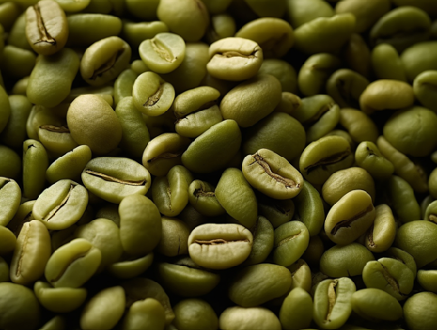
Functional Ingredient Spotlight: Green Coffee Extract
We choose what we eat for a variety of reasons: taste, convenience, cost, and health concerns. Food manufacturers capitalize on consumers’ desire for healthy foods by adding ingredients that are marketed to help protect our immune system, improve mood, and increase energy levels.
According to a market analysis report, these added ingredients, known as functional ingredients, are expected to grow by 6.4% annually over the next seven years. While whole foods like fruit, vegetables, and whole grains are essential for good health, today’s consumers are shifting toward fortified convenience foods and beverages that contain functional ingredients.
Three popular functional ingredients you’ll find in various foods and beverages are turmeric, collagen, and green coffee extract. Let’s talk about that last one…
Coffee is one of the most popular beverages in the world, and potential health benefits of coffee on metabolic syndrome, Type 2 diabetes, and cardiovascular disease have been extensively researched.
Green coffee is the name for unroasted coffee beans that contain higher amounts of chlorogenic acid (CGA) — the phytochemical in coffee that provides many of the health benefits — than roasted coffee.
Studies using CGA have found that it decreases fasting blood sugar, insulin levels, triglycerides, and LDL cholesterol as well as reducing body weight and decreasing body fat.
In 2015, researchers investigated the possibility of adding ground green coffee extract as a functional ingredient into bread. In 2021, CGA-7, a unique extract that contains all 7 isomers of chlorogenic acid present in green coffee beans, was approved for GRAS status by the FDA. FDA grants GRAS (generally recognized as safe) status for food additives shown to be safe under the conditions of its intended use.
However, it’s not known if CGA-7 added to foods as a functional ingredient will provide similar health benefits as supplements or even drinking coffee. Moreover, while there is research on functional ingredients in supplement form, there is no research that shows the amounts added to foods have any measurable health benefit.
References online.
Written By Lynn Grieger, RDN, CDCES, CHWC, CPT

Slide 9
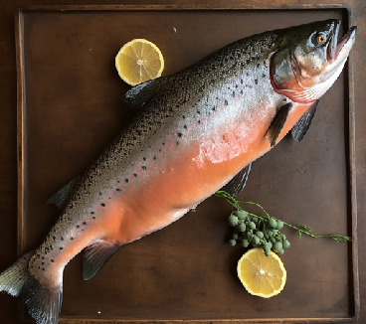
Choose More Blue Foods for Improved Health
When someone mentions blue foods, I bet you think about blueberries. In this article, we’re talking about aquatic foods, also known as blue foods (because water is blue). Aquatic or blue foods include any animal, plant, or microorganism that originates in water. The blue foods include fish, crustaceans (crabs, shrimp, krill, prawns, lobster), octopus, squid, mollusks (clams, cockles, sea snails, mussels, scallops), aquatic plants like water spinach or watercress, seaweed, and other aquatic animals such as sea cucumbers, sharks, and eels. There are over 2500 different types of blue foods that contain important nutrients for optimum health.
Global blue food production
Blue foods can be caught or harvested in the wild from lakes, rivers, wetlands, or oceans. Some blue foods are farmed, which started 3000 years ago in China. According to the National Oceanic and Atmospheric Administration (NOAA), aquaculture—the breeding, rearing, and harvesting of animals and plants in all types of water environments—is one of the most resource-efficient ways to produce protein. In today’s world, aquaculture is a worldwide business in over 35 countries, with the major producers in China, India, Viet Nam, Bangladesh, and Egypt. Farmed species imported to the United States include shrimp from Asian countries and Ecuador, Atlantic salmon from Canada, Norway, and Chile, shellfish, and tilapia.
Aquaculture is present in every region in the United States, including shellfish and aquatic plants in Alaska; salmon, oysters, clams, mussels, and sea vegetables in the Middle Atlantic; oysters, mussels, shellfish, salmon, and algae in the Pacific Northwest; oysters, clams, red drum, spotted sea trout, flounder, snook, pompano, black sea bass, and algae in the Southeast and mussels, oysters, red abalone, rock scallops, and seaweed in California. Even though aquaculture is growing in the US, we import 70–85 percent of our seafood. Globally farmed seafood production is now almost equal to seafood from wild fisheries and is expected to continue to grow.
Why include blue foods in your meals?
There are three primary reasons to choose blue foods in your weekly meals:
Improved health
Decreased greenhouse gas emissions
Additional food options as the climate changes
Blue foods are sources of important nutrients, including omega-3 fatty acids, protein, zinc, iron, magnesium, selenium, iodine, copper, and vitamins A, B6, B12, and D. All of these nutrients are vital for good health, and omega-3 fatty acids are especially important for cardiovascular health. Omega-3s are particularly high in oily fish like salmon, sardines, tuna, and mackerel.
In fact, the top 7 categories of nutrient-rich animal foods are all blue foods, including the wide variety of different types of fish, clams, mussels, oysters, octopus, and squid – ranking above land-based animal protein foods such as beef, chicken, and pork.
Written By Lynn Grieger, RDN, CDCES, CHWC, CPT

Slide 10
Choose More Blue Foods for Improved Health
Blue foods improve our health in three important ways:
Provide essential vitamins and minerals that are key for optimum health, including Vitamin A, calcium, and iron
Contain omega-3 fatty acids that reduce the risk of heart disease and promote brain and eye health
Do not contain saturated fatty acids found in red and processed meats that increase the risk of hypertension, stroke, heart disease, diabetes, colorectal cancer, and breast cancer.
Sea vegetables are another nutrition powerhouse, excellent sources of vitamins, minerals, fiber, and antioxidants.
Aquaculture generally is better for the environment than land-based proteins, and unfed aquacultures, such as seaweeds and filter-feeding shellfish, can improve water quality through nutrient uptake. Fishing and aquaculture produce fewer greenhouse gas emissions than land-based protein production. Increasing consumption of a diverse range of blue foods can build resilience and offer more nutrient-dense foods in areas that might be most impacted by climate change.
Our tips:
Swap out land-based animal protein for aquatic protein:
Enjoy a grilled fish sandwich instead of a burger
Use tuna or salmon instead of lunchmeat in a sandwich
Instead of beef stew, make fish stew
Include sea vegetables like seaweed and watercress into your vegetable line-up:
Sauté sea greens in olive oil the same way you would sauté spinach
Use nori sheets instead of tortillas or wraps
Toss watercress into a salad, use it to make pesto, or add to smoothies instead of spinach.
Choose sustainable types of seafood that use environmentally responsible practices and prevent overfishing.
NOAA has an online tool to search for seafood caught or farmed in the US that provides specific information on sustainability and nutrition facts at https://www.fisheries.noaa.gov/topic/sustainable-seafood/seafood-profiles
The Monterey Bay Aquarium Seafood Watch has pocket guides that assess how specific fisheries or farms perform against our rigorous environmental sustainability standards and then assign ratings based on the outcomes from Best Choices, Good Alternatives, and Avoid. https://www.seafoodwatch.org/recommendations/download-consumer-guides
References:
Harvard TH Chan School of Public Health. The Nutrition Source. Aquatic Foods. https://www.hsph.harvard.edu/nutritionsource/aquatic-foods/ last reviewed September 2021; accessed 4.22.23
Blue Food Assessment. https://bluefood.earth/ accessed 4.22.23
Alimentarium. The History of Aquaculture. https://www.alimentarium.org/en/fact-sheet/history-aquaculture accessed 4.27.23
NOAA Fisheries. Aquaculture. https://www.fisheries.noaa.gov/topic/aquaculture Accessed 4.27.23
NOAA Fisheries. Global Aquaculture. https://www.fisheries.noaa.gov/national/aquaculture/global-aquaculture accessed 4.27.23
NOAA Fisheries. U.S. Aquaculture. https://www.fisheries.noaa.gov/national/aquaculture/us-aquaculture accessed 4.7.23
Golden, C.D., Koehn, J.Z., Shepon, A. et al. Aquatic foods to nourish nations. Nature 598, 315–320 (2021). https://doi.org/10.1038/s41586-021-03917-1
Lomartire S, Marques JC, Gonçalves AMM. An Overview to the Health Benefits of Seaweeds Consumption. Mar Drugs. 2021 Jun 15;19(6):341. doi: 10.3390/md19060341. PMID: 34203804; PMCID: PMC8232781.
Atalah, J. and Sanchez-Jerez P. On the wrong track: Sustainable and low-emission blue food diets to mitigate climate change. Front. Sustain. Food Syst., 11 November 2022. Sec. Aquatic Foods. Volume 6 - 2022 | https://doi.org/10.3389/fsufs.2022.994840
Crona, B.I., Wassénius, E., Jonell, M. et al. Four ways blue foods can help achieve food system ambitions across nations. Nature 616, 104–112 (2023). https://doi.org/10.1038/s41586-023-05737-x
Written By Lynn Grieger, RDN, CDCES, CHWC, CPT

Slide 11
Earlier Meals Mean Better Blood Sugar Control
According to the CDC, over 11% of the US population has diabetes while over 23% are undiagnosed. 1 The complications of diabetes are usually the demise of those that have it. Cardiovascular disease, renal failure, and complications of communicable diseases like Covid are common. Preventing diabetes is key.
New research out of the University of Adelaide and South Australian Health and Medical Research Institute evaluated two diets: a time-restricted intermittent fasting diet and a lower calorie diet to find which was better for people that are likely to develop type 2 diabetes.
Senior author from the University of Adelaide's Professor Leonie Heilbronn, Adelaide Medical School notes, “Following a time-restricted, intermittent fasting diet could help lower the chances of developing type 2 diabetes,"
In her study, she showed that individuals that fasted and only ate between 8 AM and 12 PM during three days of the week had better glucose tolerance after six months than those that followed a daily calorie-restricted.
Individuals using this type of intermittent fasting had better insulin sensitivity and also benefitted from a drop in blood lipids compared to those on a calorie-restricted diet.
When the body’s cells no longer respond to insulin effectively and lose the ability to make the hormone, type 2 diabetes develops.
Experts estimate that almost 60% of cases of type 2 diabetes could be prevented or delayed with modifications to diet and lifestyle. Nearly 1.3 million Australians have diabetes.
The 18-month study was published in Nature Medicine and had over 200 subjects from South Australia.
Similar amounts of weight loss were seen in subjects doing either time-restricted or calorie-controlled diets.
First author Xiao Tong Teong, a PhD student at the University of Adelaide states, "This is the largest study in the world to date and the first powered to assess how the body processes and uses glucose after eating a meal, which is a better indicator of diabetes risk than a fasting test,".
Results of the study add to previous research that suggests that meal timing and fasting are superior to a calorie-restricted diet alone, regardless of weight loss. This may be beneficial in clinical practice.
Written By Lisa Andrews, MEd, RD, LD

Slide 12
Earlier Meals Mean Better Blood Sugar Control
More research is needed to study if similar benefits may be seen with a longer eating window, which in the long term, may make the diet more sustainable.
Here are some tips for individuals considering time-restricted eating:
Include high-protein food with all meals. Eggs, low-fat cottage cheese, Greek yogurt, or peanut butter at breakfast may promote satiety.
Add beans, lentils, tuna, hard-boiled eggs, fish, or lean meat to salads.
Choose whole grains for more fiber- rolled oats, 100% whole wheat bread or pasta, brown rice, bulgur, farro, quinoa, or soba noodles.
Add more leafy greens to meals to add volume without calories or carbohydrates. Spinach, kale, cabbage, Brussels sprouts, collard, and mustard greens are great.
Drink plenty of water, especially on fasting days.
Plan fasting days around heavy bouts of exercise, eating out, or travel.
Keep small servings of nuts or seeds on hand for quick snacks.
Skip empty-calorie foods such as sweetened beverages, alcohol, processed pastries, and snack foods.
References:
National Diabetes Statistics Report | Diabetes | CDC
Xiao Tong Teong, Kai Liu, Andrew D. Vincent, Julien Bensalem, Bo Liu, Kathryn J. Hattersley, Lijun Zhao, Christine Feinle-Bisset, Timothy J. Sargeant, Gary A. Wittert, Amy T. Hutchison, Leonie K. Heilbronn. Intermittent fasting plus early time-restricted eating versus calorie restriction and standard care in adults at risk of type 2 diabetes: a randomized controlled trial. Nature Medicine, 2023; DOI: 10.1038/s41591-023-02287-7
Written By Lisa Andrews, MEd, RD, LD

Slide 13
Protect Your Brain Now. Hypertension in your 30s means worse brain health later
Ten Tips to Drop Your Blood Pressure
Follow a heart-healthy, DASH diet. Limit high-sodium, high-fat foods including fast food, fried food, processed meats, ultra-processed snacks, and full-fat dairy products.
Lose weight if overweight or obese. A reduction of 2.2 pounds can drop blood pressure by 1 millimeter of mercury (mm Hg).
Eat 4 to 5 servings of high-potassium fruits including apricots, bananas, dates, citrus fruit, peaches, mango, melon, kiwi, and dried fruit.
Include 4 to 5 servings of dark leafy or other vegetables in your diet daily- broccoli, collard and mustard greens, kale, peas, spinach, and more.
Add low-fat dairy or non-dairy products containing calcium to your diet. Low-fat yogurt, skim or 1% milk, low-fat cheese, or calcium-fortified soy milk are good choices.
Snack on unsalted or lightly salted almonds, pistachios, and walnuts.
Be moderate about alcohol and caffeine intake.
Walk or do another aerobic exercise for a minimum of 30 minutes most days of the week.
Reduce stress- meditate, do yoga or see a mental health professional if needed.
Heed your doctor’s advice. If your blood pressure doesn’t decline with diet and lifestyle, medication may be necessary.
Reference:
1. Kristen M. George, Pauline Maillard, Paola Gilsanz, Evan Fletcher, Rachel L. Peterson, Joseph Fong, Elizabeth Rose Mayeda, Dan M. Mungas, Lisa L. Barnes, M. Maria Glymour, Charles DeCarli, Rachel A. Whitmer. Association of Early Adulthood Hypertension and Blood Pressure Change With Late-Life Neuroimaging Biomarkers. JAMA Network Open, 2023; 6 (4): e236431 DOI: 10.1001/jamanetworkopen.2023.6431
Written By Lisa Andrews, MEd, RD, LD

