Slide 1
August 2023
Nutrition
NEWSLETTER
Inside:
Brought to you by:
Greek Pasta Salad, By Judy Doherty, MPS
Shrimp Kabobs, By Judy Doherty, MPS
Chronic Stress Could Mean Constant Cravings by Lisa Andrews (3 pages), MEd, RD, LD
Functional Food Spotlight: Mushrooms by By Lynn Grieger (3 pages), RDN, CDCES, CHWC, CPT
Fermented Foods for Brain Health by Lisa Andrews (2 pages), MEd, RD, LD
Americans Need Help with Heart Healthy Habits by Lisa Andrews (3 pages), MEd, RD, LD

Slide 2
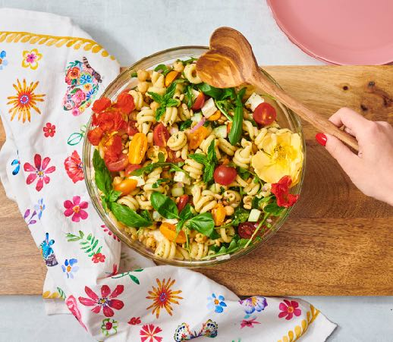
Greek Pasta Salad
This delicious salad has so many flavors,, and it is delicious cold!
Ingredients:
Pasta salad
1 pound box of pasta
1/2 cup feta cheese cut in cubes
1/2 cucumber diced
1 cup cherry tomatoes cut in half
1/4 red onion diced
1 cup arugula
1 can garbanzo beans, drained
2 tablespoons roasted pine nuts
Dressing
3 tablespoons olive oil
1/4 cup red wine vinegar
1 tsp Dijon mustard
1/2 lemon juice
3 cloves garlic, peeled and minced
2 tablespoons chopped mint leaves
2 tablespoons chopped fresh basil leaves
1 tsp red pepper flakes
Directions:
Pasta Salad
Cook the pasta according to the package directions, drain in a colander, rinse with cold water, and reserve.
Toss the pasta with the dressing.
Add the rest of the ingredients.
Toss together.
Serve immediately or chill for later use up to 2 days.
Dressing
Mix all of the ingredients for the dressing with a whisk until the dressing is smooth.
Serves 4. Each 1 cup serving: 361 calories, 11 g fat, 2 g saturated fat, 8 mg cholesterol, 283 mg sodium, 53 g carbohydrate, 5 g fiber, 12 g protein.

Slide 3
Shrimp Kabobs
Ingredients:
2 yellow summer squash, cut in 1/4 inch slices
2 zucchini, cut in 1/4 inch slices
8 small red peppers, sliced in half
1 pound #15-18 shrimp, peeled and deveined
bamboo skewers
1 tsp olive oil
salt and pepper to taste
4 tsp basil pesto
Directions:
Cut the veggies and peel and devein the shrimp.
Thread the veggies and shrimp onto the bamboo skewers. Each skewer gets 2 pieces of each item.
Place all on a grill pan. Brush with oil and pesto and season with salt and pepper.
Heat a grill to high, around 450 degrees. Add the shrimp on their grill pan. Cook 3 minutes per side or until the shrimp is done.
Serve immediately.
Note: you can use any lean protein in place of the shrimp.
Nutrition Facts:
Serves 4. Each serving: 196 calories, 4.5 g fat, .8 g saturated fat, 182 mg cholesterol, 245 mg sodium, 15 g carbohydrates, 5 g fiber, 10 g sugar, 27 g protein

Slide 4
Chronic Stress Could Mean Constant Cravings
If you find yourself hunting for M and Ms when you’ve had a stressful day, you’re not alone. Comfort food is a common go-to when we’re under pressure. Unfortunately, the combo platter of stress and high-calorie comfort food alters the brain and can lead you to eat too much. It may also increase cravings for sweet, highly palatable food, which inevitably could lead to weight gain.
Scientists from the Garvan Institute of Medical Research in Sydney discovered that stress trumped the brain’s normal response to satiety, leading to constant reward signals that promote the consumption of very palatable food. This was observed in the lateral habenula, a part of the brain that when activated typically decreases these reward signals.
"Our findings reveal stress can override a natural brain response that diminishes the pleasure gained from eating -- meaning the brain is continuously rewarded to eat," says Professor Herzog, senior author of the study and Visiting Scientist at the Garvan Institute.
His team found that chronic stress and the addition of a high-calorie diet, may result in more and more food intake plus a penchant for sweet, highly palatable food, which promotes weight gain and obesity. His research raises awareness at how important a healthy diet is in times of stress.
The research was published in the journal Neuron.
Your brain when stressed
Some people lose their appetite when under stress, but most will eat more food than normal and pick calorie-dense options high in fat and sugar.
To evaluate what motivates these eating habits, the researchers used mouse models and investigated how various areas of the brain react to chronic stress under various diets.
Lisa Andrews, MEd, RD, LD

Slide 5
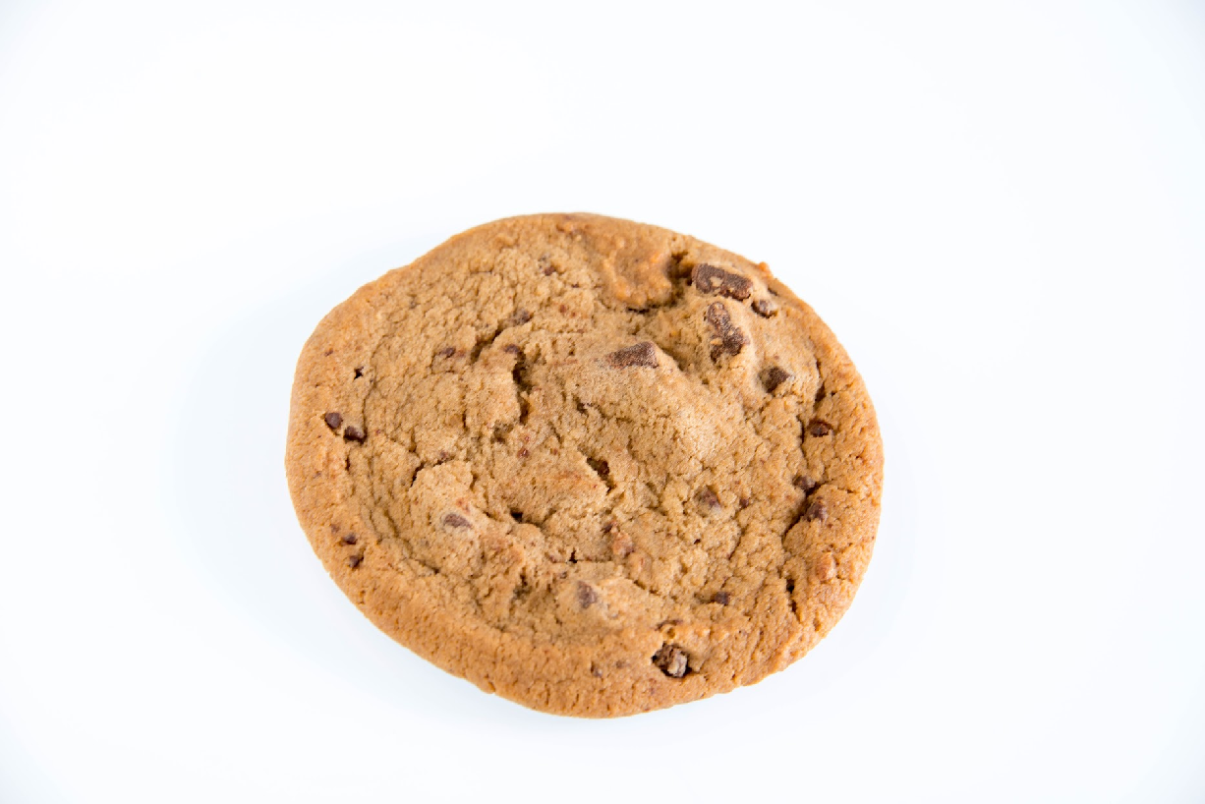
How Stress Creates Cravings
"We discovered that an area known as the lateral habenula, which is normally involved in switching off the brain's reward response, was active in mice on a short-term, high-fat diet to protect the animal from overeating. However, when mice were chronically stressed, this part of the brain remained silent -- allowing the reward signals to stay active and encourage feeding for pleasure, no longer responding to satiety regulatory signals," explains author Dr Kenny Chi Kin Ip from the Garvan Institute.
They discovered that stressed mice eating a high-fat diet gained twice as much weight as those on the same diet that were not under stress.
The researchers found that a chemical called NPY was at the heart of stress response. Our brains produce this when we’re under stress. When NPY was blocked from being activated in brain cells in the lateral habenula of stressed mice eating a high-fat diet, the mice ate less comfort food, which led to less weight gain.
Driving comfort eating
A ‘sucralose preference test’ was then done which let the mice choose to drink water or water sweetened with sucralose (AKA Splenda).
Mice under stress that were on the high-fat diet drank three times more sucralose than mice on the high-fat diet alone. This suggests that stress activates more reward when eating and also directly drives a craving for sweet, palatable food, according to Professor Herzog.
The preference for sweetened water was not seen in stressed mice consuming a regular diet.
Stress trumps normal calorie intake
According to Herzog, "In stressful situations it's easy to use a lot of energy and the feeling of reward can calm you down -- this is when a boost of energy through food is useful. But when experienced over long periods of time, stress appears to change the equation, driving eating that is bad for the body long term,
These findings suggest that stress is an important regulator of eating habits that can trump the brain’s natural way of balancing calorie requirements.
Professor Herzog notes, "This research emphasizes just how much stress can compromise a healthy energy metabolism. "It's a reminder to avoid a stressful lifestyle, and crucially -- if you are dealing with long-term stress -- try to eat a healthy diet and lock away the junk food.”
Lisa Andrews, MEd, RD, LD

Slide 6
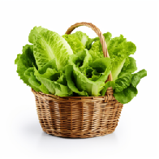
Nutrition Tips to Combat Stress
When you’re under stress, your body and brain need the best “food in your food”. Below are 10 tips to keep your brain and body fueled when you’re dealing with stress.
Don’t skip meals. Eating at regular times keeps you fueled to face whatever situation heads your way. Being “hangry” may increase the likelihood of grabbing snacks or treats when you’re stressed.
Keep ultra-processed foods out of site. A treat or snack now and then is fine but when you’re under stress, chips, soda, fast food, and high-fat desserts can exacerbate feelings of anxiety and depression.2
Water. While not “food”, drinking adequate water is so important to prevent dehydration in times of stress. Dehydration can lead to fatigue, which could trigger overeating.
Fruit. Fresh, frozen, or dried fruit can curb a sweet tooth and provide fiber to help fill you up. Pair fruit with nuts, cottage cheese, or Greek yogurt for a filling pick-me-up.
Veggies. Raw veggies may curb the urge to crunch on high-fat, salty snacks. Keep a variety on hand including peppers, carrot sticks, celery sticks, grape tomatoes, and more.
Whole grains. Carbs get a bad rap but to be honest, avoiding them may increase stress. Whole grain carbs like rolled oats, whole grain pasta, brown rice, or quinoa provide slowly digested carbs and B vitamins for the brain to function and focus.
Beans and lentils. Beans are great brain food because they give you both carbs and protein. These may help regulate your blood sugar in addition to providing zinc, magnesium, and B vitamins.
Lean meat or poultry. Lean cuts of beef or poultry provide your body and brain with B vitamins and protein to stay focused. Trim the fat from cuts of meat and bake, broil, or grill to keep fat and calories in check.
Fatty fish. When it comes to mental health, fish is on your side. Fatty fish such as mackerel, salmon, and tuna provide omega-3 fatty acids to help reduce inflammation. Observational studies show an association between unsaturated fatty acid intake and reduced risk of depression. 3
Nuts and seeds. A study on adults and dietary patterns related to the risk of depression found that those who consumed nuts and seeds had lower depression scores.3
Lisa Andrews, MEd, RD, LD

Slide 7
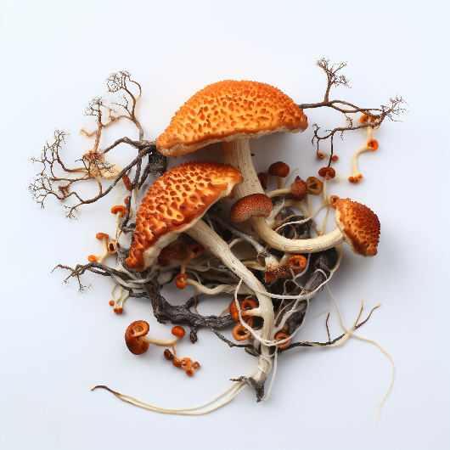
Functional Food Spotlight: Mushrooms
What are functional ingredients?
A functional ingredient is a bioactive compound obtained from a variety of sources such as fruits and vegetables, marine sources, microorganisms, inorganic raw materials, and mushrooms. Functional ingredients are added to foods and beverages – either in processing or at home – to provide possible health benefits such as regulating mood, boosting digestive health, decreasing inflammation, promoting cardiovascular health, and supporting cognitive health.
Functional mushrooms?
Mushrooms add flavor and texture to a variety of meals, but have you ever tried foods or beverages made with functional mushrooms? There are estimated at least 12,000 different mushroom species worldwide, with 2000 used in foods or as functional ingredients.
We think about mushrooms as vegetables, but botanically they are a fungus. Nutritionally, mushrooms contain high-quality protein, fiber, vitamins, minerals, and antioxidants. They are also low in fat and calories. Each different type of mushroom offers slightly different health benefits that are being used in a variety of different applications as functional ingredients.
By Lynn Grieger, RDN, CDCES, CHWC, CPT

Slide 8
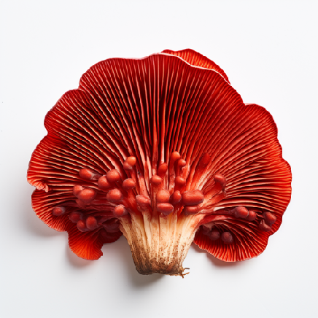
Functional Food Spotlight: Mushrooms
Four functional mushrooms currently available:
Reishi, often described as the ‘mushroom of immortality’, is one of the most widely used medicinal mushrooms in the world, used to promote well-being and longevity in traditional Chinese medicine. Research shows reishi has anticancer, hypoglycemic, immunomodulatory, antihypertensive, cytotoxic, anti-diabetic, antioxidant, antihyperlipidemic, antimutagenic, antiaging, antimicrobial, and hepatoprotective properties due to triterpenes/triterpenoids and polysaccharides. Reishi is a good source of several vitamins and minerals and also contains amino acids and fiber. Dried reishi is readily available, and its naturally bitter flavor works well in tea, smoothies, or savory soups at home.
Cordyceps, traditionally found in higher altitudes in the Himalayan regions of China, Nepal, Tibet, and India, is known for adaptogenic, tonic effects and the ability to reduce fatigue and stimulate the immune system. Cordyceps contains several different types of antioxidants as well as vitamins and minerals. It’s found in capsules, tinctures, powders, and teas and used as a functional ingredient in several types of foods. There are over 750 different cordyceps species, each with different potential health benefits. C. senensis and C. militaris are two cordyceps species with scientific research as well as used for thousands of years in Chinese medicine.
By Lynn Grieger, RDN, CDCES, CHWC, CPT

Slide 9
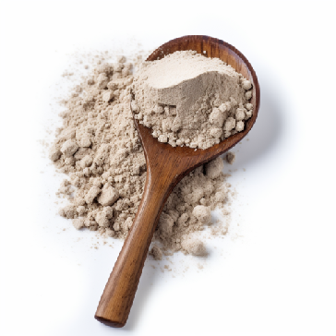
Functional Food Spotlight: Mushrooms
I. obliquus is commonly known as chaga mushrooms, grows throughout Europe, North America, and Asia, and has a long history in traditional medicine. Research on I. obliquus extracts confirms a variety of antioxidants that have antiviral, antibacterial, immune-stimulating, and anti-tumor activity in lab and animal experiments but there are not yet human research trials. Dried chaga is often used in tea, smoothies, or even added to hot chocolate. It’s used as a functional ingredient in soups and frozen meals to promote a strong immune system and healthy skin and support cardiovascular health.
Lion’s Mane mushrooms are big, white mushrooms with a flavor that many compare to shellfish that grow in Asian countries where they are consumed raw, dried or cooked. They are a good source of several vitamins and minerals and also contain antioxidant and antiviral properties that may decrease chronic inflammation associated with arthritis and cardiovascular disease. Studies have found that Lion’s mane mushrooms contain ericenones and erinacines, two chemicals that accelerate the growth of brain cells and may be important in preventing dementia and neurodegenerative conditions, including Parkinson’s. They’ve also been investigated as a possible treatment for anxiety and depression. You can purchase raw Lion’s mane mushrooms to use in recipes at home, and it’s also used as a functional ingredient in beverages, energy bars, and prepared meals.
Our suggestions:
The U.S. Food and Drug Administration (FDA) doesn’t regulate supplements, so you never know how much of a specific mushroom a supplement actually contains.
More research is needed, especially studies that measure health benefits in humans, in order to confirm any of the proposed benefits and how effective they really are. Even though mushrooms have been used for thousands of years in Eastern medicine, we still need human scientific studies to determine both health benefits as well as safety.
Mushrooms used as functional ingredients also need more research to determine genetic variabilities and optimum growth, environmental and post-harvest conditions.
If you’re thinking about using mushrooms to treat an illness or chronic condition, be sure to discuss this with your physician in advance due to the potential of interference with medications.
By Lynn Grieger, RDN, CDCES, CHWC, CPT

Slide 10
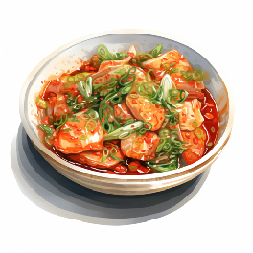
Fermented Foods for Brain Health
Previous studies have found a connection between diet and mental health. Foods like blueberries, salmon, and green leafy vegetables may protect you against dementia. We also know that a diet containing lots of ultra-processed foods is linked with depression.
Fermented foods have been used for years to aid in preserving food. New research suggests they may also be good for your brain. Consuming fermented foods may have long-and short-term effects on brain function such as stress reduction. What’s the scoop on SCOBY?
Scientists at APC Microbiome, University College Cork, and Teagasc (Ireland’s Agriculture and Food Development Authority) in Moorepark, Cork, Ireland, are studying data from over 200 foods from around the globe to find various metabolites that may benefit brain health.
The study isn’t finalized but early results indicate that fermented foods are rising to the top as several show potential to improve both gut and brain health. Further studies are necessary to totally understand which fermented foods have the best impact on brain health. 3
While fermented sugar-based products are often demonized, when raw sugar is fermented, it changes, and a variety of beneficial metabolites may be produced.
Kombucha, for example, contains B vitamins, polyphenols, and acetic acid. 4 The amino acid tryptophan is found in fermented foods and is key to producing serotonin, a neurotransmitter in the brain that impacts mood and other aspects of brain health.
Fermented vegetable products also have a lot of potential benefits for brain health. Kimchi and sauerkraut are both fermented though may need to be limited by those with hypertension due to their high sodium content.
The study authors plan to use her top-ranked fermented foods in further testing using an artificial colon and animal models to evaluate the impact on the brain. She hopes that individuals will use her early study results and consuming fermented foods as a way to boost their mental health and overall well-being. (References are in online version.)
Lisa Andrews, MEd, RD, LD

Slide 11
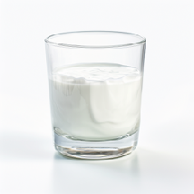
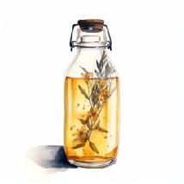
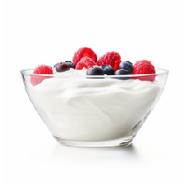
3 popular fermented foods and beverages to try
Kefir- a fermented dairy-based drink. Peptides, bioactive compounds, and bacteria strains occurring in kefir, can alter gut microbiota composition, low-grade inflammation, and intestinal permeability. Kefir may affect the gut-brain axis and boost brain health. Plus it is a great swap for smoothies
Kombucha- a fizzy, fermented drink made from black tea and “SCOBY” (symbiotic culture of bacteria and yeast). Kombucha is sold commercially but some people make their own at home. It is a healthy drink to replace soda.
Yogurt- subjects consuming yogurt containing probiotics have been found to have fewer menopausal symptoms including anxiety, hot flashes, depression, and LDL cholesterol compared to a control group. Yogurt is a great way to start your day with breakfast or to include it later on as a snack or dessert.
References:
Bear TLK, Dalziel JE, Coad J, Roy NC, Butts CA, Gopal PK. The Role of the Gut Microbiota in Dietary Interventions for Depression and Anxiety. Adv Nutr. 2020 Jul 1;11(4):890-907. doi: 10.1093/advances/nmaa016. PMID: 32149335; PMCID: PMC7360462.
Agarwal P, Leurgans SE, Agrawal S, Aggarwal N, Cherian LJ, James BD, Dhana K, Barnes LL, Bennett DA, Schneider JA. Association of Mediterranean-DASH Intervention for Neurodegenerative Delay and Mediterranean Diets With Alzheimer Disease Pathology. Neurology. 2023 Mar 8:10.1212/WNL.0000000000207176. doi: 10.1212/WNL.0000000000207176. Epub ahead of print. PMID: 36889921.
Microbiology Society. "Kombucha to kimchi: Which fermented foods are best for your brain?." ScienceDaily. ScienceDaily, 13 April 2023. <www.sciencedaily.com/releases/2023/04/230413154458.htm
Abaci N, Senol Deniz FS, Orhan IE. Kombucha - An ancient fermented beverage with desired bioactivities: A narrowed review. Food Chem X. 2022 Apr 6;14:100302. doi: 10.1016/j.fochx.2022.100302. PMID: 35434600; PMCID: PMC9011011.
Peluzio MDCG, Dias MME, Martinez JA, Milagro FI. Kefir and Intestinal Microbiota Modulation: Implications in Human Health. Front Nutr. 2021 Feb 22;8:638740. doi: 10.3389/fnut.2021.638740. PMID: 33693024; PMCID: PMC7938729.
Shafie M, Homayouni Rad A, Mirghafourvand M. Effects of prebiotic-rich yogurt on menopausal symptoms and metabolic indices in menopausal women: a triple-blind randomised controlled trial. Int J Food Sci Nutr. 2022 Aug;73(5):693-704. doi: 10.1080/09637486.2022.2048360. Epub 2022 Mar 9. PMID: 35264075.
Lisa Andrews, MEd, RD, LD

Slide 12
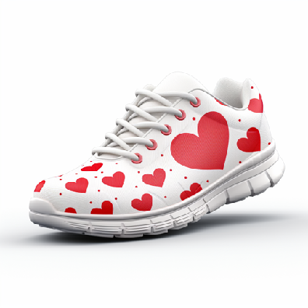
Americans need help with heart healthy habits
Researchers at OSU discovered that US adults scored an average of 60 out of 100 on the eight measures, meaning there’s lots of room to improve even in those that had healthy diets and exercise habits that improved some of the metrics. The checklist for Americans to lower heart disease risk includes managing weight, blood pressure, blood sugar, cholesterol, smoking, physical activity, diet, and sleep.
Senior study author Colleen Spees, associate professor of medical dietetics in the School of Health and Rehabilitation Sciences at Ohio State notes, "The Life's Essential 8 is a valuable tool that provides the core components for cardiovascular health, many of which are modifiable through behavior change,". She notes that her findings show that Americans have more work to do in practicing the Life Essential 8 behaviors that are directly linked with cardiovascular health.
The study data included 20,305 adults aged 19 and older who were part of the National Health and Nutrition Examination Survey (NHANES) between 2007 and 2016. Participants. Subjects offered information on smoking, exercise, average hours of sleep each night, weight history and weight loss methods, and diet history of the past 24 hours. Other health parameters included lab tests, BMI, blood pressure, LDL cholesterol, and blood sugar.
This information was used to determine individual scores for Life’s Essential 8 measures and evaluate diet quality according to the Healthy Eating Index, which measures how well the US Dietary Guidelines for Americans are followed.
Within participants, 17,465 people lost 5% of their body weight, gained weight, or maintained weight over the previous year. The remaining 2,840 reported an intentional weight loss of a minimum of 5% of the body weight during the same time.
Lisa Andrews, MEd, RD, LD

Slide 13
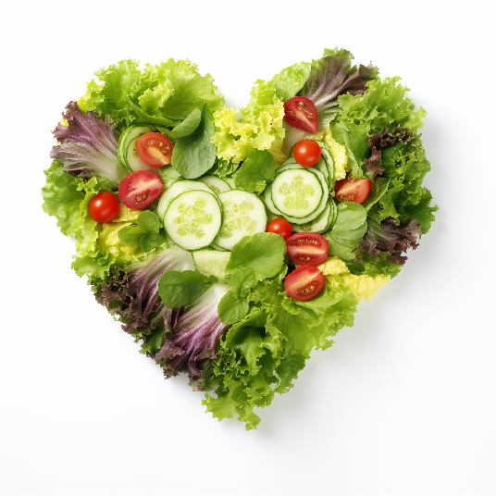
Americans need help with heart healthy habits
Speeches notes, "Clinically significant weight loss results in improvements in some health indices," "People should feel hopeful in knowing that losing just 5% of their body weight is meaningful in terms of clinical improvements. This is not a huge weight loss. It's achievable for most, and I would hope that incentives people instead of being paralyzed with a fear of failure."
A higher-quality diet was reported in those with clinically significant weight loss, especially from protein, whole grains, and reduction of added sugar. Moderate and vigorous physical activity and lower LDL cholesterol were also seen in those with clinically significant weight loss.
. Moderate and vigorous physical activity and lower LDL cholesterol were also seen in those with clinically significant weight loss.
However, the weight-loss group also had higher BMI, fewer hours of sleep, and higher HbA1c blood sugar numbers. These measures decreased their Life Essential 8 scores.
In those that didn’t lose at least 5% of their weight, meal skipping and using prescription diet pills as a weight loss method were more common. Other ways of losing weight that were reported in the group included low-carb and liquid diets, laxative use, vomiting, and smoking.
"We saw that people are still gravitating to non-evidence-based approaches for weight loss, which are not sustainable. What is sustainable is changing behaviors and eating patterns," Spees said.
As recent data shows over 85% of the US population will be overweight or obese by 2030, prevention is much needed to ward off heart disease as well as other chronic conditions.
"We absolutely need to be moving toward prevention of disease versus waiting until people are diagnosed with a disease. This becomes quite overwhelming, and individuals may feel it's too late at that point," she said.
Lisa Andrews, MEd, RD, LD

Slide 14
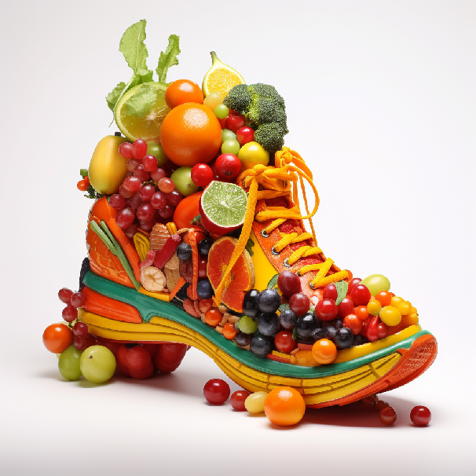
Eight Risk Factors for Heart Disease
While there are many factors that impact a person’s weight and risk for heart disease, it’s no surprise that a nutritious diet and exercise remain the leading ways to manage both.
A recent study published in the Journal of the American Heart Association. on more than 20,000 adults in the US finds that eating a healthier diet and doing regular exercise leads to weight loss and a reduced risk of heart disease. Despite the hype, diet pills and skipping meals appear less effective.
Unfortunately, dropping 5% of body weight did not erase risk factors for heart disease as would be expected. A score of eight risk factors was evaluated and weight changes (up or down) did not alter it.
The study done at The Ohio State University was the first to investigate weight loss methods and results considering the American Heart Association’s “Life’s Essential 8”- a checklist of 8 areas of cardiovascular risk reduction.
Here are the 8 risk factors that do help lower heart disease risk:
managing weight
blood pressure
blood sugar
cholesterol
smoking cessation
physical activity
diet
sleep
Lisa Andrews, MEd, RD, LD

