Slide 1
January 2024
Nutrition
NEWSLETTER
Inside:
Brought to you by:
Winter Soup Recipes (2)
DASH 101 (New Year’s Resolution)
Working Out (New Year’s Resolution)
Hobbies and Activities to Fight Boredom (New Year’s Resolution)
Sleep More (New Year’s Resolution)
Kitchen Equipment Checklist (New Year’s Resolution)
Try These Herbs and Spices (New Year’s Resolution)

Slide 2
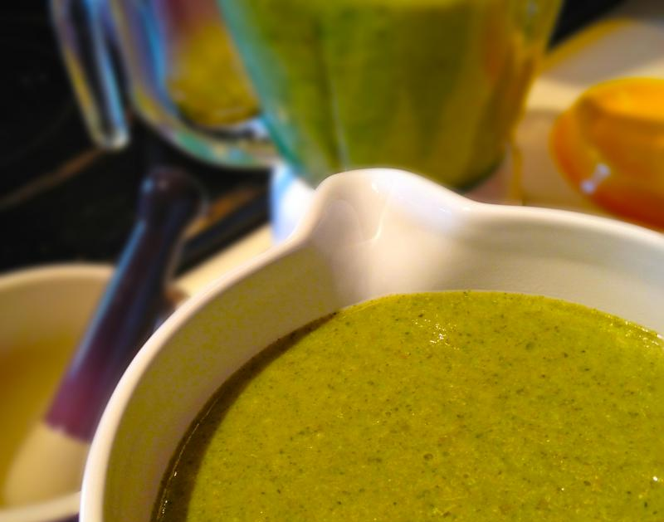
Winter Souper Green Soup
INGREDIENTS
1 onion, diced
2 teaspoons garlic, minced
2 tablespoons extra virgin olive oil
1/2 leek, washed, sliced
3 potatoes, cubed with skin on
1 quart low-sodium broth (vegetarian or chicken)
1 cup arugula
1 cup spinach, raw
1 bay leaf
1 teaspoon dried thyme
2 teaspoons Italian seasoning
Black pepper to taste
4 cups fresh broccoli florets
1/2 cup chopped parsley
1 cup water
1 can evaporated skim milk or fat-free half-n-half
INSTRUCTIONS
Sauté the onion and garlic in the olive oil over medium heat in a large Dutch oven or non-stick wok. Cook until it is lightly golden, about 3 minutes.
Add the leek, potatoes, broth, arugula, spinach, and seasonings and simmer over low heat, covered, for about 20 minutes.
Add the broccoli and parsley; cover and simmer on low for another 15 minutes.
Add a little water and a can of evaporated skim milk. Purée in the blender.
Chill until ready to serve or reheat and serve in a bowl with a sprinkle of grated cheddar (or Parmesan) cheese and chopped parsley on top.
Serves 8. Each 1 cup serving: 141 calories, 4.5g fat, 0.8g saturated fat, 0 mg cholesterol, 0 g trans fat, 65 mg sodium, 18 g carbohydrate, 4 g fiber, 6 g protein.

Slide 3
Lean Turkey Chili
Ingredients:
Vegetable oil cooking spray
1 cup chopped onion
2 cloves garlic, minced
1/2 bell pepper, chopped
1/2 jalapeno pepper, seeded, chopped
1/2 pound extra-lean ground turkey breast
2 15-ounce cans of diced tomatoes, no-salt-added
1 15-ounce cans kidney beans, drained
1 teaspoon granulated garlic
1 teaspoon chili powder
1/2 teaspoon cumin
1 teaspoon dried oregano
Directions:
Generously spray a large non-stick skillet with vegetable cooking spray and heat over medium-high heat. Sauté the onion until golden, about 1 minute. Add the green pepper and sauté briefly. Add ground turkey and cook until brown.
Add the rest of the ingredients and bring to a boil. Simmer about 8 minutes.
Chef's Tips: Serve this chili with rice, pasta, or a baked potato.
Serves 4. Each serving: 214 calories, 2g fat, .5 g saturated fat, 31 mg cholesterol., 0 g trans fat, 500 mg sodium, 21 g carbohydrate, 9 g fiber, 21 g protein.

Slide 4
New Year’s Resolutions
DASH Diet 101
The DASH diet, which stands for Dietary Approaches to Stop Hypertension, is a dietary plan designed to help prevent and control high blood pressure (hypertension). It was developed by the National Heart, Lung, and Blood Institute (NHLBI) in the United States and is considered one of the most effective diets for reducing hypertension. The DASH diet emphasizes the consumption of nutrient-rich foods while reducing sodium (salt) intake. Here are the key principles of the DASH diet:
Fruits and Vegetables: The DASH diet encourages a high intake of fruits and vegetables, aiming for several servings each day. These foods are rich in vitamins, minerals, fiber, and antioxidants.
Whole Grains: Choose whole grains like brown rice, whole wheat bread, and whole grain pasta over refined grains. Whole grains provide more nutrients and fiber.
Lean Protein: Include sources of lean protein in your diet, such as poultry, fish, lean cuts of meat, and plant-based options like beans, lentils, and tofu.
Nuts, Seeds, and Legumes: Incorporate nuts, seeds, and legumes into your meals and snacks for healthy fats, protein, and fiber.
Dairy: Opt for low-fat or fat-free dairy products like milk, yogurt, and cheese to get the benefits of calcium and protein without excess saturated fat.
Limit Sweets and Added Sugars: Minimize your consumption of sweets and added sugars, as they can contribute to weight gain and high blood pressure.
Reduce Sodium: The DASH diet recommends limiting sodium intake to 2,300 milligrams per day or ideally 1,500 milligrams for those with high blood pressure. This involves reducing the use of table salt and being mindful of processed and restaurant foods that are often high in sodium.
Moderate Alcohol: If you choose to consume alcohol, do so in moderation. This typically means up to one drink per day for women and up to two drinks per day for men.
Portion Control: Be mindful of portion sizes to manage calorie intake and maintain a healthy weight.
The DASH diet is not only effective for managing blood pressure but also for promoting overall heart health and reducing the risk of cardiovascular diseases. It's a balanced and nutritious eating plan that focuses on whole, natural foods and is recommended by healthcare professionals for individuals with hypertension and those looking to improve their dietary habits.

Slide 5
New Year’s Resolutions
Get A Good Habit: Working Out
Getting into the habit of working out can be challenging, but with dedication and the right approach, it's definitely achievable. Here are some steps to help you establish a regular exercise routine:
Set Clear Goals: Define your fitness goals. Whether you want to lose weight, build strength, improve flexibility, or boost your overall health, having specific objectives can provide motivation.
Start Small: If you're new to exercise, begin with manageable goals. Instead of aiming for an hour-long workout, start with 15-30 minutes a few times a week. Gradually increase the duration and intensity as your fitness level improves.
Choose Activities You Enjoy: Find exercises or activities that you genuinely like. This will make it easier to stick with your routine. Whether it's walking, jogging, swimming, dancing, or playing a sport, select something that excites you.
Schedule Your Workouts: Plan your workouts into your daily or weekly schedule. Treat them like appointments that you can't miss. Consistency is key to forming a habit.
Workout with a Friend: Having a workout buddy can be motivating and make exercise more enjoyable. You can hold each other accountable and make it a social activity.
Set Reminders: Use alarms or notifications on your phone or other devices to remind you of your workout time.
Create a Home Gym: If going to a gym isn't feasible, create a workout space at home with some basic equipment like dumbbells, resistance bands, or a yoga mat.
Variety is Key: To prevent boredom and plateaus, vary your workouts. Incorporate different types of exercises, such as cardio, strength training, and flexibility routines.
Track Your Progress: Keep a workout journal or use a fitness app to track your progress. Celebrate your achievements, no matter how small they may seem.
Join Classes or Work with a Trainer: Group fitness classes or personal training sessions can provide structure and guidance. Trainers and instructors can also help you stay motivated.
Set Rewards: Reward yourself for meeting your workout goals. These rewards can be both short-term (e.g., treating yourself to a favorite snack) and long-term (e.g., a new piece of workout gear).
Stay Accountable: Share your goals and progress with friends or family members who can hold you accountable. You might also consider joining online fitness communities or using social media to share your journey.
Listen to Your Body: Pay attention to your body's signals. Rest when needed, and don't push yourself too hard, especially when you're just starting.
Stay Positive: Cultivate a positive attitude toward exercise. Focus on the benefits and the positive impact it has on your overall well-being.
Don't Be Too Hard on Yourself: If you miss a workout or have a setback, don't be discouraged. Just get back on track the next day.
Remember, forming a habit takes time, so be patient with yourself. Over time, working out will become a natural and enjoyable part of your daily life.

Slide 6
New Year’s Resolutions
Boredom Can Lead to Overeating
Boredom is a common experience, but there are various ways to avoid or alleviate it by engaging in activities that stimulate your mind and creativity. Here are some strategies to help you avoid boredom:
Explore New Hobbies: Discover new interests or revisit old ones. Hobbies like painting, playing a musical instrument, cooking, or gardening can be both enjoyable and fulfilling.
Read: Reading books, magazines, or articles can transport you to different worlds, expand your knowledge, and keep your mind engaged.
Exercise: Physical activity is not only great for your health but can also be a fun way to combat boredom. Try different sports, dance, or even go for a walk or run.
Learn Something New: Enroll in an online course or take up a new skill, such as a foreign language or coding. Learning keeps your brain active and engaged.
Socialize: Spending time with friends and family, or meeting new people, can be a great way to avoid boredom. Engaging in conversations and social activities can be highly stimulating.
Travel and Explore: If possible, visit new places, even if they are just local attractions. Traveling and exploring can be exciting and break the monotony.
Set Goals: Establish personal or professional goals to give your life purpose and direction. Pursuing your goals can be motivating and eliminate boredom.
Volunteer: Helping others through volunteer work can be fulfilling and provide a sense of purpose.
Meditate and Reflect: Practicing mindfulness or meditation can help you focus on the present moment and reduce feelings of boredom.
Creative Expression: Express yourself through art, writing, music, or other creative outlets. This can be a great way to channel your emotions and thoughts.
Play Games and Puzzles: Engaging in games, puzzles, or brain teasers can be a fun way to challenge your mind and pass the time.
Watch Educational Content: Instead of mindlessly surfing the internet or watching TV, opt for documentaries, TED talks, or educational videos that can be both entertaining and informative.
Set a Schedule: Having a structured daily routine can help you allocate time to various activities, reducing the likelihood of boredom.
Take Breaks: If you're stuck in a monotonous task, it's important to take short breaks to recharge and refocus.
Practice Mindfulness: Sometimes, boredom can be a sign that you need to slow down and be more present. Practice mindfulness to appreciate the current moment and find contentment in simplicity.
Remember that boredom is a natural emotion, and occasional boredom can lead to creativity and self-discovery. It's okay to have moments of boredom, but if it becomes chronic, consider making changes to your routine and trying new things to keep life interesting and fulfilling.

Slide 7
New Year’s Resolutions
Sleep More
Getting enough sleep is crucial for overall health and well-being. If you're looking to increase the amount of sleep you get, here are some strategies to help you sleep more:
1. | Establish a Consistent Sleep Schedule: Try to go to bed and wake up at the same time every day, even on weekends. This helps regulate your body's internal clock and improves the quality of your sleep.
2. | Create a Relaxing Bedtime Routine: Develop a calming pre-sleep routine to signal to your body that it's time to wind down. Activities like reading, taking a warm bath, or practicing relaxation exercises can be helpful.
3. | Optimize Your Sleep Environment: Make your bedroom conducive to sleep. Ensure it's dark, quiet, and cool. Invest in a comfortable mattress and pillows.
4. | Limit Exposure to Screens: The blue light emitted by phones, tablets, and computers can interfere with your sleep. Avoid screens for at least an hour before bedtime.
5. | Watch Your Diet: Avoid large meals, caffeine, and alcohol close to bedtime, as they can disrupt your sleep. If you're hungry, opt for a light snack.
6. | Get Regular Exercise: Regular physical activity can improve the quality of your sleep. However, avoid intense workouts close to bedtime. Getting outside in natural light for a walk can be beneficial.
7. | Manage Stress: Stress and anxiety can interfere with sleep. Practice relaxation techniques like deep breathing, meditation, or yoga to reduce stress levels.
8. | Limit Naps: If you need to take a nap, keep it short (20-30 minutes) and earlier in the day to avoid interfering with nighttime sleep.
9. | Avoid Clock Watching: Continuously checking the time during the night can create anxiety and make it harder to fall back asleep. Turn your clock away from you or cover it if necessary.
10. | Use White Noise: White noise machines or apps can drown out disruptive sounds and create a more peaceful sleep environment.
11. | Consider a Sleep Aid: If you've tried various strategies and still struggle to sleep, consult a healthcare professional. They may recommend sleep aids, but these should be used sparingly and under medical supervision.
12. | Mind Your Mental Health: Address any underlying mental health issues, such as depression or anxiety, which can impact your sleep. Seek professional help if needed.
13. | Limit Liquid Intake Before Bed: Reducing your fluid intake in the evening can help prevent middle-of-the-night awakenings to use the bathroom.
Written By Judy Doherty, MPS, PCII

Slide 8
New Year’s Resolutions
Kitchen Equipment Checklist
Creating a healthful kitchen involves having the right equipment to prepare nutritious meals efficiently and effectively. Here are some essential cooking equipment items for a health-conscious kitchen:
1. | Sharp Knives: High-quality, sharp knives are essential for safe and efficient food preparation. Invest in a chef's knife, a paring knife, and a serrated knife.
2. | Cutting Boards: Use separate cutting boards for raw meats and vegetables to prevent cross-contamination. Consider using wooden or plastic boards that are easy to clean.
3. | Pots and Pans: A set of nonstick or stainless steel pots and pans in various sizes is essential for cooking a wide range of healthy dishes.
4. | Steamer Basket: A steamer basket allows you to cook vegetables, fish, and other foods without losing nutrients to boiling water.
5. | Baking Sheets and Pans: Baking sheets and pans are useful for roasting vegetables, baking whole grains, and making healthy desserts.
6. | Blender: A high-quality blender is essential for making smoothies, soups, and sauces. Look for one that can handle tough ingredients like frozen fruits and ice.
7. | Food Processor: A food processor can be used to chop, slice, dice, and puree ingredients for a variety of healthy recipes.
8. | Grill or Grill Pan: Grilling is a healthy cooking method that imparts delicious flavors to vegetables, lean meats, and seafood.
9. | Salad Spinner: A salad spinner helps you wash and dry leafy greens quickly, making it easier to prepare salads.
10. | Measuring Cups and Spoons: Accurate measurements are crucial when following healthy recipes. Make sure you have a set of measuring cups and spoons.
11. | Mixing Bowls: A variety of mixing bowls in different sizes is useful for preparing and storing ingredients.
12. | Colander: A colander is handy for draining pasta and rinsing fruits and vegetables.
13. | Strainer: A fine-mesh strainer is useful for sifting flour, draining small ingredients, and straining sauces.
Written By Judy Doherty, MPS, PCII

Slide 9
New Year’s Resolutions
Kitchen Equipment Checklist
Creating a healthful kitchen involves having the right equipment to prepare nutritious meals efficiently and effectively. Here are some essential cooking equipment items for a health-conscious kitchen:
14. | Oven Thermometer: To ensure accurate baking and roasting, consider using an oven thermometer to monitor the temperature inside your oven.
15. | Kitchen Scale: A kitchen scale can help you measure ingredients more precisely, which is especially important when portion control is essential.
16. | Microplane Grater/Zester: Use a microplane grater for adding zest to dishes and grating ingredients like garlic and ginger.
17. | Digital Meat Thermometer: If you cook meat, a digital meat thermometer helps you ensure it reaches the correct internal temperature to avoid foodborne illnesses.
18. | Silicone or Wooden Utensils: Use non-stick utensils to protect your cookware and prevent scratching. Wooden utensils are a healthy, eco-friendly option.
19. | Glass Storage Containers: Invest in glass containers with lids for storing leftovers and meal prep. Glass is a safer choice than plastic for food storage.
20. | Herb and Spice Grinder: Freshly ground herbs and spices can add a burst of flavor to your dishes. A grinder makes this easy.
21. | Citrus Juicer: A citrus juicer allows you to extract fresh juice for recipes and beverages.
Having these essential cooking equipment items in your kitchen will help you prepare and enjoy nutritious, healthful meals with ease. Remember to maintain your equipment regularly, keeping it clean and in good working condition for optimal results.
Photo: example title
Written By Judy Doherty, MPS, PCII

Slide 10
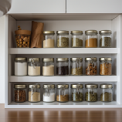
New Year’s Resolutions
Try These Herbs and Spices
If you're looking to elevate your culinary skills and explore more complex and sophisticated flavors, here are some fancier herbs, spices, and spice mixes to try:
1. | Saffron: Saffron is one of the world's most expensive spices, known for its vibrant color and unique, subtle flavor. It's often used in dishes like paella and risotto.
2. | Truffle Salt or Oil: Truffle-infused salt or oil adds an earthy and luxurious flavor to dishes. Drizzle truffle oil over pasta or risotto, or sprinkle truffle salt on fries or roasted vegetables.
3. | Cardamom: Cardamom has a warm, slightly sweet, and citrusy flavor. It's commonly used in Indian and Middle Eastern cuisine, both in sweet and savory dishes.
4. | Sumac: Sumac has a tart and lemony flavor and is often used in Middle Eastern and Mediterranean dishes, such as fattoush salad and kebabs.
5. | Za'atar: Za'atar is a Middle Eastern spice mix made from thyme, sumac, and sesame seeds. It's great on bread, in marinades, or as a seasoning for roasted vegetables.
6. | Fennel Pollen: Fennel pollen is prized for its sweet and licorice-like flavor. It can be used as a rub for meats or added to baked goods.
7. | Harissa: Harissa is a North African chili paste made from roasted red peppers and spices. It adds heat and depth to sauces, stews, and grilled meats.
8. | Garam Masala: Garam masala is a complex spice blend used in Indian cuisine. It combines warm and aromatic spices like cardamom, cinnamon, and cloves.
9. | Herbes de Provence: This French herb blend typically includes thyme, rosemary, oregano, and other aromatic herbs. It's perfect for seasoning roasted meats and vegetables.
10. | Ras el Hanout: A North African spice mix, ras el hanout is a blend of various spices and herbs, including cumin, coriander, and cinnamon. It's used in tagines and couscous dishes.
11. | Shichimi Togarashi: This Japanese spice blend contains chili peppers, orange peel, and various seasonings. It's commonly used to add heat and flavor to dishes like ramen and tempura.
12. | Fenugreek: Fenugreek seeds and leaves have a slightly bitter taste with notes of maple. They are used in Indian and Middle Eastern cuisine, especially in curries and spice blends.
13. | Juniper Berries: Juniper berries have a piney, resinous flavor and are a key ingredient in classic dishes like German sauerkraut and Scandinavian game dishes.
Written By Judy Doherty, MPS, PCII

Slide 11
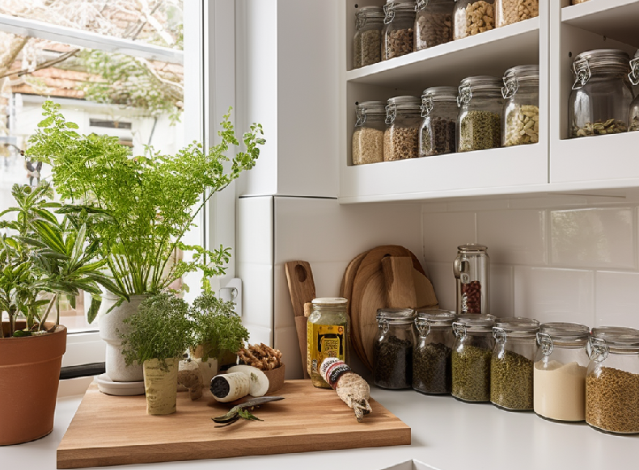
New Year’s Resolutions
Try These Herbs and Spices
14. | Aleppo Pepper: Aleppo pepper is a moderately spicy pepper with fruity and cumin-like undertones. It's popular in Middle Eastern and Mediterranean cuisine.
15. | Chinese Five Spice: This Chinese spice blend combines five flavors—sweet, sour, bitter, salty, and umami. It's used in various Chinese dishes, particularly with pork and duck
16. | Cubeb Pepper: Cubeb pepper has a complex, pungent flavor with hints of juniper and black pepper. It's used in Moroccan cuisine.
17. | Anise Hyssop: Anise hyssop offers a licorice-like flavor and is excellent in desserts, teas, or as a garnish for salads.
5. | Za'atar: Za'atar is a Middle Eastern spice mix made from thyme, sumac, and sesame seeds. It's great on bread, in marinades, or as a seasoning for roasted vegetables.
6. | Fennel Pollen: Fennel pollen is prized for its sweet and licorice-like flavor. It can be used as a rub for meats or added to baked goods.
7. | Harissa: Harissa is a North African chili paste made from roasted red peppers and spices. It adds heat and depth to sauces, stews, and grilled meats.
Adding these fancier herbs, spices, and spice mixes to your pantry can open up a world of culinary possibilities and help you create more refined and intriguing dishes. Experiment with them in your recipes to discover new and exciting flavor combinations.
Written By Judy Doherty, MPS, PCII

