Slide 1
March 2024
Nutrition
NEWSLETTER
Inside:
Brought to you by:
Pasta Fagioli
Greek Cauliflower and Chicken Stew
Red Curry Chicken & Brown Rice (butternut squash base)
Nutrition Month Handout: Beyond the Table
Reduce Salt Intake to Lower Blood Pressure - Research Plus Handout
Connection between Ultra-Processed Food and Risk of Cancers of the Mouth
Healthy Aging 101 Handout
Avoid the Risk for Alzheimer’s Disease

Slide 2
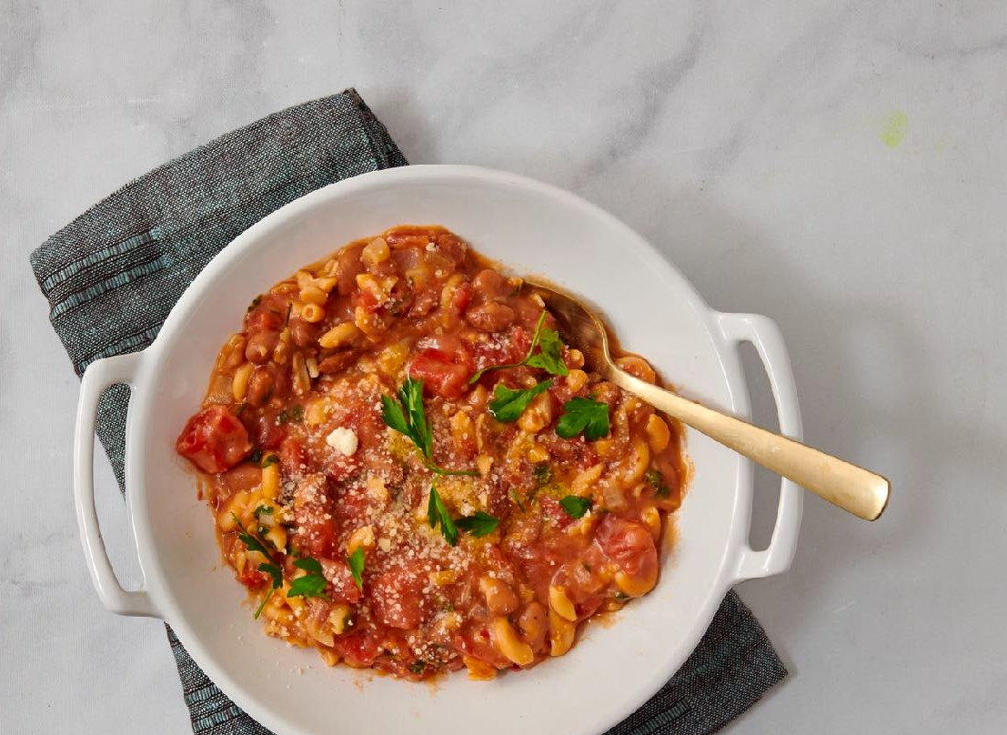
Pasta Fagiole
INGREDIENTS
1 tsp olive oil
1 onion, peeled and diced
1 tsp minced garlic
2 cups low-sodium vegetable broth (or chicken broth)
2 boneless skinless chicken thighs, diced
1 14.5 ounce can pinto beans, drained
1 14.5 ounce can no-salt-added diced tomatoes, with juice
2 tsp Italian seasoning (salt-free)
1 pinch red pepper flakes or Aleppo pepper flakes
1/4 cup chopped fresh parsley
INSTRUCTIONS
Heat a large Dutch oven over medium heat. Add the oil and saute the onions and garlic for a few minutes.
Add the broth, chicken, pinto beans and all seasonings except the pepper and parsley.
Bring to a boil, cover, and lower the heat to a simmer.
Cook for 20 minutes or until the chicken is done.
Top with pepper flakes and chopped parsley and serve hot.
You can freeze leftovers in portion sized containers for future use.
Serves 46. Each 1 cup serving: 217 calories, 4 g fat, 1 g saturated fat, 54 mg cholesterol, 0 mg trans fat, 465 mg sodium, 28 g carbohydrates 8 g fiber, 7 g sugar, 18 g protein.

Slide 3
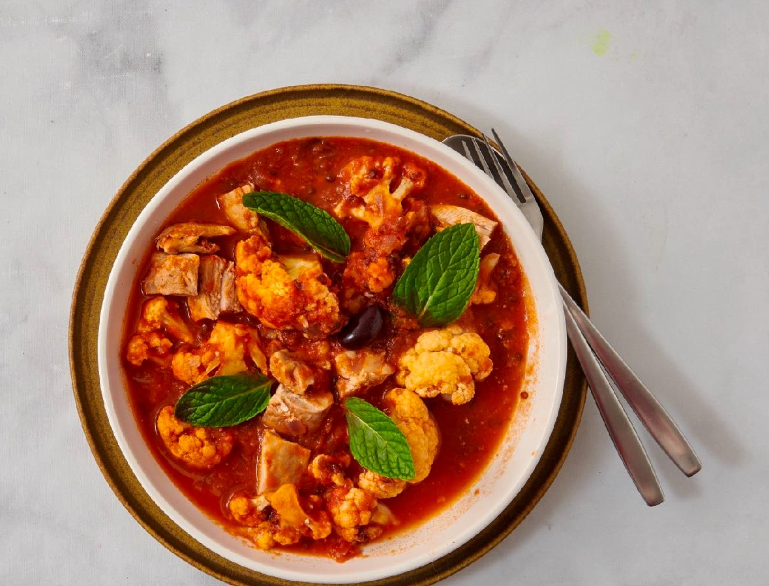
Greek Chicken Cauliflower Stew
Ingredients:
1 tsp olive oil
1 tablespoon minced garlic
1/2 onion, peeled and chopped
4 chicken thighs cut into bite-sized pieces
1 can black lentils, drained
1/2 head cauliflower cut into florets
2 cans diced tomatoes, no salt added
2 cups low-sodium chicken or vegetable broth
Garnish: 1 kalamata olive, mint leaves, crushed red pepper or Aleppo pepper
Directions:
Saute the garlic and olive oil in a large Dutch oven pan over medium heat. Add the onion and chicken. Cook until golden
Add the lentils, cauliflower, tomatoes and broth, Bring to a boil then lower to a simmer. Cover and cook 25 minutes until the chicken and cauliflower are done. Stir occasionally.
Garnish with an olive, mint, and red pepper flakes. Serve hot.
Serves 4. Each 1 cup serving: 383 calories, 20 g fat, 5 g saturated fat, 110 mg cholesterol., 0 g trans fat, 404 mg sodium, 25 g carbohydrate, 8 g fiber, 26 g protein.

Slide 4
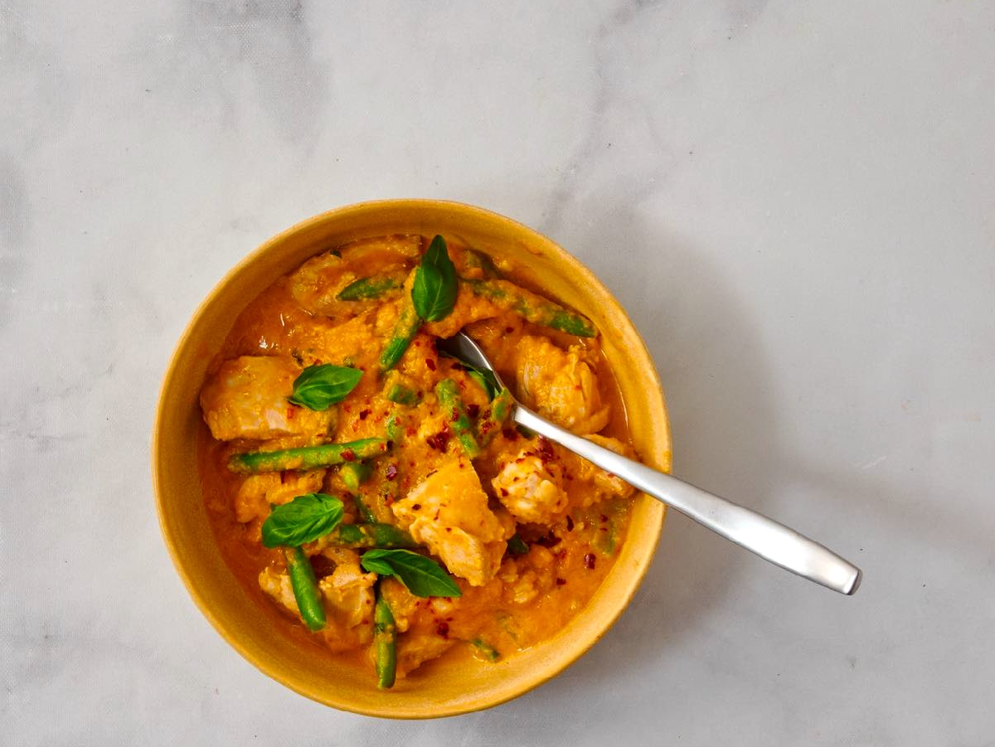
Red Curry Chicken & Brown Rice
Ingredients:
2 tsp olive oil
2 tsp minced garlic
1/4 cup minced red bell pepper
3 chicken thighs, cut into pieces
1 tablespoon Red Curry Paste
1/4 tsp fish sauce
2 cups pureed pumpkin or butternut squash
2 tablespoons cream or coconut milk
1 cup chicken broth, low sodium
2 cups fresh or frozen green beans cut into 2 inch pieces
2 cups cooked brown rice
1/4 cup basil leaves
Pinch red pepper flakes for each plate
Directions:
In a large Dutch oven pan, saute the garlic and red pepper in the olive oil. Cook for a few minutes until nutty.
Add the chicken and sauté together for a few minutes.
Add the red curry paste, fish sauce, pumpkin or squash, cream, broth, and green beans. Bring to a boil. Lower to a simmer
Cook all together for 20 minutes until the chicken is cooked and the green beans are tender, stirring frequently.
Serve the red curry over the brown rice. Garnish with basil leaves. Top with a little crushed red pepper.
Serves 4. Each 2 cup serving: 397 calories,19 g fat, 6 g saturated fat, 83 mg cholesterol., 0 g trans fat, 209 mg sodium, 37 g carbohydrate, 5 g fiber, 19 g protein.

Slide 5
March: National Nutrition Month
Beyond The Table
The theme for National Nutrition Month, a registered trademark by the Academy of Nutrition and Dietetics, is Beyond the Table. This theme helps us make more informed choices while meal planning, shopping, and exercising. Many good decisions happen before we get to the table! And certainly, they are important afterwards.
Certainly! "Beyond the Table" is a great theme that encourages a holistic approach to health, extending beyond just the act of eating. Here are some tips to help you make more informed choices in meal planning, shopping, and exercising:
Meal Planning and Meal Prep
Plan and prepare meals in advance to avoid the temptation of unhealthy, convenient options. Having nutritious options readily available makes it easier to stick to your health goals.
Food Shopping
Take the time to read and understand food labels. Look for products with minimal additives, lower sugar content, and limited saturated and trans fats.
Focus on the perimeter of the grocery store where fresh produce, lean proteins, and dairy are typically located. This helps you avoid the more processed, less nutritious center aisles.
Exercising
Set achievable and realistic fitness goals. This could be a certain number of steps per day, a specific amount of time for workouts, or a target for strength or endurance.
Find opportunities to move throughout the day, such as taking the stairs, walking during breaks, or doing quick home workouts. It all adds up!
Source: https://eatright.org

Slide 6
How to Reduce Sodium Intake
It can be challenging but reducing your sodium intake in any amount will be beneficial. Excess intake of sodium causes blood pressure to rise. High blood pressure is the leading cause of morbidity and mortality in the world. High blood pressure can lead to heart failure, heart attacks, and strokes because it puts extra pressure on your arteries. It affects the heart's ability to work effectively and pump blood.
1. Read labels for sodium content. Anything below 140 mg per serving is considered low in sodium. Avoid foods with 15% or more of the Daily Value for sodium.
2. Limit intake of fast food, frozen meals, restaurant meals, and salty snacks. Boxed pasta and rice mixes also tend to be high in sodium.
3. Taste food first before adding salt.
4. Use flavored powders in place of salts such as garlic powder, onion powder, or celery powder.
5. Go for low-sodium versions of ketchup, soy sauce, fish sauce, BBQ sauce and other condiments. Many condiments and pickled foods are very high in sodium. Even the reduced sodium versions are very high in sodium so it is best to use them sparingly.
6. Try citrus juice or flavored vinegar to season vegetables or meats in place of salty sauces or marinades.
7. Make your own salad dressing with lemon or lime juice, vinegar, dried or fresh herbs, and healthy oils like avocado, canola, or olive.
8. Top dishes with fresh herbs including basil, cilantro or mint.
9. Season vegetables or proteins with garlic, onions, ginger, mushrooms, or peppers.
10. Use herbs and spices in place of salt on beef, eggs, fish, pork, or poultry. Ideas include Italian Seasoning Mix, Granulated Garlic and Parsley, Aleppo or Korean pepper, Crushed pepper, paprika, and any favorite no-added-salt seasoning mix.
By Lisa Andrews, MEd, RD, LD

Slide 7
Reduce Your Risk for Stomach and Mouth Cancer
Mouth and throat cancer is no joke. To reduce your risk, follow the tips below:
1. Don’t smoke or quit if you do. Smoking is linked with several types of cancer, including aero-digestive cancers.
2. Drink alcohol in moderation or not at all. Like smoking, alcohol intake is associated with several types of gastrointestinal and other cancers.
3. Reduce or avoid Ultra Processed Foods. This includes fast food, fried snacks, high fat/high sugar treats and snacks, and highly processed meats such as bacon, sausage, and lunch meat.
4. Focus on fruits and vegetables- especially those high in vitamin C and beta-carotene such as berries, melon, citrus fruit, green leafy vegetables, cabbage family vegetables and bell peppers.
5. Reduce red meat and processed meat intake. Both are associated with colorectal and other cancers.
6. Include more beans and lentils in your diet for adequate fiber and protein.
7. Choose whole grains over processed grains.
8. Maintain a healthy body weight if possible.
9. Swap out chips and other snacks with nuts or seeds which contain the antioxidants vitamin E and selenium.
10. Do regular physical activity. Find exercise you enjoy and be consistent with it.
Lisa Andrews, MEd, RD, LD

Slide 8
Healthy Aging 101
Staying healthy as you age involves adopting a combination of physical, mental, and lifestyle habits. Here are some important habits to consider for maintaining health and the quality of life in older age:
1. Regular Exercise:
Engage in regular physical activity, including both cardiovascular exercises (like walking or swimming) and strength training. Exercise helps maintain muscle mass, bone density, and cardiovascular health.
2. Balanced Diet:
Consume a well-balanced diet rich in fruits, vegetables, whole grains, lean proteins, and healthy fats. Adequate nutrition is crucial for maintaining energy levels, supporting the immune system, and preventing chronic diseases.
3. Adequate Sleep:
Aim for 7-9 hours of quality sleep each night. Good sleep is essential for cognitive function, emotional well-being, and overall health.
4. Social Connection & Mental Stimulation:
Stay socially active by maintaining relationships with friends and family. Social connections contribute to emotional well-being and may even have positive effects on physical health.
Keep your mind active with activities that challenge your brain, such as reading, puzzles, learning new skills, or engaging in hobbies. Mental stimulation is vital for cognitive health.
5. Limit Alcohol and Quit Smoking:
If you drink alcohol, do so in moderation. Avoid smoking, as it poses numerous health risks, including cardiovascular disease and respiratory issues.
6. Maintain a Healthy Weight:
- Strive to maintain a healthy weight through a combination of a balanced diet and regular exercise. Excess weight can contribute to various health problems, including cardiovascular issues and joint pain.
7. Fall Prevention:
- Take measures to prevent falls, such as maintaining a clutter-free home, using assistive devices if necessary, and engaging in exercises that improve balance and strength.
Remember that individual needs and circumstances vary, so it's important to tailor these habits to your specific health goals and requirements. Always consult with healthcare professionals for personalized advice based on your health status and any existing medical conditions.
Source: https://www.nia.nih.gov/health

Slide 9
Written By Lisa Andrews, MEd, RD, LD
Research Corner
What you can do to reduce your risk of Alzheimer’s Disease:
· Know your family history. Ask your parents, aunts, uncles, and other family members about any known history of AD.
· Eat a heart-healthy diet to keep your blood lipids in balance.
· Don’t smoke and avoid secondhand smoke. Smokers and those exposed to cigarette smoke have higher rates of dementia according to research. 2
· Manage blood pressure to prevent strokes. The BBB may be damaged due to stroke. 3
· Avoid traumatic brain injuries such as concussions or falls. These raise the risk of dementia.4
· Limit alcohol consumption. Alcohol passes the BBB and damages brain tissue over time. 5
· Stay social! We need social interaction daily. Research shows that older individuals with strong social connections have lower rates of AD. 6

