Slide 1
October 2023
Nutrition
NEWSLETTER
Inside:
Brought to you by:
Share with Your Clients:
Recipe: Kale and Rooted Vegetable Salad
Recipe: Chicken Fajita Pan Dinner
Healthier Halloween Treat List
Functional Food Shopping List
Label Reading Lesson: Frozen Pizza
Carbohydrate 101
Food Sources of Flavonols
Inadequate Amounts of Flavonols Linked to Memory Loss

Slide 2
Kale and Winter Root Salad
INGREDIENTS:
2 red beets, rinsed to remove the dirt
2 golden beets, rinsed to remove dirt
2 bunches of kale, rinsed and chopped without the stems
1 shallot, peeled and diced
olive oil spray
cider vinegar
1 bunch rainbow carrots, peeled and sliced thin lengthwise
1/4 cup roasted and shelled pistachios
1 cup carrot or butternut squash puree
1/4 cup tomato paste
Garnish: radicchio leaves or red cabbage, optional
INSTRUCTIONS:
Roast the beets in a roasting pan for 1 hour at 350 degrees. Remove from oven, allow to cool, then slip the beets out of their skins. Slice into 1/4 inch thick pieces.
Meanwhile, peel and dice the shallot. Sauté in a little olive oil and then add the chopped rinsed kale. Add a big dash of cider vinegar. Cover and cook for 3 minutes.
Assemble the salad close to serving time. Place the radicchio or red cabbage leaves in 6 little piles on a large platter. Fill each one with the cooked kale. Place the sliced beets in between each pile. Add the carrots and pistachios in the center.
Place the butternut squash or carrot puree in the center. Top with pistachios. Spray with olive oil spray and cider vinegar.
Chef's Tips:
You can make this salad a meal by adding grilled poultry or hard boiled eggs.
NUTRITION FACTS:
Serves 6. Each 1.5 cup serving: 113 calories, 3 g fat, 0.5 g saturated fat, 0 mg cholesterol, 113 mg sodium, 19 g carbohydrate, 9 g sugar, 6 g fiber, 4.5 g protein.

Slide 3
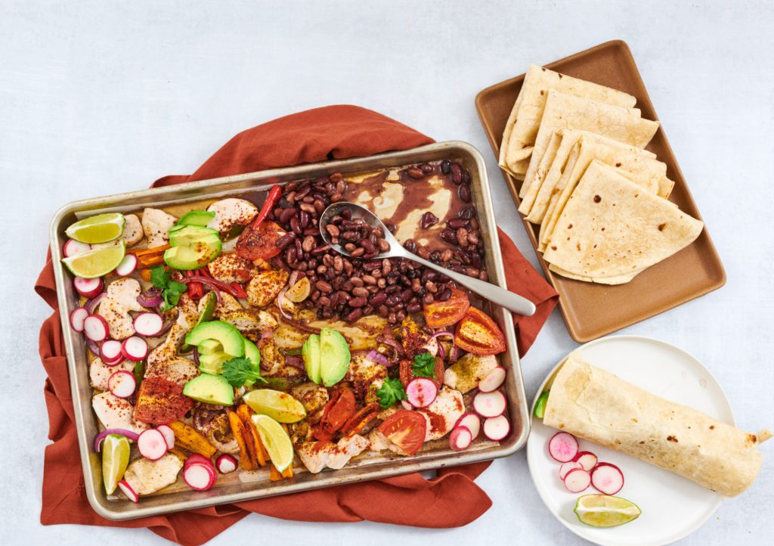
Chicken Fajita Pan Dinner
INGREDIENTS:
1 tsp olive oil
1 each onion peel and slice
1 each red bell pepper cored and sliced into thin strips
1 each jalapeño pepper cored, seeded, diced
2 each chicken breasts boneless, skinless, sliced in strips
1 tsp ground cumin
1 tsp paprika
1 tsp garlic salt
1 tsp oregano
1 tsp chili powder
2 each limes
1 cup radishes
2 cups pinto beans (canned or cooked) drained
1 each avocado peeled, pitted, sliced
8 each tortillas flour or corn, warmed in foil in the oven
INSTRUCTIONS:
Preheat oven to 400 degrees F. Place the chicken, peppers, onions, and oil on the sheet tray, tossing them together. Top with seasonings. Bake in the oven until the chicken is done, about 20 minutes.
Meanwhile, prepare the other ingredients. Slice the radishes and avocado. Cut the limes in wedges. Heat the corn tortillas in the oven in foil. Heat and drain the beans.
When the chicken is done, add all the items to the tray. Serve hot.
Chef’s Notes:
You can make burritos with flour tortillas or serve taco style with corn tortillas.
NUTRITION FACTS:
Serves 4. Each 2 cup serving: 400 calories, 13 g fat, 2.5 g saturated fat, 36 g cholesterol, 400 mg sodium, 50 g carbohydrate, 15 g fiber, 4.5 g sugar, 24 g protein.

Slide 4
Healthier Halloween Treat List
When it comes to Halloween candy, some options are generally considered healthier than others. Here are a few healthier choices for Halloween candy:
Dark Chocolate: Dark chocolate with a high cocoa content is a good choice. It contains antioxidants and is often lower in sugar compared to milk chocolate. Look for dark chocolate mini bars or individually wrapped pieces.
Miniature Nut Packs: Mini packs of nuts, like almonds or peanuts, can provide a dose of healthy fats and protein. Just make sure there are no added sugars or excessive salt.
Fruit Snacks: Fruit snacks made from real fruit juice and without artificial colors or high amounts of added sugarer a good choice. Look for ones with minimal ingredients.
Dried Fruit: Mini packs of unsweetened dried fruits, like raisins, apricots, or cranberries, can be a sweet yet healthier option.
Dark Chocolate-Covered Fruits or Nuts: Dark chocolate-covered fruits like raisins or nuts like almonds can offer a combination of sweetness and nutritional value.
Small-Sized Natural Candies: Look for candies made with natural or organic ingredients, which might have less artificial additives and colors.
Mini Granola Bars or Energy Bars: Some brands offer mini versions of their healthier granola bars or energy bars, which can provide whole grains, nuts, and natural sweeteners.
Stickers, Toys, or Non-Food Treats: Consider offering non-food treats like stickers, small toys, or temporary tattoos, which can be a fun alternative to candy.
Remember that moderation is key. While these options are generally considered healthier than traditional candy, they can still be high in calories and should be consumed in moderation. Always read labels and consider your own dietary preferences and restrictions.
Additionally, if you're giving out Halloween candy, offering a mix of both traditional treats and some healthier options can be a considerate choice for families with various dietary needs and preferences.

Slide 5
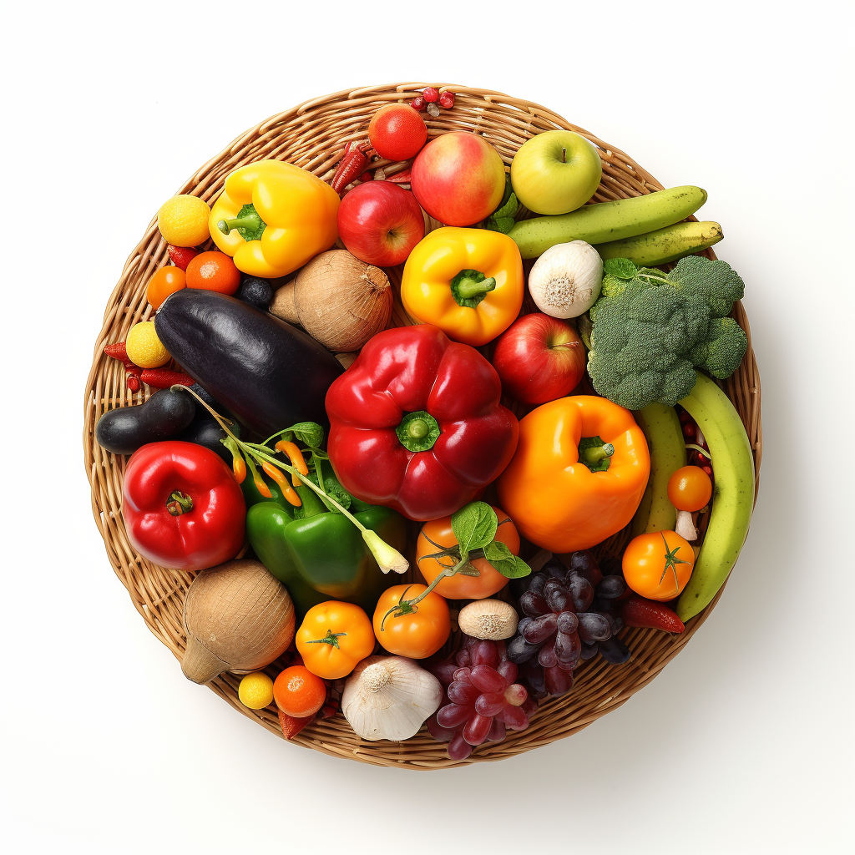
Functional Food Shopping List
Functional foods are those that provide additional health benefits beyond basic nutrition. They often contain bioactive compounds that promote health and help reduce the risk of chronic diseases. Here are some of the most popular functional foods that are whole and affordable:
Berries: Blueberries, strawberries, raspberries, and other berries are rich in antioxidants, vitamins, and fiber that support heart health, brain function, and immune system.
Oats: Oats are high in soluble fiber, which helps lower cholesterol levels. They also have a low glycemic index, making them good for blood sugar control.
Yogurt and Probiotic Foods: Yogurt contains probiotics, which are beneficial for gut health. Probiotic-rich foods like kimchi, sauerkraut, and kefir also support digestive health.
Fatty Fish: Fish like salmon, mackerel, and sardines are high in omega-3 fatty acids, which have anti-inflammatory properties and support heart and brain health.
Nuts: Nuts, such as almonds, walnuts, and pistachios, are packed with healthy fats, protein, and fiber. They promote heart health and can help manage weight.
Whole Grains: Whole grains like quinoa, brown rice, and whole wheat are rich in fiber, vitamins, and minerals, contributing to better digestion and long-lasting energy.
Leafy Greens: Vegetables like spinach, kale, and Swiss chard are nutrient powerhouses, offering vitamins, minerals, and antioxidants that support overall health.
Turmeric: Curcumin, the active compound in turmeric, has anti-inflammatory and antioxidant properties, which may help with various health conditions.
Green Tea: Green tea is rich in antioxidants, particularly catechins, which are associated with various health benefits, including improved metabolism and heart health.
Garlic: Garlic contains allicin, a compound known for its immune-boosting and heart-protective properties.
Legumes: Beans, lentils, and chickpeas are high in fiber, protein, and various nutrients. They contribute to heart health and help manage blood sugar levels.
Dark Chocolate: Dark chocolate with a high cocoa content contains antioxidants called flavonoids, which may contribute to heart health and brain function.
Tomatoes: Tomatoes are rich in lycopene, an antioxidant associated with a reduced risk of certain cancers and heart disease.
Ginger: Ginger has anti-inflammatory and antioxidant effects and may help with digestion and nausea.
Eggs: Eggs are a good source of protein and various nutrients, including choline, which supports brain health.
Remember that while these functional foods have health benefits, a balanced diet that includes a variety of nutrient-rich foods is essential for overall well-being. It's also important to consult with a healthcare professional before making significant dietary changes, especially if you have specific health conditions or dietary restrictions.

Slide 6
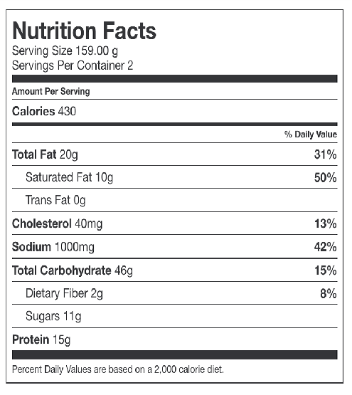
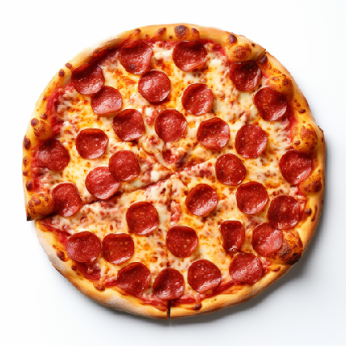
Fact Check: Reading the Nutrition Facts Label Vs Package Claims
Reading a nutrition facts label while shopping is a smart way to make informed food choices. These labels provide crucial information about the nutritional content of a product. Here's a step-by-step guide on how to read a nutrition facts label:
Serving Size:
Look at the serving size and number of servings per package.
Make sure to compare this to the portion you actually eat.
Calories:
Check the calorie count per serving.
This is the amount of energy the food provides.
% Daily Value (%DV):
%DV indicates how much a nutrient in one serving contributes to a daily diet (based on a standard diet of 2,000 calories).
Aim for low %DV in nutrients like saturated fat, trans fat, cholesterol, and sodium. Aim for higher %DV in nutrients like fiber, vitamins, and minerals.
Fats:
Limit saturated and trans fats, as they can increase the risk of heart disease.
Sodium:
Choose products with lower sodium content to help prevent high blood pressure, osteoporosis, stroke, and certain cancers. .
Carbohydrates:
Aim for higher dietary fiber and lower added sugars.
Protein:
Compare protein content of various food. Vary your proteins.
Ingredient List:
Ingredients are listed in order of quantity, from highest to lowest.
EXAMPLE: Frozen pepperoni pizza declares: real meat and cheese - but the nutrition facts shows 430 calories, 20 grams of fat, 10 grams of saturated fat and 1000 mg of sodium for 2 slices of pizza.

Slide 7
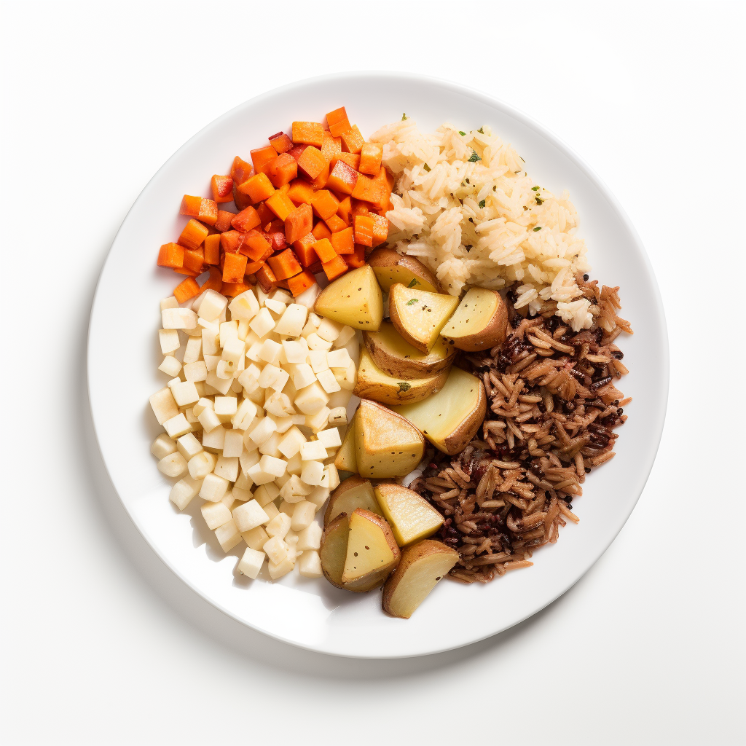
Carbohydrate 101
What is a carbohydrate?
Carbohydrates are one of three macronutrients: carbohydrates, protein, and fat. They contain carbon, hydrogen, and oxygen atoms. Carbohydrates provide most of the energy needed in our daily lives for normal body functions such as heartbeat, breathing, and digestion and for physical activity and exercise.
Net carbs are the total amount of carbohydrates in a food item that impacts blood sugar levels. It is calculated by subtracting the dietary fiber and sugar alcohols, if any, from the total carbohydrates present in the food.
What are net carbohydrates?
Dietary fiber and sugar alcohols are subtracted from the total carbohydrates because they are not fully digested or absorbed by the body. Fiber passes through the digestive system largely intact and does not significantly raise blood sugar levels. Sugar alcohols are partially absorbed and have a smaller impact on blood sugar than regular sugar.
Which foods contain carbohydrates?
Grains and grain products
Fruits
Vegetables
Beans and legumes
Dairy products
Sugars
Do I need carbs?
High-carbohydrate foods are the best and sometimes only food sources of many essential nutrients, including:
Fiber
Vitamins C & E
The majority of B vitamins
Carotenoids and other beneficial phytochemicals
Potassium
The majority of trace minerals
A diet that is low in or deficient in any of these nutrients leads to many health problems, including an increased risk for osteoporosis, high blood pressure, and heart disease.

Slide 8
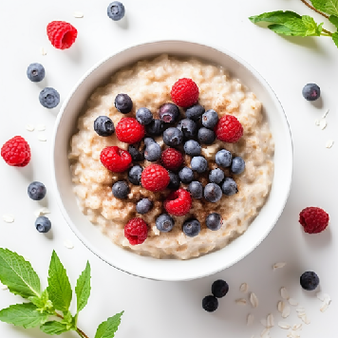
Carbohydrate 101
Take a look at our lists below. The numbers on the right measure the density of calories in a food by showing how much each food contains per pound. Non-starchy vegetables, such as lettuce, tomatoes, and carrots, are the lowest in calories while foods that contain white flour, sugar and fat, such as cookies, are the highest.
“Skinny” Carbohydrates and their calorie content per pound:
Vegetables, non-starchy 195
Fruits 135-425
Skim milk 158
Hot cereals 242-281
Brown rice 488
Potatoes, yams 494
Barley 557
Whole-wheat spaghetti 562
Beans 576
Calorie-Dense Carbohydrate Foods and their calorie content per pound:
These include foods high in sugar, refined grains, and/or fat.
Ice cream 1,283
French fries 1,400
Cake with frosting 1,544
Pretzels 1,700
Sweetened dry cereal 1,701
Cheesecake 1,733
Baked potato chips 1,760
Doughnut 1,800
Croissant 1,800
Brownies 2,000
Snickers 2,163
Cookies 2,200
Crackers 2,268
Potato chips 2,450

Slide 9
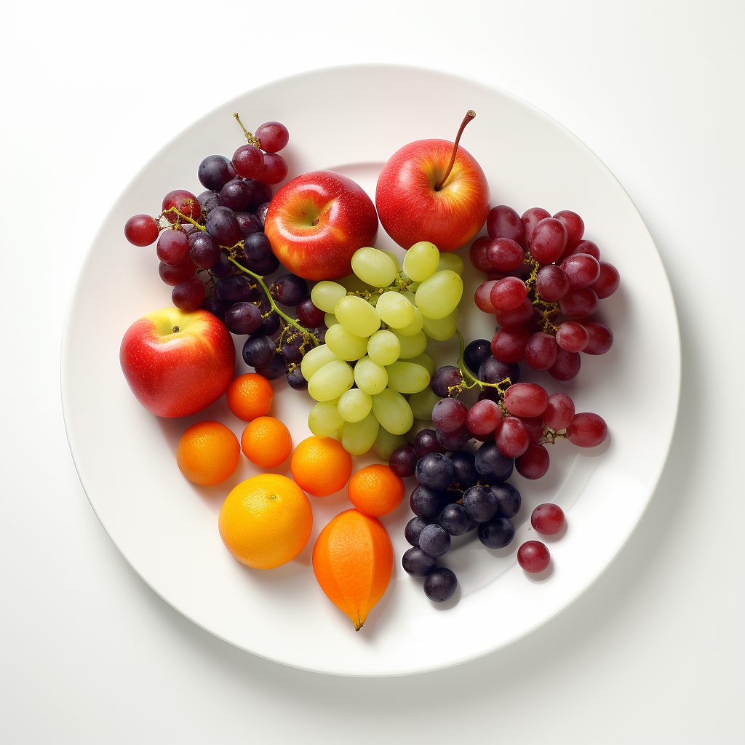
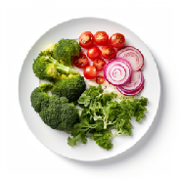
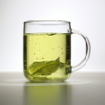
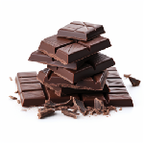
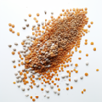
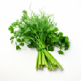
Food Sources of Flavonol
Flavonols are a type of flavonoid, which are natural compounds found in plants. They are known for their antioxidant and anti-inflammatory properties, and they are associated with various health benefits. Here are some common dietary sources of flavonols:
Fruits:
Apples
Berries (such as blueberries, strawberries, raspberries)
Citrus fruits (such as oranges, grapefruits)
Grapes
Vegetables:
Onions
Broccoli
Kale
Spinach
Tomatoes
Tea:
Green tea is particularly rich in flavonols, with a specific type called catechins.
Cocoa and Dark Chocolate:
Cocoa and dark chocolate contain significant amounts of flavonols, especially a type known as epicatechin.
Legumes:
Soybeans
Lentils
Chickpeas
Herbs:
Parsley
Chives
Nuts:
Some nuts, such as almonds and hazelnuts, contain moderate amounts of flavonols.
Wine:
Red wine, in moderation, contains flavonols, particularly a type known as quercetin. Most people should not drink more than one glass a day and less is even more desirable according to many new studies.
Remember that the flavonol content of these foods can vary based on factors like growing conditions, processing, and preparation methods. Eating a variety of fruits, vegetables, whole grains, and other plant-based foods can help ensure you’re getting a diverse range of flavonols and other beneficial compounds.

Slide 10
Low Flavanol Intake May Lead to Memory Loss
Looking for natural ways to protect your noggin from memory loss? Join the club! A recent study from the combined research teams at Columbia and Brigham and Women’s Hospital/Harvard discovered that a diet low in flavanols- those important nutrients in fruits and veggies, may lead to age-related memory loss.
The research showed that in older adults, flavanol consumption aligns with scores on tests that measure memory loss related to normal aging. Replacing these bioactive compounds in individuals over the age of 60 that are mildly deficient in flavanols enhances performance on these particular tests.
Adam Brickman, PhD, professor of neuropsychology at Columbia University Vagelos College of Physicians and Surgeons and co-leader of the study suggests that "The improvement among study participants with low-flavanol diets was substantial and raises the possibility of using flavanol-rich diets or supplements to improve cognitive function in older adults,".
His research also supports the theory that the aging brain needs specific nutrients to function optimally, similar to how the developing brain also needs specific nutrients for normal growth and development.
The study's senior author, Scott Small, MD, the Boris and Rose Katz Professor of Neurology at Columbia University Vagelos College of Physicians and Surgeons recognizes that "The identification of nutrients critical for the proper development of an infant's nervous system was a crowning achievement of 20th century nutrition science,".
Now we are living longer and research is beginning to show that various nutrients are necessary to fuel our aging minds. His study, which relies on biomarkers of flavanol intake, can be utilized as a template by other scientists to find additional, necessary nutrients.
Age-related memory loss associated with changes in the hippocampus
The new research adds to over 15 years of studies in Small’s lab connecting age-related memory loss to changes in an area of the brain’s hippocampus known as the dentate gyrus. This region is necessary for learning new memories. Flavanols improve function in this area of the brain.
Other studies done in mice showed that flavanols, especially epicatechin (found in green tea), enhanced memory by improving neuron growth and blood vessels in the hippocampus.
Smith’s team evaluated flavanol supplements in humans. One small study showed that the dentate gyrus is connected to cognitive aging. A second, bigger study found that flavanols improved memory by selectively acting on this region of the brain and had the most affect on those who started out with a low-quality diet.
The Columbia and Brigham and Women’s Hospital teams evaluating the effects of flavanols and multivitamins in COSMOS (Cocoa Supplements and Multivitamin Outcomes Study). The new study called COSMOS-Web was developed to evaluate the effect of flavanols in a bigger group and test whether flavanol deficiency resulted in cognitive aging in this area of the brain.
Lisa Andrews, MEd, RD, LD

Slide 11
Low Flavanol Intake May Lead to Memory Loss
Study design
Over 3,500 healthy older adults were assigned randomly to receive a daily flavanol supplement (pill form) or a placebo for three years. The ‘real’ supplement had 500 mg of flavanols, of which 80 mg of epicatechins were included, the amount that adults should receive from food.
At the start of the study, all subjects did a survey that evaluated their diet quality, including foods with high amounts of flavanols. Subjects then did a series of web-based activities at home, designed and validated by Brickman, to evaluate the types of short-term memory controlled by the hippocampus. These evaluations were repeated after one, two, and three years. The majority of subjects identified themselves as non-Hispanic and white.
Over a third of the subjects also provided urine samples. This allowed the researchers to measure a dietary flavanol biomarker level, developed by co-study authors at Reading University in the UK, before and during the study. The biomarker provided the researchers with a more exact way to find if flavanol levels correlated to performance on the cognitive tests and monitor if participants were sticking to their assigned regimen (adherence was high throughout the study). Flavanol levels varied moderately, though no subjects were severely deficient in flavanols.
People with mild flavanol deficiency benefited from flavanol supplement
In the group taking the daily flavanol pill, memory scores increased slightly. The majority of subjects were already eating a nutritious diet high in flavanols.
At the end of the initial year of taking the flavanol pill, subjects that admitted to eating a poorer diet and had lower levels of flavanols at baseline had an increase in memory scores by an average of 10.5% when compared to those taking a placebo. This was increased by 16% compared to their baseline memory score. The improvement seen at one year was maintained for at least two more years based on annual cognitive testing.
The study results strongly suggest that a deficiency in flavanols could result in age-related memory loss. Flavanol intake was associated with memory scores and flavanol supplements enhanced memory in older adults who were flavanol deficient.
The results of this study align with a recent study that discovered that flavanol supplements didn’t improve memory in a group of individuals with a range of baseline flavanol levels. However, the other study failed to review the impact of flavanol supplements on those with low and high flavanol levels separately.
Both studies found that flavanols have no impact on individuals who aren’t deficient in flavanols, according to Small. The other study may not have used memory tests that evaluate memory processes in the hippocampus impacted by flavonols. The new study showed that flavanols only helped memory processes regulated by the hippocampus and didn’t improve memory modulated by other regions of the brain.
Lisa Andrews, MEd, RD, LD

Slide 12
Low Flavanol Intake May Lead to Memory Loss
What’s next?
"We cannot yet definitively conclude that low dietary intake of flavanols alone causes poor memory performance, because we did not conduct the opposite experiment: depleting flavanol in people who are not deficient," Small says, adding that such an experiment might be considered unethical.
A clinical trial to restore levels of flavanols in those with severe deficiency would be the next step. "Age-related memory decline is thought to occur sooner or later in nearly everyone, though there is a great amount of variability," says Small. "If some of this variance is partly due to differences in dietary consumption of flavanols, then we would see an even more dramatic improvement in memory in people who replenish dietary flavanols when they're in their 40s and 50s."
Below are the top foods to include in your diet to increase flavanol intake:
Apples
Green and black tea
Blackberries, blueberries, strawberries, raspberries
Citrus fruit
Kale, spinach, and other leafy greens
Beans and lentils
Broccoli
Cocoa
Red wine in moderation
Reference:
Adam M. Brickman, Lok-Kin Yeung, Daniel M. Alschuler, Javier I. Ottaviani, Gunter G. C. Kuhnle, Richard P. Sloan, Heike Luttmann-Gibson, Trisha Copeland, Hagen Schroeter, Howard D. Sesso, JoAnn E. Manson, Melanie Wall, Scott A. Small. Dietary flavanols restore hippocampal-dependent memory in older adults with lower diet quality and lower habitual flavanol consumption. Proceedings of the National Academy of Sciences, 2023; 120 (23) DOI: 10.1073/pnas.2216932120
Lisa Andrews, MEd, RD, LD

