Slide 1
November 2023
Nutrition
NEWSLETTER
Inside:
Brought to you by:
Butternut Squash Tart
Orange Roasted Turkey
Healthy Snack Ideas
Protein 101
What is Nutrient Dense?
Rating Ultra Processed Foods for Nutritional Value

Slide 2
Winter Squash Walnut Tart
Ingredients
Walnut Crust:
1 cup walnuts, ground
1 Tbsp flour
Squash Filling:
1 butternut squash, cut in half, peeled, seeded, sliced thin
1 acorn squash, cut in half, peeled, seeded, sliced thin
10 walnut halves for garnish
This savory tart makes a fancy vegetable side dish with a wow factor!
Instructions
Grind the walnuts in a food processor with the flour
Spray a nonstick tart pan with vegetable oil spray.
Press the walnut crust into the pan.
Place the sliced squash in the pan in a ring fashion as pictured.
Bake in a 350 degree oven for an hour or until the squash is tender.
Brush with butter or cover with foil half way through.
Garnish with the walnuts, slice and serve.
Serves 10. Each slice: 143 calories, 9 g fat, .8 g saturated fat, 0 mg cholesterol, 4 mg sodium, 15 g carbohydrate, 3 g fiber, 3 g protein.

Slide 3
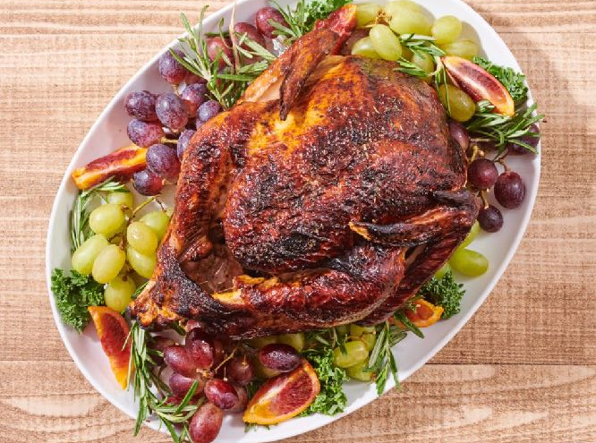
Orange-Carmel Roasted Turkey
This delicious turkey has a nice caramel glaze, which holds in moisture and makes an excellent presentation.
Ingredients
10-pound turkey thawed
1 tablespoon olive oil
1 tsp kitchen bouquet
2 tsp apricot or orange marmelade
1 tsp Italian seasoning
1/2 tsp garlic
1 pinch salt and pepper
Instructions
Mix the oil, Kitchen Bouquet, seasonings, and marmalade. Heat in a pan on the stove. Brush the turkey well with the glaze. Put in a 350-degree oven. We like to use a probe-style thermometer that inserts into the thigh and is set for 165 degrees F with an alarm. When the turkey reaches this temperature it is perfectly done and can be pulled from the oven. The time will vary according to the size of the bird.
Cover the bird when it is the color you desire. You can keep brushing with glaze in the beginning until the glaze is used up.
Put the bird on a big platter with fruits and rosemary. Carve at the table.
Serve with cranberries or gravy. For the gravy, we used the one that comes with the bird, and we added water to thin it down and reduce the sodium.
Serves 12. Each 4 ounce serving dark and white meat no skin: 120 calories, 2 g fat, .5 g saturated fat, 50 mg cholesterol, 120 mg sodium, 4 g carbohydrate, 0 g fiber, 20 g protein.

Slide 4
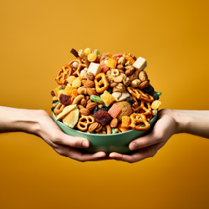
Healthy Snack Ideas
Healthy snacks are a great way to satisfy your hunger between meals while providing your body with essential nutrients. Here are some healthy snack ideas:
Fresh Fruit: Fruits like apples, bananas, berries, and oranges contain vitamins, minerals, and fiber. They're easy to carry and require no preparation.
Vegetable Sticks with Hummus: Slice up some cucumbers, carrots, bell peppers, or celery and dip them in a portion-controlled amount of hummus. This combo provides fiber, vitamins, and healthy fats.
Greek Yogurt: Greek yogurt is rich in protein and probiotics. Add some fresh berries or a drizzle of honey for extra flavor.
Nuts and Seeds: Almonds, walnuts, and sunflower seeds are high in healthy fats, protein, and fiber. A small handful can be quite satisfying. Feel free to mix them!
Nut Butter and Whole Grain Crackers: Spread almond or peanut butter on whole-grain crackers for a balance of healthy fats and carbohydrates.
Trail Mix: Make your own trail mix with a mix of nuts, seeds, dried fruits, and a few dark chocolate chips for a sweet touch.
Hard-Boiled Eggs: Eggs are a good source of protein and can be boiled in advance for a quick and easy snack.
Avocado Toast: Spread mashed avocado on whole-grain toast and sprinkle with a pinch of salt and pepper. You can also add tomato slices or a poached egg for extra flavor and nutrients.
Cottage Cheese with Fruit: Low-fat cottage cheese with sliced peaches, pineapple, or strawberries makes a protein-packed, sweet snack.
Popcorn: Air-popped popcorn is a whole grain and can be a healthy snack when not loaded with butter and excessive salt.
Homemade Smoothies: Blend spinach, kale, or other leafy greens with fruits like banana, berries, and a scoop of protein powder for a nutritious snack.
Rice Cakes with Toppings: Top rice cakes with almond butter, avocado, or cottage cheese, and add sliced fruits or veggies for extra flavor.
Chia Pudding: Mix chia seeds with almond milk, a touch of honey, and some vanilla extract. Let it sit in the fridge until it thickens, and then top with berries or nuts.
Sliced Turkey or Chicken: Roll up slices of lean turkey or chicken for a protein-rich snack.
Edamame: Steamed edamame (young soybeans) sprinkled with sea salt is a protein-rich, satisfying snack.
Remember that portion control is important, even with healthy snacks, to maintain a balanced diet. Also, try to choose snacks that provide a mix of macronutrients (carbohydrates, protein, and healthy fats) to keep you feeling full and energized throughout the day. Drinking water alongside your snacks can also help with satiety.

Slide 5
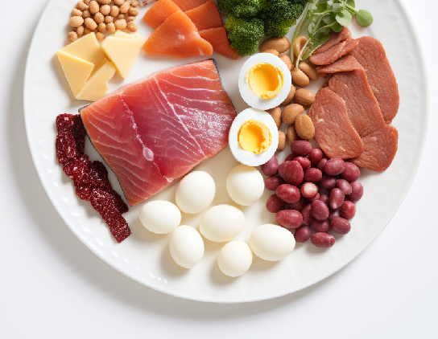
Protein 101: Needs
Protein is one of the three macronutrients found in food, alongside carbohydrates and fats. While fat provides 9 calories per gram, carbohydrates and protein provides 4 calories per gram. This means that for every gram of protein consumed, it contributes approximately 4 calories to the total energy content of the food.
To calculate the calorie content of a food item that contains protein, you need to know the amount of protein it contains. This information is typically found on nutrition labels or in nutritional databases.
Here's an example: If a food item contains 20 grams of protein, you can calculate the calorie content from protein by multiplying the protein amount by 4:
Calories from protein = 20 grams * 4 calories/gram = 80 calories
Therefore, in this example, the food item would contribute 80 calories to your overall energy intake from protein.
The Dietary Reference Intake (DRI) for protein is the amount of protein intake recommended by health authorities to meet the nutritional needs of most healthy individuals. The DRI for protein varies depending on age, sex, weight, activity level, and other factors. Here are the general DRI recommendations for protein:
Infants:
0-6 months: 9 grams per day
7-12 months: 11 grams per day
Children:
1-3 years: 13 grams per day
4-8 years: 19 grams per day
9-13 years: 34 grams per day
Adolescents:
Boys 14-18 years: 52 grams per day
Girls 14-18 years: 46 grams per day
Adults:
Men 19 years and older: 56 grams per day
Women 19 years and older: 46 grams per day
According to the NHANES data from 2015-2016, the average protein intake for Americans aged two years and older was approximately 98 grams daily. It's important to note that this value represents an average and may vary based on individual factors such as age, sex, activity level, and dietary preferences.
The USDA's recommended daily protein intake for adults is around 46 grams for women and 56 grams for men. Therefore, based on the NHANES data, the average protein consumption of the American population appears to meet or exceed the recommended levels.

Slide 6
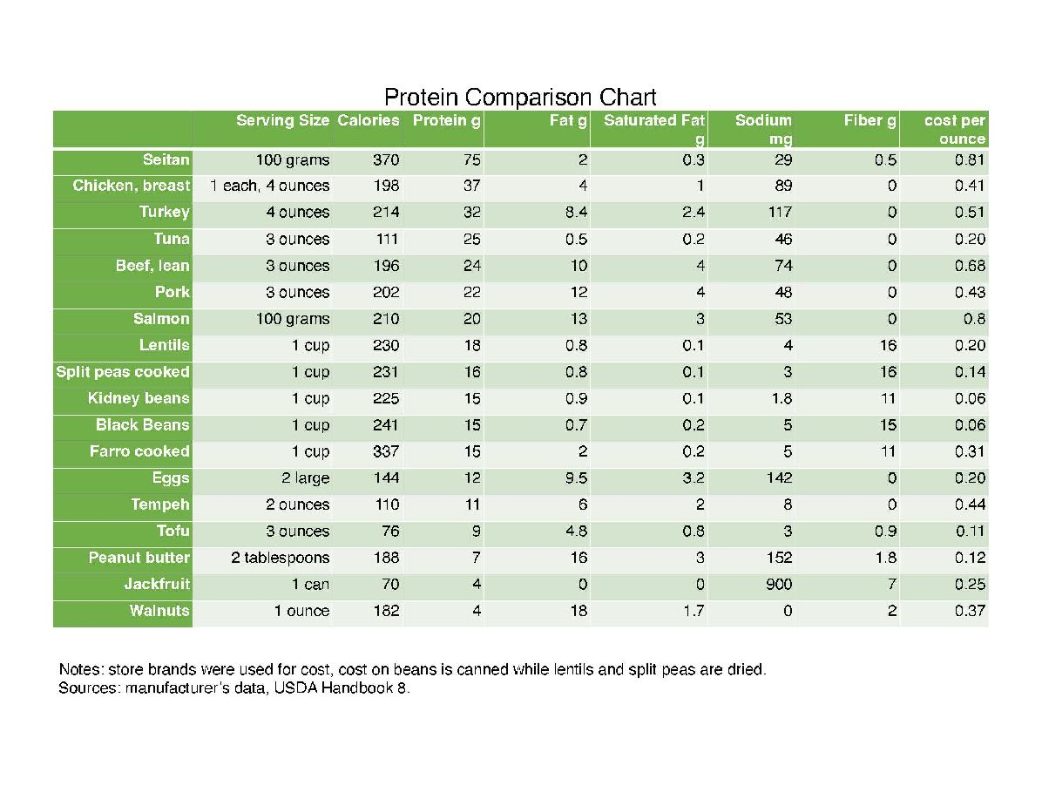
Protein 101: Quality & Variety
Recommended Daily Amount: The guidelines recommend a range for protein intake, expressed as a percentage of daily calorie intake. The range is 10% to 35% of total daily calories. The specific protein needs within this range can vary depending on factors such as age, sex, and activity level.
Variety of Protein Sources: The guidelines emphasize the importance of consuming a variety of protein foods, including seafood, lean meats, poultry, eggs, legumes, nuts, seeds, and soy products. This variety helps to ensure intake of essential nutrients and different types of protein.
Nutrient-Dense Choices: The guidelines encourage choosing protein foods that are nutrient-dense and lower in saturated fats, added sugars, and sodium. This includes lean meats, poultry without skin, seafood, eggs, nuts, seeds, legumes, and low-fat or fat-free dairy products.
Consider Sustainability: The dietary guidelines also acknowledge the importance of considering the environmental impact of food choices. They suggest choosing protein sources that are produced sustainably, such as seafood, plant-based proteins, and lean meats from animals raised using sustainable practices.

Slide 7
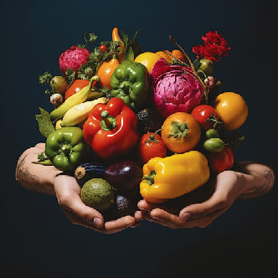
What Does Nutrient-Dense Mean?
Nutrient density refers to the amount of essential nutrients (such as vitamins, minerals, fiber, and protein) in a food or beverage relative to its calorie content. Foods that are nutrient-dense provide a high concentration of these essential nutrients per calorie, making them a healthy choice for your diet.
In contrast, foods that are calorie-dense but lack significant nutritional value are often referred to as "empty-calorie" foods. These foods provide a lot of calories but very few essential nutrients. For example, sugary sodas, candies, and many fast foods are considered low in nutrient density because they are high in calories from added sugars and unhealthy fats but offer little in the way of vitamins, minerals, or other beneficial nutrients.
Nutrient-dense foods are typically whole, unprocessed, and minimally processed foods that provide a wide range of nutrients without excessive calories. Examples of nutrient-dense foods include:
Fruits and Vegetables: These are packed with vitamins, minerals, fiber, and antioxidants while being relatively low in calories.
Lean Proteins: Skinless poultry, lean cuts of beef or pork, fish, tofu, and legumes are good sources of protein without excessive fat.
Whole Grains: Foods like quinoa, brown rice, whole wheat bread, and oats provide complex carbohydrates, fiber, vitamins, and minerals.
Dairy: Low-fat or fat-free dairy products like yogurt and milk offer calcium, protein, and other essential nutrients.
Nuts and Seeds: These provide healthy fats, protein, and various vitamins and minerals.
Eggs: Eggs are a good source of protein, vitamins, and minerals.
Beans and Legumes: These are rich in fiber, protein, and various nutrients.
Leafy Greens: Vegetables like spinach, kale, and Swiss chard are particularly nutrient-dense due to their high vitamin and mineral content.
Berries: Berries like blueberries, strawberries, and raspberries are rich in antioxidants and vitamins.
Choosing nutrient-dense foods is a key aspect of maintaining a balanced and healthy diet. They provide the essential nutrients your body needs to function properly while helping you manage your calorie intake. Incorporating a variety of nutrient-dense foods into your meals and snacks can promote overall health and well-being.

Slide 8
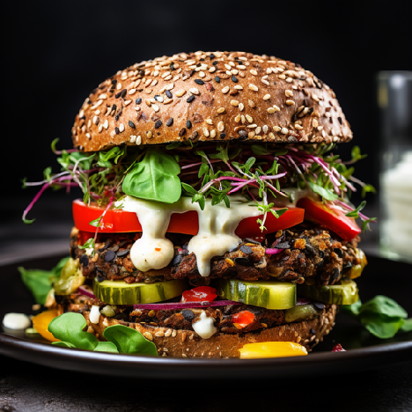
Rating Ultra Processed Foods for Nutritional Value
What are Ultra-Processed Foods?
No doubt you’ve seen ultra-processed foods in the news. “Ultra-Processed Foods are Linked to Early Death” and “Ultra-Processed Food is Killing Us but We’re Too Selfish to Stop Eating It” are two of many frightening headlines. But what exactly are ultra-processed foods, and are they all equally damaging?
Nutrition is nuanced
The NOVA classification does not indicate the healthfulness of a food, merely its degree or type of processing. In fact, researchers with the USDA created a healthful diet following the recommendations of the Dietary Guidelines for Americans, with 91% of calories coming from category four ultra-processed foods. The diet provided ample potassium, calcium, and fiber, which are largely under-consumed in the U.S.
The problem with the NOVA classification is the same problem other classification systems have. They are rigid and can be applied too strictly. Not all ultra-processed foods are harmful any more than all foods with carbohydrates are bad, all foods with salt are unhealthy, or all dogs are attack dogs.
The USDA research does not suggest that candy and chips are wholesome foods or that they don’t contribute to health problems. However, the research does argue that the widely-used classification system for processed foods cannot determine the healthfulness of the diet.
What are ultra-processed foods?
Candy, chips, cookies, and cheese from a spray can probably come to mind. But other foods may surprise you. The most widely accepted classification for identifying processed foods is the NOVA classification, in which foods are bucketed into four categories. Category 1 consists of unprocessed foods like fresh apples and minimally processed foods like chopped almonds in a resealable plastic bag. Culinary ingredients like olive oil and butter fall into category 2. Canned beans, bread, and other foods with added sugars, oils, or salt and smoked or canned foods are in category three processed foods. Considered the most processed and the most harmful are category 4 ultra-processed foods.
Category 4 foods are those containing manufactured or extracted ingredients and include candy, chips, cookies, and spray-can cheese but also yogurt with added sugar, fiber-fortified bread, high-protein hot cereal, plant-based milk substitutes, and zero-calorie plain sparkling water.
Written By Jill Weisenberger, MS, RDN, CDCES, CHWC, FAND

Slide 9
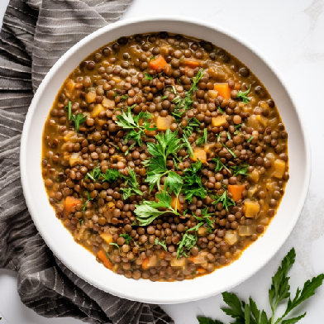
Rating Ultra Processed Foods for Nutritional Value
What you can do
Take headlines with a grain of salt. Attention-grabbing headlines often misrepresent research conclusions. Ask yourself these five questions to determine the nutrient density of your diet:
Do you eat ample fruits and vegetables every day? MyPlate calls for 3-5 cups of fruits and vegetables daily for adults. If you are eating them with most snacks and meals, you are probably in good shape.
Do the majority of your foods provide critical nutrients? If you are making a healthy plate with MyPlate, you will be getting adequate carbohydrates, protein, vitamins, and minerals. The food groups in MyPlate include fruits, vegetables, whole grains, and heart-healthy proteins, along with 2-3 servings of calcium-rich dairy or nondairy foods.
Do you eat protein-rich foods with most meals, and foods with fiber at every meal? Protein-rich foods include seafood, poultry, meat, nuts, nut butter, legumes, eggs, and seeds.
Do you eat the right amount of food and calories for your body and energy level?
Bottom line:
Processed and ultra-processed foods of high nutrient density such as soy milk, tofu, whole grain tortillas, cottage cheese, and canned lentil soup fit well into wholesome meal patterns.
Enjoy!
Reference:
https://jn.nutrition.org/article/S0022-3166(23)72434-6/fulltext
“Dietary Guidelines Meet NOVA: Developing a Menu for A Healthy Dietary Pattern Using Ultra-Processed Foods” by Julie M. Hess, Madeline E. Comeau, Shanon Casperson, Joanne L. Slavin, Guy H. Johnson, Mark Messina, Susan Raatz, Angela J. Scheett, Anne Bodensteiner and Daniel G. Palmer, 24 June 2023, The Journal of Nutrition.
Written By Jill Weisenberger, MS, RDN, CDCES, CHWC, FAND

