Slide 1
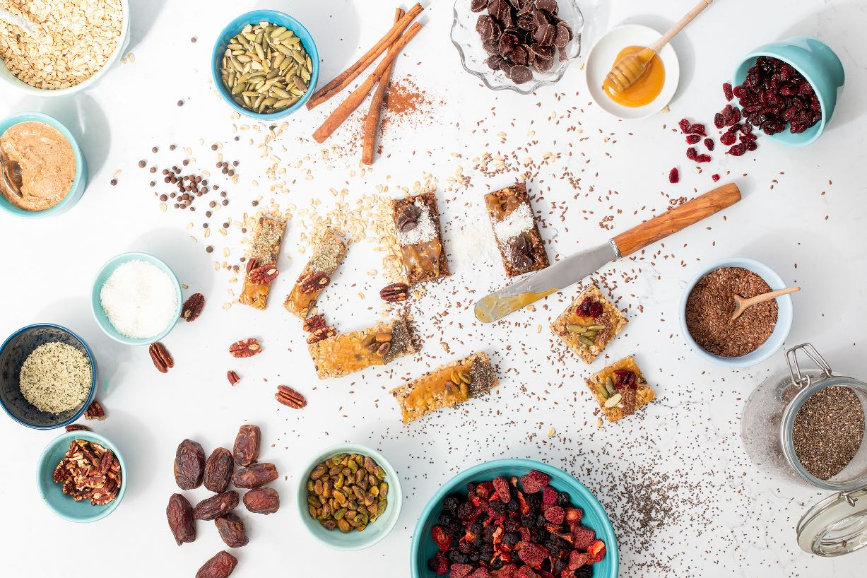
March 2023
Nutrition
NEWSLETTER
Inside:
Brought to you by:
Vegetarian Taco, by Judy Doherty, MPS, PC II
Tempeh Bowl, by Judy Doherty, MPS, PC II
Sustainable Eating Made Simple, by Judy Doherty, MPS, PCII
MyPlate for National Nutrition Month® by Judy Doherty, MPS, PC II
Another Possible Cause of Obesity by Lisa Andrews, MEd, RD, LD
Make the Best of the Protein Drive by Lisa Andrews, MEd, RD, LD
Should You Be Drinking Kombucha? by Hollis Bass, MEd, RD, LD

Slide 2
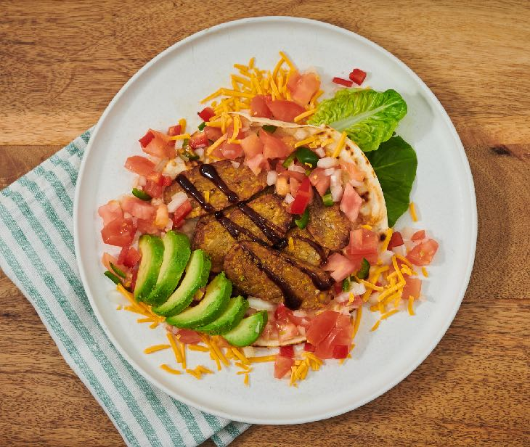
Vegetarian Taco
Ingredients:
2 medium flour tortillas
6 ounces tempeh, sliced
1 tsp canola oil
1/2 avocado
1/2 cup chopped tomato
1/4 cup chopped onion
1/2 chopped jalapeno pepper
1 tsp lime juice
1/4 cup grated carrots
1/2 cup lettuce
1 radish, sliced
1/4 cup green onion
Directions:
Fry the tempeh slices in oil over medium heat until warmed and crispy. Finish with splash of low-sodium Tamara or soy sauce. Remove from heat.
Heat the corn tortilla in a skillet over medium heat until toasted and warm.
Place the tortilla on a plate. Fill with all of the ingredients. Serve immediately.
Nutrition Facts:
Serves 2. Each 2 cup serving: Calories: 385 calories, 21 g fat, 4 g saturated fat, 250 mg sodium, 0 mg cholesterol, 33 g carbohydrate, 6 g fiber, 5 g sugar, 20 g protein
Chef's Tip:
Tempeh is made by fermenting soy beans or any time of bean and grain in a pressed cake. It has a wonderful flavor and cooks up very crisp. Best of all it is high in protein and low in fat and added sodium. Give it a try! You won’t be disappointed.

Slide 3
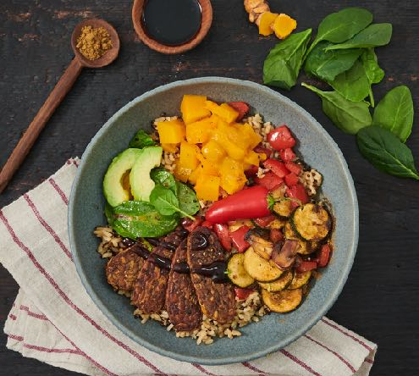
Simple Vegetarian Bowl
This bowl meal is has so many wonderful flavors and textures. You will want to make it again and again. Based on grains it is topped with raw and cooked veggies and fried tempeh slices. You can use any protein or any variety of veggies.
Ingredients:
1-1/2 cups cooked brown rice
6 ounces tempeh, sliced
1 tablespoon olive oil
1 tsp low-sodium Tamari sauce
1/2 avocado, peeled and sliced, pit removed
2 cups butternut squash, roasted cubed
1 cup zucchini
1/4 cup sliced mushrooms
1/4 cup bell pepper, red, sliced
1 cup lettuce
1 tablespoon salad dressing
Drizzle balsamic vinegar
1/2 hot pepper, 2 tsp fresh cilantro, and 1/2 quartered lime for garnish, optional
Directions:
You can cook the brown rice and quinoa in a rice cooker or on the stove following the package directions.
Cook the tempeh in a medium-hot skillet with the olive oil. Don’t make the pan too hot. Brown on both sides, splash with the Tamari sauce, and remove from the heat.
Sauté the vegetables.
Assemble the bowls as pictured, dividing the ingredients between two bowls. Place the grains in the bowl first. Top with the cooked tempeh, add the veggies, toss the lettuce in the dressing and place under the avocado slices. Garnish with hot pepper and optional lime and cilantro. Serve immediately.
Serves 2. Each 3 cup bowl: 543 calories, 26 f fat, 4 g saturated fat, 4 g saturated fat, 268 mg sodium, 0 mg cholesterol, 56 g carbohydrate, 12 g sugar, 14 g fiber, 22 g protein,.

Slide 4
Sustainable Eating Made Simple
Sustainability is a complex global issue that centers around solving global warming and feeding future population growth. The good news is that there are many things we can do as consumers to make small changes that have a significant impact. Our health will benefit, too. Pick a few items on this list and see what works for you.
Better Food Choices
Overall local produce, locally made food, and more plant-based ingredients have a lower environmental impact. Meat has one of the most significant environmental impacts because of the methane gases produced. Choose grass fed, humanely raised meat and try to cut back on its use. Here are some common foods on the Top 50 Sustainable Foods List.
Oats and grains
Beans and lentils
Local fruits and veggies in season
Ugly fruits and veggies
Upcycled foods
Seaweed and algae
Greens
Mushrooms
Nuts and seeds
Potatoes, tubers, roots
Reduce Waste
By wasting less food, you help keep the trash dumps and your local community cleaner. Rotting food adds greenhouse gases to the environment. Food waste all begins with buying too much food, so it is best to plan meals and only buy what you need. That lowers your food cost, too.
Choose Sustainable Partners
Choosing more sustainable-minded companies when it's time to shop is a good idea. This strategy benefits everyone in the long run. We can support those who make better packaging, waste less, and treat their employees, environment, communities, and vendors respectfully—research before you buy.
For more information:
https://www.usda.gov/foodlossandwaste
https://www.upcycledfood.org/
https://www.knorr.com/content/dam/unilever/knorr_world/global/online_comms_/knorr_future_50_report_online_final_version-1539191.pdf

Slide 5
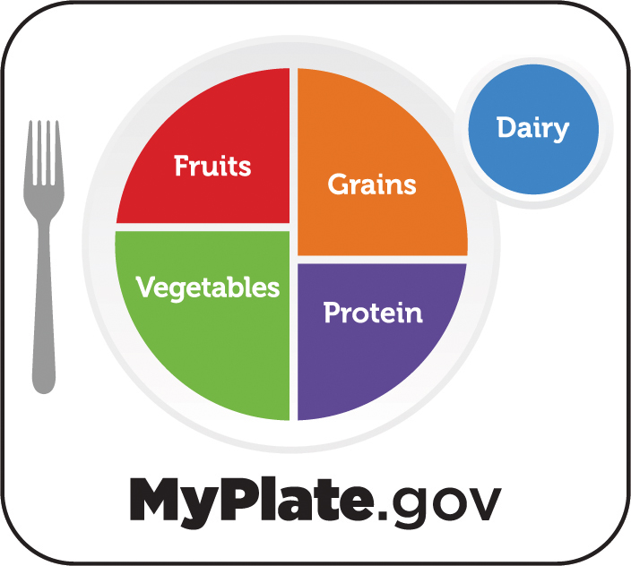
MyPlate for National Nutrition Month®
The theme for National Nutrition Month® this year is “Fuel for the Future,” and MyPlate’s messages dovetail beautifully. MyPlate is 3/4 plant based. Here are tips to make it about sustainability.
#1: Fill Up Half Your Plate With Fruits and Veggies Thinking Locally and In Season: MyPlate’s main message for fruit and vegetable consumption is that variety is key (and fun!). Use National Nutrition Month® to kickstart your produce explorations by trying a new-to-you vegetable that is also good for the earth.
Seaweed, mushrooms, and local produce in season are at the top of the list along with beans, pulses and legumes. Let a variety of fruits and veggies be fuel for your body and the future!
#2: Go for Unique Whole Grains: According to the latest research, ancient whole grains are good for more than just health. They’re also being touted for their sustainability.
Since MyPlate advises people to make at least half of the grains they eat whole grains every day, these ancient grains offer the perfect way to try fun new foods that fuel the future during National Nutrition Month®.
Have you ever tried teff? Or amaranth? You’d be surprised how many grocery stores stock them; there are endless preparation possibilities.
#3: The Future is Now with Fun New Protein Foods: Pulses like beans, lentils, and peas regularly top the “most-sustainable foods” lists. It’s still tough to access lab-grown meats, but plant-based burgers and more are flying off the shelves. If you like meat, try to pick more grass-fed choices. Fueling for the future means being aware and making better choices as you can. Plant-based proteins like beans, legumes, and peas are better for you and the environment.
#4: Plant-based milk products are chocked full of calcium. Read labels to find the ones best for you. MyPlate.gov offers a full list of suggestions for good calcium choices online.
By Judy Doherty, MPS, PCII
For More Information:
Check out the homepage for National Nutrition Month®:
https://www.eatright.org/national-nutrition-month
And MyPlate:
https://www.myplate.gov/

Slide 6
Research: Refined Foods Increase Obesity
University of Sydney’s (USYD) Charles Perkins Centre (CPC) researched and used data from the National Nutrition and Physical Activity Survey (NNPAS), acquired from the Australian Bureau of Statistics, to support the “protein leverage hypothesis.” The hypothesis hints that our bodies have a strong appetite for protein, but we overeat fats and carbohydrates. As our current diets are full of highly processed foods that are low in protein, people over-consume energy-dense food until their protein demand is met.
Refined Foods Lack Protein and Increase Cravings Lead author Dr. Amanda Grech, a postdoctoral research fellow at the CPC and the university's School of Life and Environmental Sciences department, believes that dietary protein is watered down by the consumption of highly processed junk food. This raises a person’s risk for being overweight and obese, which may in turn lead to chronic illnesses. Professor David Raubenheimer, the Leonard Ullmann Chair in Nutritional Ecology at the School of Life and Environmental Sciences, agrees that human bodies are trying to meet a protein target in terms of what they eat. Food in the Western diet has less protein, so we eat more of it to obtain the protein our bodies crave.
Protein is Vital to Good Health The data from the NNPAS, which studied the nutrition and physical activity of 9,341 adults with an average age of 46.3 years from May 2011 to June 2012, found that the mean percent of energy from protein was 18.4%. 43.5% of energy came from carbohydrates, 30.9% from fat, 4.3% from alcohol, and only 2.2% from fiber.The study plotted calorie intake versus the time of consumption. The researchers discovered that those who ate lower amounts of protein in the morning ate more calories at subsequent meals, while those who ate adequate protein declined more food throughout the day. This finding is the “protein leverage hypothesis”.
Hunger for Protein Increases Overeating By the third meal of the day, there was a statistically significant difference in the two groups of the study. Individuals who consumed more protein earlier in the day had less overall calorie intake. Those who ate lower protein foods at the beginning of the day had higher overall calorie intake, suggesting they were trying to compensate for the lack of protein. This occurred even though both groups had a small initial meal and a large final meal. Subjects with a lower protein intake than recommended ate more energy-dense foods high in sugar, saturated fat, salt, or alcohol during the day and less of the recommended number of servings of grains, vegetables, legumes, fruit, dairy, and meats. Their diets were of poor quality overall, and the percentage of protein was not met even as discretionary food intake increased. This is known as “protein dilution”.
By Lisa Andrews, MEd, RD, LD
A recent Australian study, published in the Journal of Obesity, adds more evidence that an increase in the consumption of refined and highly processed foods due to lack of protein intake are one of the root causes of obesity.

Slide 7
Make the Best of the Body’s Protein Drive
Food in a typical Western diet has less protein than in other eating patterns, so we tend to eat more to obtain the protein our bodies crave.
The protein dilution effect has been observed in other studies, including randomized controlled trials. However, the findings of trials have their limitations. "The problem with randomized controlled trials is that it treats diet as a disease when it's not," said Dr. Grech. "Laboratory studies may not be indicative of what people are actually eating and doing at a population level. This study, however, is important as it builds on work, showing that people do seek out protein. And it confirms that, at a population level, as the proportion of energy from protein increases in the diet, people consume less fats and carbohydrates."
Several factors contribute to weight gain including diet habits, physical activity levels, and sleep. The scientists from USYD note that the main driver of calorie overconsumption and obesity in the Western world is related to the body’s demand for protein and the lack of it in highly refined foods.
If you’re struggling with overweight or obesity, try the following…
High-protein foods -- especially at the start of the day. Eggs, low-fat cottage cheese, Greek yogurt, or breakfast quinoa are good starters.
Add protein powder or Greek yogurt to smoothies or oatmeal to increase protein content.
Reduce consumption of refined grains such as muffins, bagels, breakfast “cookies,” or granola bars.
Include lean protein throughout the day. Add beans or legumes to salads and soups.
Snack on hard-boiled eggs or light string cheese with whole grain crackers in place of chips or treats.
Choose low-fat cow’s milk or soymilk over almond or coconut milk for higher protein quality.
Balance meals with plenty of vegetables, fruit, whole grains, beans, and legumes.
Include nuts and seeds in your diet for healthy fats and small amounts of protein.
Reference:
Amanda Grech, Zhixian Sui, Anna Rangan, Stephen J. Simpson, Sean C. P. Coogan, David Raubenheimer. Macronutrient (im)balance drives energy intake in an obesogenic food environment: An ecological analysis. Obesity, 2022; 30 (11): 2156 DOI: 10.1002/oby.23578
By Lisa Andrews, MEd, RD, LD

Slide 8
Should You Be Drinking Kombucha?
You’ve probably seen colorful bottles of kombucha in the supermarket. What are these concoctions that tout all kinds of health benefits? Should you include them in your eating pattern?
Kombucha is an ancient beverage that starts with black or green tea and sugar. After yeast and bacteria are added, the mixture ferments for a period of time, usually at least a week. This fermentation process produces a fizzy, tangy drink. Other ingredients, such as fruit and vegetable juices, herbs, spices, and flavorings, may be added to kombucha after fermentation to broaden its appeal.
Is Kombucha Healthy? Kombucha contains ingredients considered to promote health, including probiotics, antioxidants, and antibacterial substances. But is it healthy?
Well, here’s what we know: For mice and rats, research shows that kombucha has antimicrobial properties, promotes gut health and immunity, prevents cancer, heart disease, diabetes, obesity, neurodegenerative diseases, and more.
And here’s what we don’t know: Do the benefits of kombucha translate to humans? How much do you need to drink to get benefits? How often do you need to drink it?
However, kombucha is in the family of fermented foods and beverages that include kefir, yogurt, and sauerkraut. One study involving humans found that people who ate a diet high in fermented foods had a wider variety of bacteria in their GI tract and decreased inflammatory markers.
Safety Note: Unless kombucha is pasteurized, it is a raw product that could pose a risk to pregnant and lactating women and anyone who is immunocompromised. Most kombucha at the supermarket is refrigerated and should be kept chilled after opening. Be especially careful with homemade kombucha.
The Bottom Line: Fermented foods and beverages appear to have some health benefits as evidenced by the study that found lower inflammatory markers and more diversity of bacteria in the gut. Kombucha won’t make up for the typical American diet, but low-sugar fermented foods can be a healthy addition to your eating pattern.
By Hollis Bass, MEd, RD, LD
Sugar: A bottle of kombucha at the supermarket may have more than 20 grams of added sugar, but there are plenty of options with a lot less.
Calories: Per serving, kombucha ranges from 20 to 80 calories.
Caffeine: Some kombuchas have as much caffeine as decaf coffee while others contain the amount found in many colas. Check the label or company website.
Alcohol: Kombucha will contain some alcohol. Anything over 0.5% alcohol by volume (ABV) is considered an alcoholic beverage. But one study found the ABV of nine brands of kombucha ranged from 0% to 1.29%.

