Slide 1
January 2023
Nutrition
NEWSLETTER
Inside:
Curry Chicken Over Thai Rice Noodles by Judy Doherty, MPS, PC II
Sicilian Sweet Potato Pasta Bowl by Judy Doherty, MPS, PC II
Cooking Oils 101 by Lynn Grieger, RDN, CDCES, CHWC, CPT
The Health Impact of Cooking Oils: A Comparison by Lynn Grieger, RDN, CDCES, CHWC, CPT
Cooking Oil Smoke Point Chart by Lynn Grieger, RDN, CDCES, CHWC, CPT
When Is a Change in Weight Appropriate for the Prevention of Diabetes? by Lisa Andrews, MEd, RD, LD
Do Foods Need to be Colorful to be Healthful? by Lynn Grieger, RDN, CDCES, CHWC, CPT
Brought to you by:

Slide 2
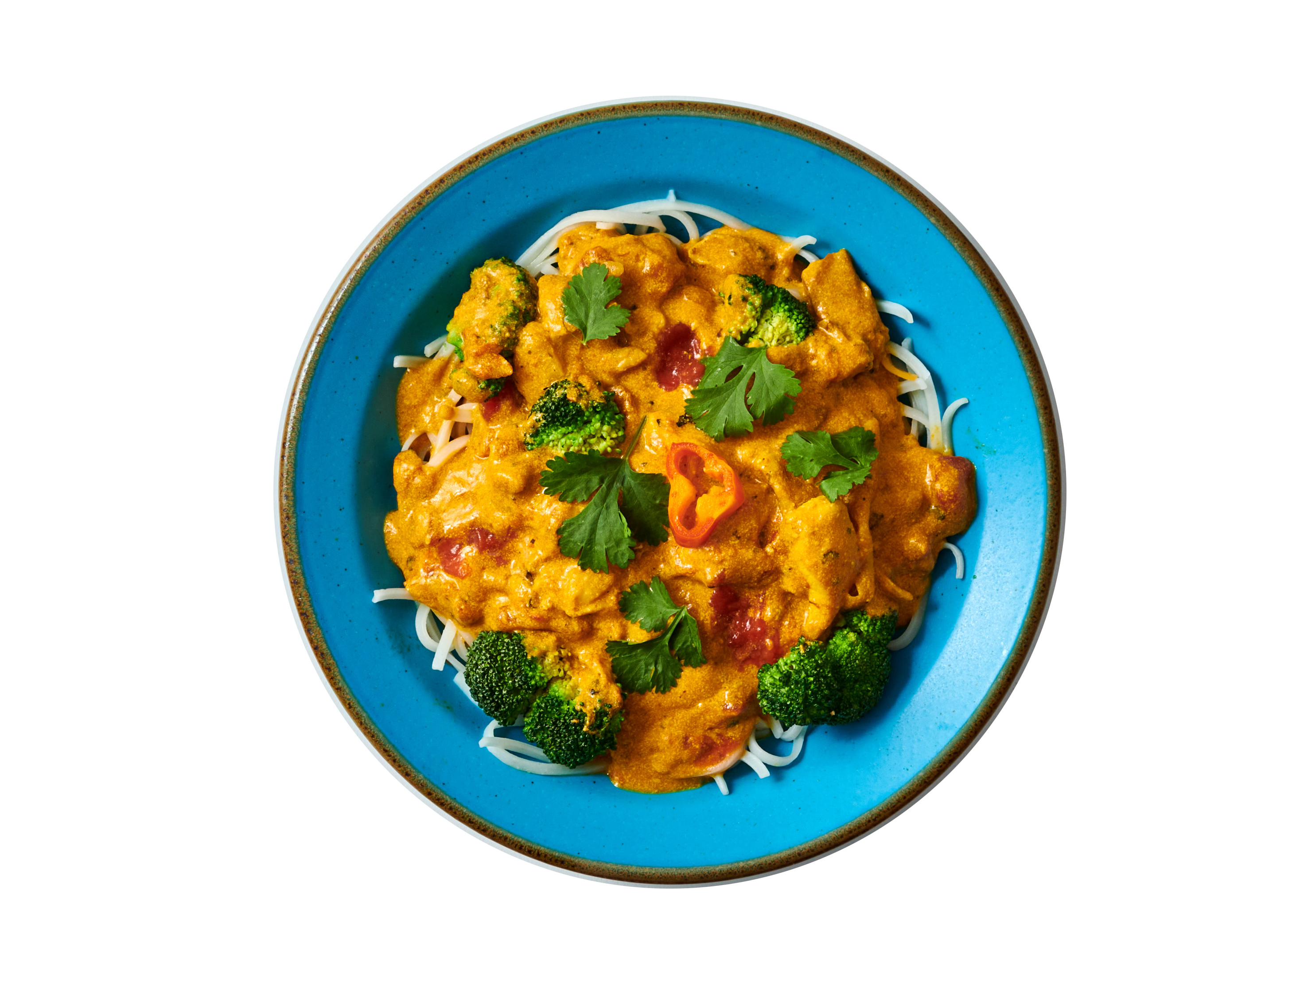
Chicken Curry Over Thai Noodles
Ingredients:
1 tsp olive oil
1 each onion peeled and diced
2 cloves garlic peeled and minced
8 ounces chicken thighs boneless, skinless, cut in small cubes
1 can diced tomatoes drained
1/2 can pumpkin puree
1 can evaporated milk
1 tsp turmeric or more depending on your taste
1/2 tsp ground ginger
1 tsp garlic powder or garlic seasoning
8 ounces Thai rice noodles cooked according to package directions
1 sprig cilantro fresh, for garnish
Directions:
Cook the Thai noodles according to the package instructions. We like to bring a pot of water to a boil, add the noodles, then turn off the stove and cover the pot. in 4-5 minutes, they are ready, just drain.
Meanwhile make the curry. Heat a large Dutch Oven pan over medium-high heat. Add the olive oil. Sauté the onions and garlic until translucent, about 3 minutes.
Add the chicken pieces and stir, cooking quickly. Add the tomatoes and coconut along with the seasonings. Keep stirring and cooking.
Add the evaporated milk. Bring to a boil. Reduce to a simmer. Cook for about 20 minutes or until the chicken is cooked and the sauce is thickened. Thin the sauce with a little broth or water if needed.
Serve the hot curry over the Thai noodles. Garnish with sprigs of cilantro. Enjoy! Nutrition Facts:
Serves 4. Each 1/2 cup serving: Calories: 30kcal | Carbohydrates: 6g | Protein: 1g | Fat: 1g | Saturated Fat: 0.1g | Polyunsaturated Fat: 0.1g | Monounsaturated Fat: 0.4g | Sodium: 13mg | Potassium: 263mg | Fiber: 1g | Sugar: 4g | Vitamin A: 592IU | Vitamin C: 27mg | Calcium: 13mg | Iron: 1mg
Chef's Tip:
You can also use regular spaghetti noodles in place of the Thai rice noodles.

Slide 3
Sicilian Sweet Potato Pasta Bowl
Tomato sauce, white beans, garlic, and sweet potatoes make a savory and spicey pasta bowl dinner.
Ingredients:
8 ounce package of sweet potato pasta or any of your favorite vegetable pasta
1 jar marinara sauce
1 cup canned tomatoes, strained
1 cup white beans canned, drained
1 each sweet potato baked or microwaved until done, peeled and diced
1 each head of cauliflower sliced and roasted in the oven
1 tsp olive oil
Directions:
Cook the pasta according to the package instructions. Drain and reserve.
Slice a head of cauliflower into 1/2 inch thick pieces. Spray with a little oil. Place on a roasting pan and place in a 375 degree oven. Cook for 20 minutes until golden brown. Break up into pieces.
Heat the white beans in a bowl in the microwave.
Prepare the sweet potato. Microwave on high for 5 minutes or until done. Peel and dice.
Heat the marinara sauce. Add a pinch of cayenne pepper.
Prepare the pasta plates: Place the cooked veggie pasta on the plate. Top with the sauce, cauliflower, white beans, and sweet potatoes. Serve hot with more sauce to the side.
Serves 4. Each 1 cup serving: Calories: 340kcal | Carbohydrates: 63g | Protein: 15g | Fat: 4g | Saturated Fat: 1g | Polyunsaturated Fat: 1g | Monounsaturated Fat: 2g | Trans Fat: 0.04g | Cholesterol: 48mg | Sodium: 906mg | Potassium: 1009mg | Fiber: 8g | Sugar: 9g | Vitamin A: 877IU | Vitamin C: 18mg | Calcium: 103mg | Iron: 5mg

Slide 4
Cooking Oils 101
How do you decide which type of cooking oil to use? Perhaps you have one type of oil you like to use when sautéing vegetables and another for baking? There are a variety of different types of oils we can choose from and loads of things to consider.
What are Cooking Oils?
Cooking oils are made from plants or animals, and are used in baking, sautéing, frying, and in recipes like salad dressings.
Plant oils include avocado, canola, chia, corn, cottonseed, flaxseed, hemp, olive, palm tree, palm kernel, peanut, sesame, soybean, sunflower, coconut, safflower, grapeseed, rice bran, and walnut. Vegetable oil is typically a blend of two or more different types of plant oils, such as corn and sunflower.
Animal fat and animal products can be made into cooking oils. These include butter, ghee, lard (e.g., pork fat, duck fat, etc.) and tallow (e.g., beef, mutton).
Any type of oil can become rancid when exposed to oxygen, heat, and light, so if the oil smells off, throw it out!
For food safety reasons, don’t reuse cooking oil. Oils high in polyunsaturated fats such as flaxseed, chia seed, hemp, sesame and nut oils oxidize more quickly and should be kept in the refrigerator.
Let's Talk Cost
Just like other types of foods, the price of oils used in cooking has increased dramatically over the past two years.
Part of the reason for the increase is the fuel industry is buying large amounts of soybean, canola, and palm oil which has caused these prices to double or triple.
According to the Economic Research Service of the US Department of Agriculture, grocery store food prices in general are 13% higher in September 2022 vs September 2021 and are expected to continue to increase into 2023.
Nut, avocado, and extra-virgin olive oil tend to be more expensive than safflower, sunflower, or canola oil.
By Lynn Grieger, RDN, CDCES
To Save Money on Cooking Oils:
Choose store brands that offer the same quality at a lower price.
Larger chain stores like Walmart, Target, and Costco tend to have lower prices for all types of oils.
Use more expensive oils as drizzles on top of salads or in sautéed veggies. That way, you'll get the most flavor bang for your buck.
Use the less expensive refined oils for baking.

Slide 5
The Health Impact of Cooking Oils: A Comparison
All cooking oils are 100% fat, but the type of fat varies. Oils contain different ranges of saturated, polyunsaturated, and monounsaturated fats.
Saturated fat is more solid at room temperature and is known to contribute to increased risk of heart disease. Oils high in saturated fat include butter, ghee, lard, tallow, palm tree, palm kernel, cottonseed and coconut.
Trans fats are created through hydrogenation, a process that takes oil that was liquid at room temperature (unsaturated) and turns it into solid fat (saturated). For example, liquid vegetable oil contains no trans fats, but when it’s hydrogenated into solid vegetable shortening, trans fats are created.Heating oil to high temperatures over a longer period of time, such as deep-frying foods in commercial kitchens, also creates trans fatty acids. Trans fats are bad news for our health because they increase cholesterol levels, create inflammation that is associated with stroke, diabetes, and heart disease; and contribute to insulin resistance and diabetes. According to Harvard Health Publishing, for every 2% of calories from trans fat consumed daily, the risk of heart disease rises by 23%. The current recommendation is to completely avoid trans fats in foods.
Polyunsaturated fats are considered essential fats because they're required for normal body functions, but since your body can't make them, we have to get them from our foods. There are two main types of polyunsaturated fats: omega-3 fatty acids and omega-6 fatty acids.
Omega-3 fatty acids help form the structure of cell membranes and are found in higher concentrations in the eye, brain and sperm. They also play important roles in cardiovascular health. Good sources of omega-3 fatty acids include fatty fish such as salmon, mackerel, and sardines, flaxseeds, walnuts, canola oil, and un-hydrogenated soybean oil. Omega-6 fatty acids help decrease inflammation and are important in blood clotting. Foods rich in linoleic acid and other omega-6 fatty acids include vegetable oils such as safflower, soybean, sunflower, walnut, and corn oils.
Monounsaturated fats can help reduce risk of cardiovascular disease and also contribute vitamin E to our diets. Good sources of monounsaturated fats are olive oil, peanut oil, canola oil, avocados, and most nuts, as well as high-oleic safflower and sunflower oils.
The American Heart Association recommends choosing oils with <4gm saturated fat per tablespoon and no hydrogenated or trans fats, choosing polyunsaturated and monounsaturated oils the majority of the time to promote health.
By Lynn Grieger, RDN, CDCES, CPT, CHWC
When it comes to selecting which oil you're going to use for your cooking project, it turns out that flavor is only one of many considerations. Here's everything you need to know about the health impact of various cooking oils...

Slide 6
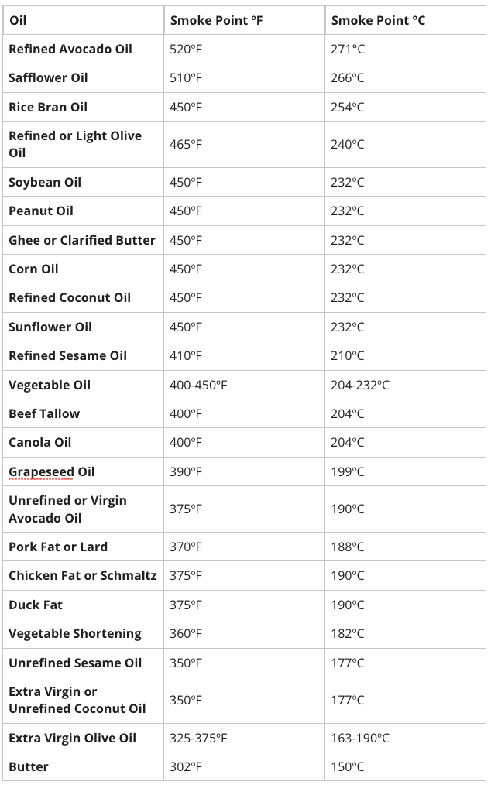
Cooking Oil Smoke Point Chart
The smoke point of oil is the temperature at which it stops shimmering and starts smoking. The smoke point is also called the burning point of oil and can range from relatively low (325 F) to very high (520 F). When oil smokes, it can release chemicals that give food an undesirable burnt or bitter flavor, as well as free radicals that can harm the body.
By Lynn Grieger, RDN, CDCES, CPT, CHWC

Slide 7
When Is a Change in Weight Appropriate for the Prevention of Diabetes?
For individuals with obesity, dropping 10 pounds or more may make a world of difference in reducing the risk of type 2 diabetes, at least according to a recent study of nearly 200,000 people. The method of weight loss does not seem to matter, though the impact of weight change over time is unknown.
The study, conducted by Qi Sun and colleagues from the TH Chan Harvard School of Public Health, included healthy subjects from three prospective cohort studies spanning 1988 to 2017. Participants were between the ages of 24 and 78 and were mostly female.
Strategies that led to weight loss of 4.5 kg or more were grouped into seven categories: low-calorie diet, exercise, low-calorie plus exercise, fasting, commercial weight loss program, diet pills, and a combination of fasting, commercial diet, and diet pills.
The most effective weight loss method for long-term weight control in those with obesity was exercise. Exercise was also linked with the least weight gain after four years -- 4.2% overall average less weight than at baseline in those with obesity, 2.5% weight loss in overweight subjects, and .4% in lean subjects.
For commercial diet + diet pills, the results were the opposite -- those with obesity sustained a .3% weight loss, overweight subjects had 2% more weight gain and lean participants had 3.7% more weight gain.
The risk for diabetes 24 years later for those with obesity, regardless of weight loss method used ranged from 21% less in those using exercise to 13% in those using diet pills. In overweight subjects, a 9% reduction was noted in those doing exercise, and a 42% increase was noted in those who took diet pills as well as lean individuals. In lean individuals, weight loss was linked with an increased risk for type 2 diabetes -- with a range of 9% with exercise and 54% in diet pill use or commercial weight loss methods
The authors note that weight loss is beneficial in overweight and obese individuals, but does offer the same benefits in lean individuals. Weight loss should not be advised unless medically necessary.
By Lisa Andrews, MEd, RD, LD

Slide 8
Do Foods Need to be Colorful to be Healthful?
While choosing a rainbow of colors of fruits and vegetables provides a wide variety of phytonutrients that the plants make to protect themselves (and which also benefit our overall health), many people forget that white foods fit into a rainbow of color too!
Onion, garlic, leeks and shallots are in the group of allium vegetables that have been shown to decrease risk of gastric cancer and help lower cholesterol due to containing flavonoid and polyphenol antioxidants.
Our Tip: Liberally add these flavorful veggies to a variety of recipes like stir-fries, soups and stews, roasted vegetables, and sauces.
Cauliflower is a descendant of the wild cabbage, Brassica oleracea, and part of the cruciferous family of vegetables (which includes Brussels sprouts, broccoli, and cabbage), named for their unique cross-shaped leaves.
Cruciferous veggies contain antioxidants such as glucosinolates, polyphenols, and flavonoids that help to decrease inflammation associated with chronic disease such as diabetes and heart disease. A 2022 meta-analysis review of 57 articles showed that cruciferous vegetables such as cauliflower are associated with a reduced risk of all-cause mortality, cancers, and depression.
Our Tip: Enjoy raw or slightly steamed cauliflower to get the most benefit from the health-promoting compounds and antioxidants, which are lost during boiling.
If you haven’t tried parsnips, give them a chance! A member of the carrot family, these root vegetables have a slightly sweet, nutty flavor. A 2021 review of 46 published articles showed that parsnips contain anti-inflammatory, antispasmodic, vasodilator, antifungal, antimicrobial and antidepressant properties.
Our Tip: Look for small- and medium-width roots for the best flavor and texture. Larger roots tend to have a woody texture and are more fibrous. Parsnips taste sweeter when cooked, and can be added to soups and stews, roasted, or baked.
By Lisa Andrews, MEd, RD, LD

