Slide 1
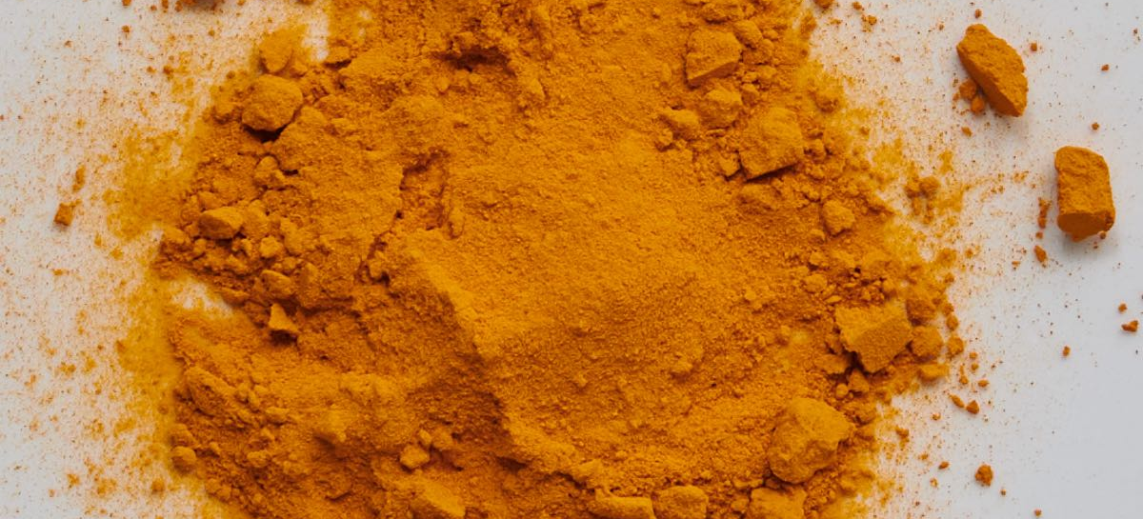
February 2024
Nutrition
NEWSLETTER
Inside:
Brought to you by:
Turmeric Chicken Stew
Golden Milk Latte
Curcurmin for Dinner?
Health Benefits of Turmeric
AHA Prevent Calculator is Coming
Lowering Risk for Heart and Kidney Disease
Bored Kids Eat More
Helping Kids Stay Busy and Have Healthier Habits
A heart-healthy diet in mid-life may mean less cognitive decline later in women

Slide 2
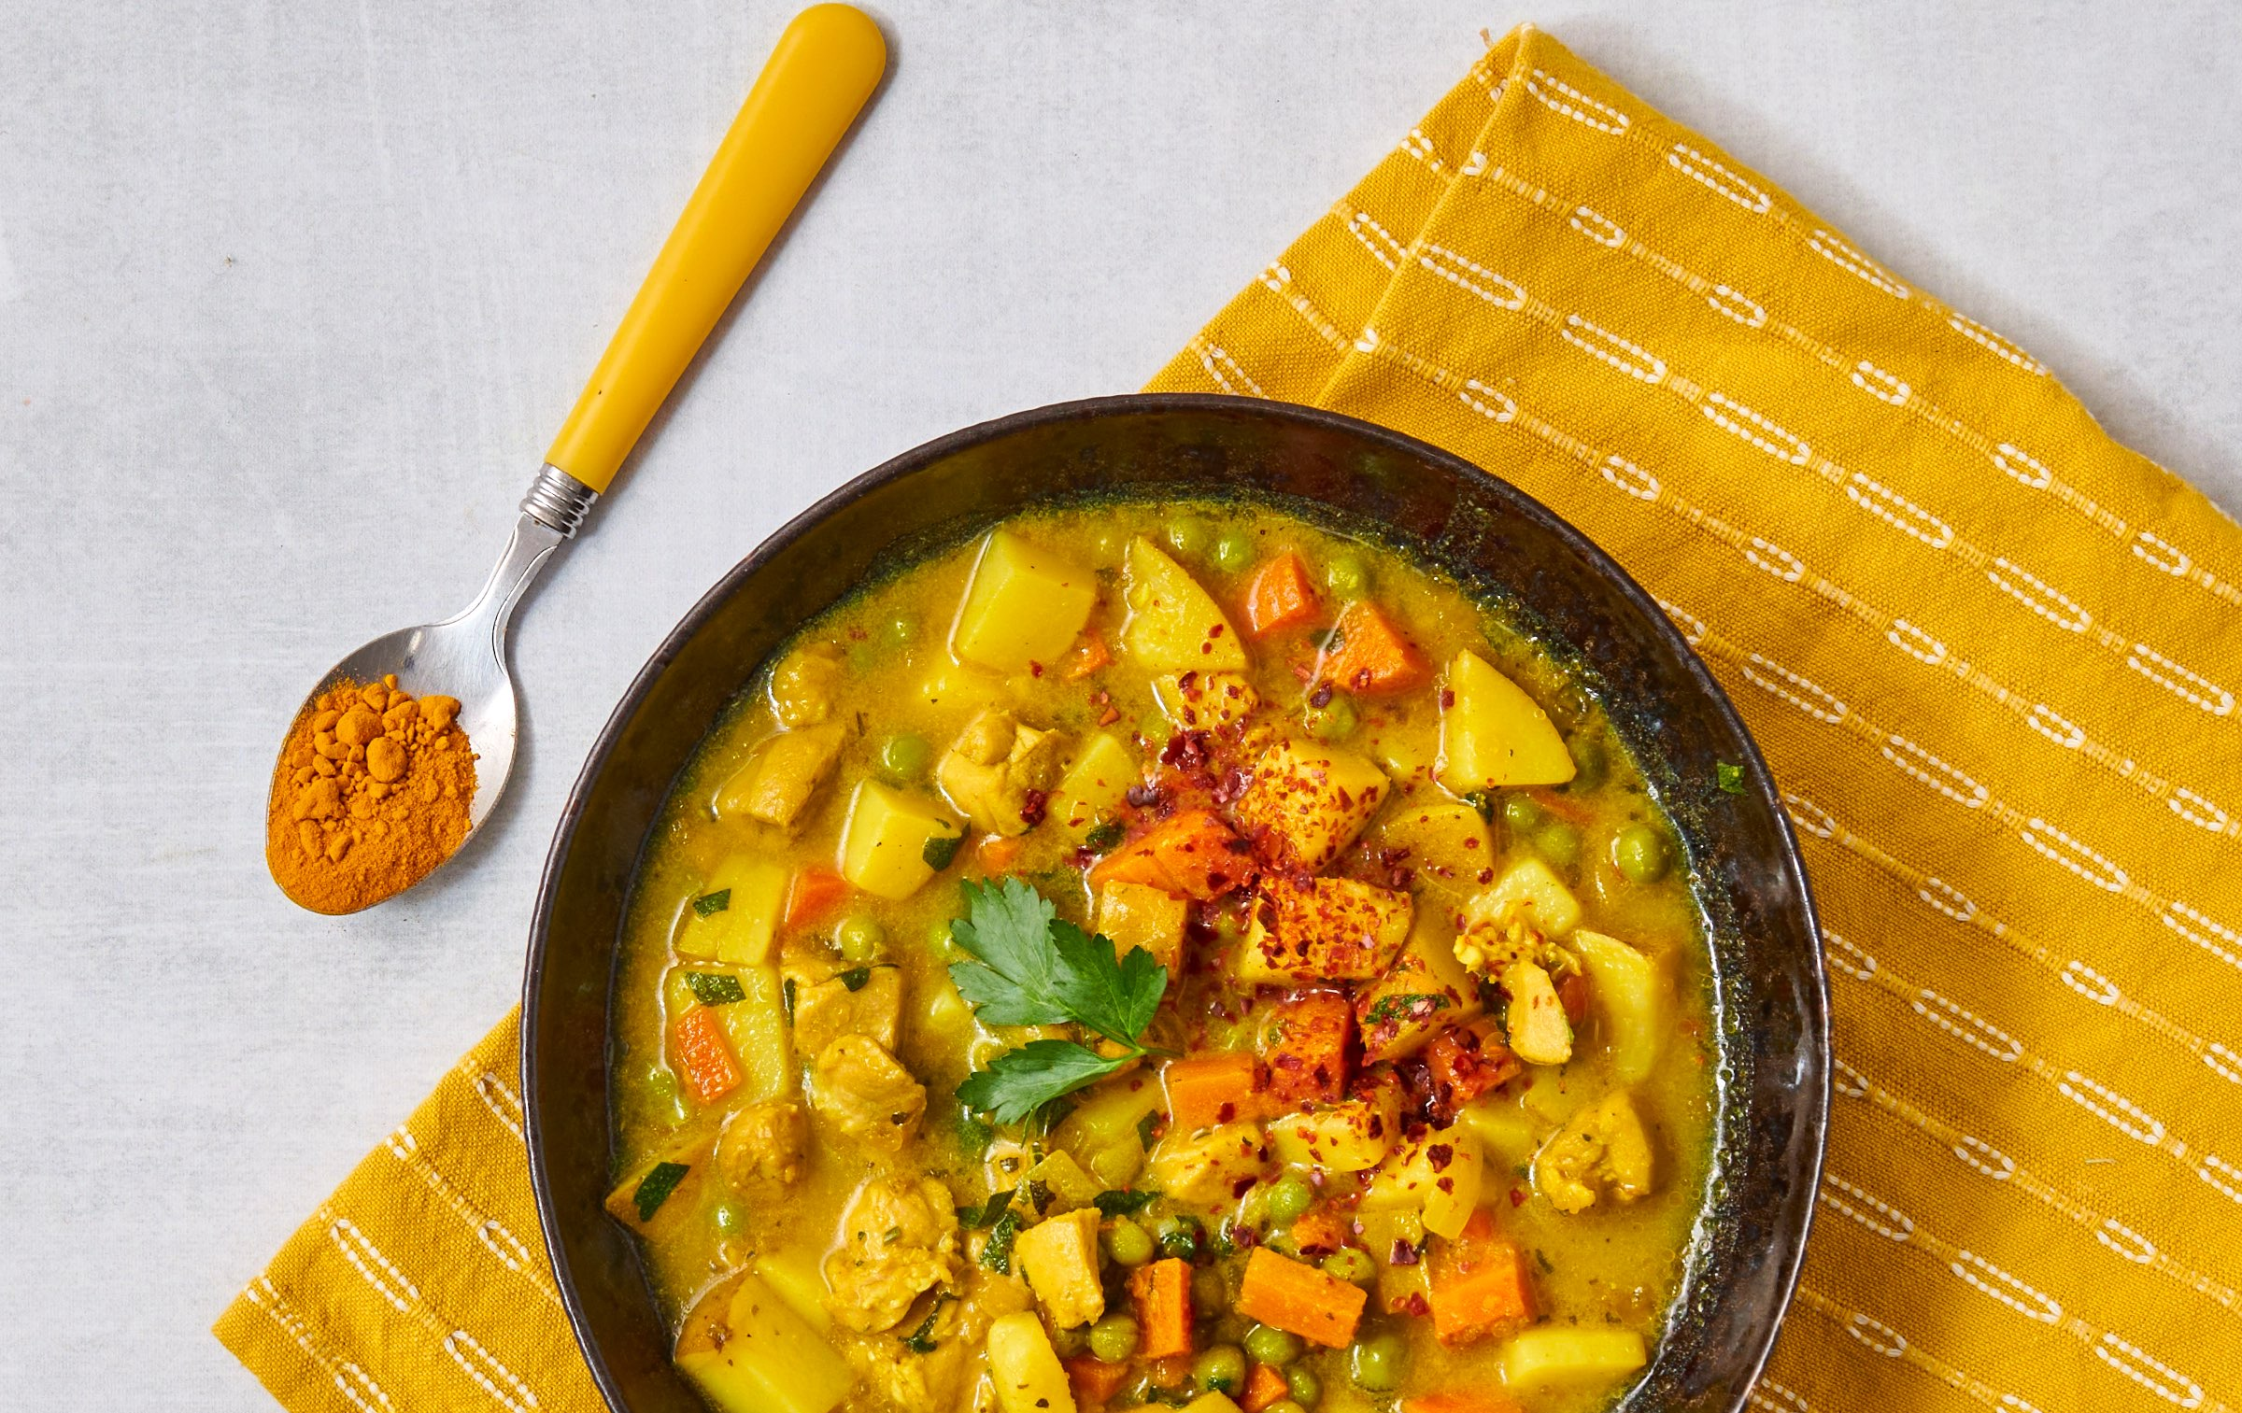
Turmeric Chicken Stew
INGREDIENTS
1 tsp olive oil
1 onion, peeled and diced
2 carrots, rinsed and diced
1 tsp minced garlic
1/2 cup diced peppers
4 cups low-sodium vegetable broth (or chicken broth)
2 boneless skinless chicken thighs, diced
2 cups diced potatoes
2 tsp Italian seasoning (salt-free)
2 tsp ground turmeric
1 pinch red pepper flakes or Aleppo pepper flakes
1/4 cup chopped fresh parsley
INSTRUCTIONS
Heat a large Dutch oven over medium heat. Add the oil and saute the onions, carrots, peppers, and garlic for a few minutes.
Add the broth, chicken, potatoes and all seasonings except the parsley.
Bring to a boil, cover, and lower the heat to a simmer.
Cook for 25 minutes or until the chicken is done and the potatoes are tender.
Top with chopped parsley and serve hot.
You can freeze leftovers in portion sized containers for future use.
Serves 6. Each 1 cup serving: 209 calories, 4 g fat, 1 g saturated fat, 54 mg cholesterol, 83 mg sodium, 30 g carbohydrates 6 g fiber, 5 g sugar, 15 g protein.

Slide 3
Golden Milk
Ingredients:
1 cup skim milk
1 teaspoon ground turmeric
1/2 teaspoon ground cinnamon
1/4 teaspoon ground ginger
1 teaspoon honey or maple syrup
A pinch of black pepper
Directions:
In a small saucepan, whisk together the milk, ground turmeric, ground cinnamon, ground ginger, honey or maple syrup.
Place the saucepan over medium heat. Stir the mixture continuously to ensure even heating. Do not bring it to a boil; just heat until it's warm.
Towards the end of heating, add a pinch of black pepper. This enhances the absorption of curcumin, the active compound in turmeric.
If you prefer a smoother texture, you can strain the mixture using a fine mesh strainer to remove any undissolved spices.
Pour the golden milk into a mug and enjoy. You can adjust the sweetness and spice levels to your liking.
Serves 1. Each serving: 114 calories,0 g fat, 0 g saturated fat, 7 mg cholesterol., 0 g trans fat, 102 mg sodium, 19 g carbohydrate, 0 g fiber, 9 g protein.

Slide 4
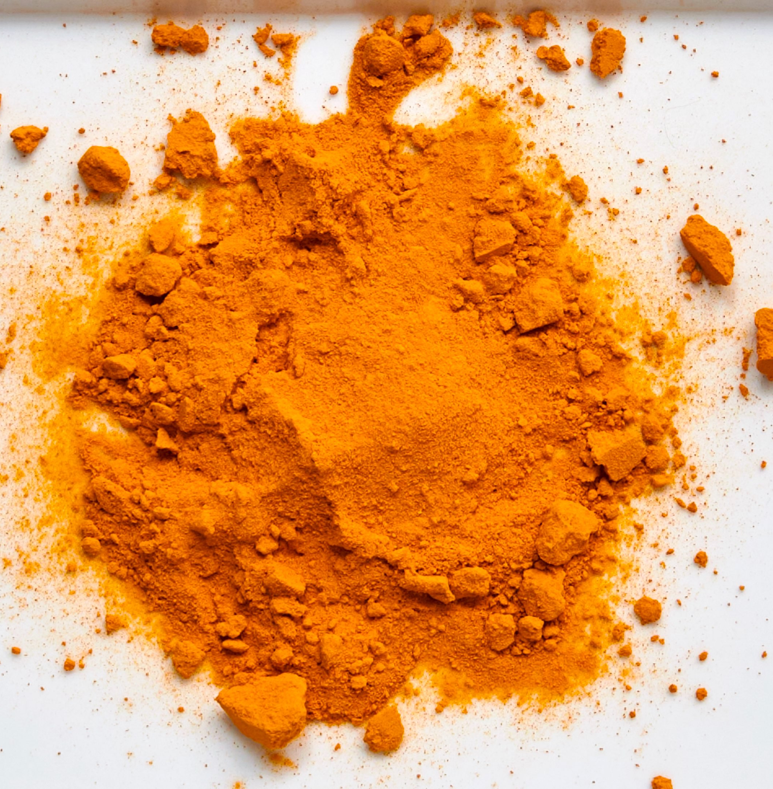
Curcurmin For Dinner?
Most people have heard of turmeric but might not have heard of the fancy name curcumin, the active health-enhancing ingredient found in it. Curcumin is a polyphenol found in the spice turmeric. Turmeric, a bright yellow spice commonly used in Indian cuisine, has been recognized for its numerous health benefits and versatile uses. The active compound in turmeric, curcumin, is responsible for many of its therapeutic properties.
Flavor
Turmeric has a warm, slightly peppery taste and earthy, bitter undertone. Its flavor profile is robust and aromatic, imparting a distinct golden-yellow color to dishes. The bitterness is subtle and often balanced by warmth and a mild spiciness. Some describe the taste as mildly pungent, reminiscent of mustard or ginger.
When used in culinary applications, such as curries or stews, turmeric adds depth and complexity to the overall flavor profile of a dish. It is a foundational spice in many spice blends like curry, contributing not only to taste but also to the vibrant color of the final preparation.
In its raw form, the flavor is more intense, while cooking tends to mellow it out somewhat. It's worth noting that turmeric has a staining property, so excessive use can impact the color of foods and surfaces. Overall, the taste of turmeric is distinctive, and it plays a crucial role in defining the flavor profile of various cuisines, particularly in Indian, Middle Eastern, and Southeast Asian cooking.
Uses in Cooking:
Turmeric is a key ingredient in many Indian dishes, providing a warm and slightly bitter flavor. It is a staple in curry powders.
Turmeric can stand in for saffron when you don’t want to spring for the expensive spice. Just mix a little water and pour it into the recipe, and you will have a nice yellow color. 1 tsp in a cup of rice is all that is needed.
Turmeric can be used to make "golden milk," a popular beverage that combines turmeric with milk and other spices for a soothing and nutritious drink. This delicious warm beverage makes a great evening drink or coffee substitute since it is without caffeine.
Turmeric is commonly used to prepare curries, stews, and soups, adding color and flavor.
Use it in chicken noodle soup for a little more color, and use less sodium since it adds a nice, rich flavor.
It can be sprinkled on roasted or sautéed vegetables to enhance taste and appearance. It is also excellent when placed on grilled items along with paprika, garlic, salt, and pepper.

Slide 5
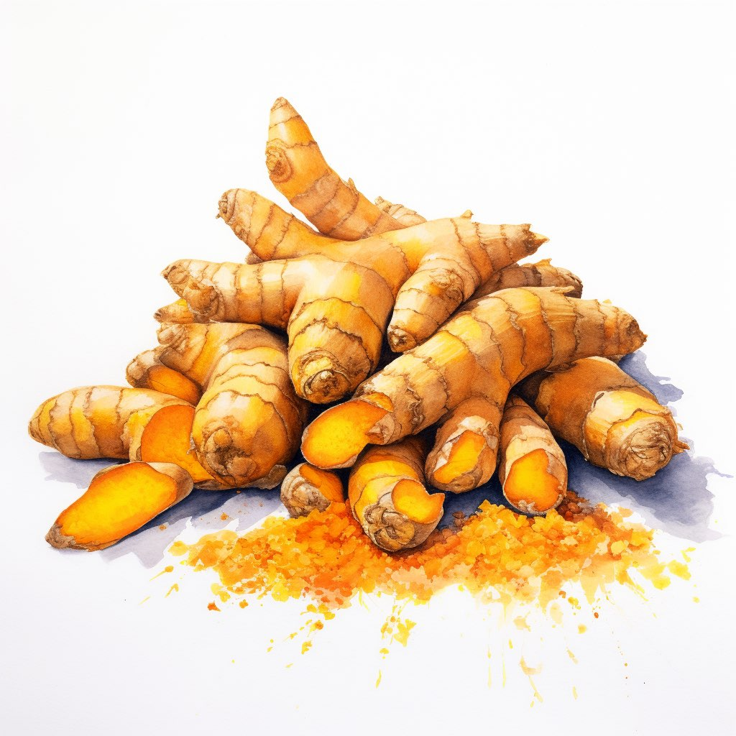
Health Benefits of Turmeric
Many studies have been on animals, and more research is needed. The active ingredient in turmeric as a spice in its natural state is not that concentrated. It's essential to note that while turmeric offers numerous health benefits, it's always a good idea to consult with a healthcare professional before using it for therapeutic purposes, especially in medicinal quantities or as a supplement. Additionally, individual responses to turmeric may vary, and excessive consumption may cause side effects in some people.
Here are some potential health benefits and uses of turmeric:
Anti-Inflammatory Properties: Curcumin, the main active ingredient in turmeric, has potent anti-inflammatory effects. It may help in managing chronic inflammatory conditions.
Antioxidant Activity: Turmeric is a powerful antioxidant, which helps neutralize free radicals in the body. This can contribute to overall health and well-being.
Heart Health: Turmeric may have cardiovascular benefits, such as improving endothelial function and reducing the risk of heart disease. Additionally when using more natural seasonings like turmeric in cooking the ability to lower the sodium used is a benefit which can help lower blood pressure.
Brain Health: Some studies suggest that curcumin may cross the blood-brain barrier and has potential neuroprotective effects, which could be beneficial for brain health.
Digestive Health: Turmeric has been traditionally used to support digestion. It may help reduce symptoms of indigestion and bloating.
Type 2 Diabetes Management: Curcumin may help improve insulin sensitivity and has anti-diabetic effects, potentially aiding in the management of type 2 diabetes.
References:
Shimizu K, Funamoto M, Sunagawa Y, Shimizu S, Katanasaka Y, Miyazaki Y, Wada H, Hasegawa K, Morimoto T. Anti-inflammatory Action of Curcumin and Its Use in the Treatment of Lifestyle-related Diseases. Eur Cardiol. 2019 Jul 11;14(2):117-122. doi: 10.15420/ecr.2019.17.2. PMID: 31360234; PMCID: PMC6659038.
Libby P. Inflammatory mechanisms: the molecular basis of inflammation and disease. Nutr Rev. 2007 Dec;65(12 Pt 2):S140-6. doi: 10.1111/j.1753-4887.2007.tb00352.x. PMID: 18240538.
Written By Judy Doherty

Slide 6
The AHA’s Updated PREVENT Risk Calculator
When the AHA (American Heart Association) speaks, listen up! They recently released an updated cardiovascular risk assessment calculator, which includes factors related to social and kidney health.
The calculator removed race as a factor but included tobacco use, age, sex, and use of medications in reducing CVD risk in their evaluation.
By including race, the authors believe it may suggest that differences by race are non-modifiable and could reinforce race as a biological factor that could exacerbate health disparities. The researchers opted to exclude race as a predictor and emphasize that the PREVENT calculator offers similar accuracy within different ethnic and racial populations.
The predictors also incorporate an option to use the Social Deprivation Index, which includes assessments of adverse social determinants of health like education, poverty, unemployment, and an individuals’ environmental factors.
According to SS Khan, one of the developers of PREVENT, adding CKM (cardiovascular-kidney-metabolic syndrome) plus social factors to the equation is an important initial step to help reduce risk of CVD.
The new calculator is called PREVENT, which stands for Predicting Risk of cardiovascular disease EVENTs. An online tool is being developed.
The scientific statement lists numerous knowledge gaps and areas for future research. These include:
Adding "net benefit" to pinpoint the expected benefit of treatment recommendations based on an individual's level of risk.
Including more data from more diverse race and ethnic populations to better represent the growing diversity in the United States. The amount of Hispanic and Asian people represented in the PREVENT datasets is lower than national estimates in the general US population, so risk assessments in these populations may not be as accurate.
Growing the collection, reporting, and standardization of social determinants of health data, including individual information instead of neighborhood information.
Expanding risk assessment and prevention to childhood and/or adolescence and in key periods of life, including the peripartum period, as adverse pregnancy outcomes are linked with increased CVD risk.
Evaluating whether predicting negative kidney outcomes, especially within people with and without type 2 diabetes, may further pinpoint cardiovascular risk prediction.
Written By Lisa Andrews, MEd, RD, LD

Slide 7
Controllable Lifestyle Habits to Prevent Cardiovascular Disease and Cardiovascular Kidney Metabolic Syndrome
Know your risk factors. See your healthcare provider and get regular labs done including a lipid profile, renal panel, and blood sugar.
· Limit red meat and processed meats. Both have been linked with the development of cardiovascular disease and diabetes.
· Include green leafy vegetables in your diet daily. These aid in managing blood pressure, weight, and blood sugar.
· Add low-fat dairy products to your diet. Calcium helps lower blood pressure as part of the DASH diet and has been linked with a reduced risk of diabetes.
· Choose whole grains over refined grains. In addition to dietary fiber, these provide antioxidants, vitamins, and minerals to reduce chronic disease risk.
· Keep moving. Regular exercise gets your blood flowing and helps manage your weight, blood pressure, blood sugar, and stress levels.
· Get plenty of sleep. Poor sleep is linked with diabetes, hypertension, high cholesterol, and anxiety.
· Avoid fad diets that stress excess protein or fat. Research indicates that these may be harmful to your heart and kidneys.
Lisa Andrews, MEd, RD, LD
References
Khan SS, Coresh J, Pencina MJ, Ndumele CE, Rangaswami J, Chow SL, Palaniappan LP, Sperling LS, Virani SS, Ho JE, Neeland IJ, Tuttle KR, Rajgopal Singh R, Elkind MSV, Lloyd-Jones DM; on behalf of the American Heart Association. Novel prediction equations for absolute risk assessment of total cardiovascular disease incorporating cardiovascular-kidney-metabolic health: a scientific statement from the American Heart Association. Circulation. 2023;148:e•••–e•••. doi: 10.1161/CIR.0000000000001191
Shi W, Huang X, Schooling CM, Zhao JV. Red meat consumption, cardiovascular diseases, and diabetes: a systematic review and meta-analysis. Eur Heart J. 2023 Jul 21;44(28):2626-2635. doi: 10.1093/eurheartj/ehad336. PMID: 37264855.
Lari A, Sohouli MH, Fatahi S, Cerqueira HS, Santos HO, Pourrajab B, Rezaei M, Saneie S, Rahideh ST. The effects of the Dietary Approaches to Stop Hypertension (DASH) diet on metabolic risk factors in patients with chronic disease: A systematic review and meta-analysis of randomized controlled trials. Nutr Metab Cardiovasc Dis. 2021 Sep 22;31(10):2766-2778. doi: 10.1016/j.numecd.2021.05.030. Epub 2021 Jun 10. PMID: 34353704.
Korostovtseva L, Bochkarev M, Sviryaev Y. Sleep and Cardiovascular Risk. Sleep Med Clin. 2021 Sep;16(3):485-497. doi: 10.1016/j.jsmc.2021.05.001. Epub 2021 Jun 25. PMID: 34325825.
Ko GJ, Rhee CM, Kalantar-Zadeh K, Joshi S. The Effects of High-Protein Diets on Kidney Health and Longevity. J Am Soc Nephrol. 2020 Aug;31(8):1667-1679. doi: 10.1681/ASN.2020010028. Epub 2020 Jul 15. PMID: 32669325; PMCID: PMC7460905.

Slide 8
Bored Kids Eat More
Currently, no research evaluating how much children eat when they’re bored has been done. Boredom is a common emotion that many kids experience. The study found that kids who felt bored consumed 95 calories even when they were already full compared to children in neutral moods who ate only 59 calories. Dr Rebecca Stone led the research as part of her PhD. It was supervised by Professor Claire Farrow and Professor Jackie Blissett from Aston University, and Professor Emma Haycraft from Loughborough University.
How Kids Learn to Eat More
Eating behavior in children develops from family history, temperament, and other factors such as feeding rituals they experience. In past studies, the researchers evaluated behaviors that make children more likely to eat when they feel negative emotions.
When kids feel bored or sad, adults may use food to assuage the pain. However, this behavior, known as emotional feeding, may increase the chances of children eating more when they’re upset, possibly teaching children to seek food when they’re feeling down or bored.
Survey of Feeding Practices
Part of the research involved querying parents about the feeding habits that they used with their children and about their child’s emotional state. Kids and parents were fed a standard meal that they consumed until they felt full. Children then participated in a series of typical conditions where their mood was checked. One of the situations was boring for the children.
Researchers discovered that if parents reported using food to quell their child’s feelings frequently and their child was very emotional, they ate five times more calories when feeling bored (104 calories) versus when in a neutral mood (21 calories).
Dr Stone said: "If children are eating this many more calories during one instance of boredom induced in a laboratory (a four-minute period), given that boredom is a commonly experienced emotion in children, the potential for excess calorie intake in response to being bored across one day, one week, or one year, is potentially very significant in a food abundant environment."
Previous Studies
Past research on what impacts eating behavior in kids has usually been based on questionnaires with negative moods (sadness, anger, anxiety) being combined. Boredom is easy to recognize and can be easily fixed. Helping parents cope with their child’s boredom without “feeding into it”, so to speak, would be a helpful way to reduce unwanted snacking.
Dr. Stone emphasizes that experiencing boredom is important in developing a sense of self and creativity in children. He advises that avoiding boredom is not advised. She suggests that children should experience being bored without seeking out food, and parents could try to shift attention from food when their child feels bored. The home environment could also be modified to make it harder for children to seek out food when they’re bored and not truly hungry.
What the Experts Say
Professor Farrow said: "It is commonly assumed that children tend to turn to food when bored and that some children are more likely to do this than others. This is the first study to experimentally test this in the laboratory. Whilst there do appear to be individual differences between children in terms of their eating when bored, it is helpful to know that the feeding practices that adults use around food might shape the likelihood of this happening. Although it is tempting to use food as a tool to comfort children, research suggests that emotional feeding might lead to greater emotional eating in the future. It is important that parents and caregivers are aware that this short-term fix could create future challenges."
Her research team is interested in evaluating other negative emotional states in children and creating advice and support for families to find better ways to deal with eating behavior challenges in children.
Written By Lisa Andrews, MEd, RD, LD

Slide 9
Help Kids Manage Snacking
Below are tips for parents to help kids stay busy and have healthier eating habits.
1. Be a role model. When you’re bored or feeling down, do something creative. Use adult coloring books, journals, or another method to cope.
2. Teach kids to meditate or practice deep breathing. This may help them to calm down and get them to a neutral state of mind.
3. Keep a bin of toys or games to guide children away from seeking food when they’re feeling bored, sad, or other negative emotions.
4. Allow children to eat what’s on their plates without forcing them to finish the food if they’re not hungry.
5. Don’t reward children with food. Did they get a good grade? Give them a sticker or other non-food reward.
6. Keep a jar with craft ideas for kids to do when they’re bored. Crayons, colored pencils, or stickers are inexpensive to have on hand.
7. Use exercise or movement as a way to cope with boredom or other unwanted feelings. Dance, do jumping jacks, or other activities to reduce negative emotions.
8. Remind your kids that boredom is a normal feeling. We all experience it and the feeling will go away.
9. Set aside time each day to explore nature and encourage curiosity. Do physical activities together.
10. Encourage reading when kids are bored. This will spark the love of reading for years to come.
Written By Lisa Andrews, MEd, RD, LD

Slide 10
Research Corner
A heart-healthy diet in mid-life may mean less cognitive decline later in women
Managing blood pressure through a healthy diet isn’t just important for heart health. It may also lead to better cognition in the future, particularly in women, according to a recent study.
The research conducted by scientists from NYU Grossman School of Medicine found that women following the DASH diet (Dietary Approaches to Stop Hypertension) in mid-life were 17% less likely to note loss of memory and other clues of cognitive decline years later. This is important as women make up over two-thirds of individuals diagnosed with Alzheimer’s disease, the most common type of dementia.
The results were published recently in the journal Alzheimer's & Dementia and may impact nearly 6.5 million Americans diagnosed in 2022 with Alzheimer’s disease over the age of 65. The number of people with Alzheimer’s is expected to be more than 13 million by 2060.
According to Yu Chen, PhD, MPH, professor in the Department of Population Health and senior author of the study, "Subjective complaints about daily cognitive performance are early predictors of more serious neurocognitive disorders such as Alzheimer's. With more than 30 years follow-up, we found that the stronger the adherence to a DASH diet in midlife, the less likely women are to report cognitive issues much later in life."
Plant-based foods high in potassium, calcium, and magnesium that limit saturated fat, cholesterol, sugar, and sodium make up The DASH diet. Previous research studies find that poorly controlled blood pressure, especially in mid-life, is a risk factor for dementia and decline in cognition.
Written By Lisa Andrews, MEd, RD, LD

Slide 11
Research Corner
A heart-healthy diet in mid-life may mean less cognitive decline later in women
How the Research was Done
Data from 5,116 of the over 14,000 women participating in the NYU Women's Health Study, was evaluated by the researchers. This is one of the longest studies to analyze the impact of lifestyle and other risks on the development of common cancers and other chronic diseases in women.
Subjects in the study were asked about their diets through questionnaires from 1985 to 1991 at the start of the study when the subjects were an average of 49 years old. The subjects were then followed for over 30 years (average age 79) and asked to note any complaints of cognitive changes. Those who did not return the surveys were reached by phone.
A questionnaire using six validated standard questions that suggest later mild cognitive impairment was used to assess self-reported cognitive complaints. Questions included trouble recalling recent events or shopping lists, comprehending spoken instructions or group conversations, or finding familiar streets.
Thirty-three percent of women reported having more than one of the six cognitive complaints. Those who followed the DASH diet the closest had a 17 percent reduction in the chances of reporting more than one cognitive complaint.
Yixiao Song, a lead author of the study noted, "Our data suggest that it is important to start a healthy diet in midlife to prevent cognitive impairment in older age."
"Following the DASH diet may not only prevent high blood pressure but also cognitive issues," said Fen Wu, PhD, a senior associate research scientist who co-led the study.
More research is advised on multiple racial and ethnic groups to examine the generalization of the results, according to the researchers. The National Institutes of Health, grant U01 CA182934 supported this study.
Written By Lisa Andrews, MEd, RD, LD

Slide 12
Research Corner
A heart-healthy diet in mid-life may mean less cognitive decline later in women
Below are 10 tips to manage blood pressure and reduce the risk of dementia.
1. Follow your doctor’s advice regarding medication and lifestyle for high blood pressure.
2. Have a plant with all meals and snacks. Add veggies to omelets or pair apples with unsalted nuts.
3. Include low-fat dairy products like Greek yogurt or milk in your coffee for calcium and vitamin D.
4. Choose whole grains such as whole wheat pasta, brown rice, quinoa or farro for magnesium.
5. Use leaner cuts of meat such as ground turkey or chicken when possible.
6. Add fish to your diet twice per week.
7. Enjoy meatless sources of protein such as beans, lentils, or soy-based products a few times per week.
8. Include leafy greens in your diet daily. This has been found to reduce the risk of cognitive decline.2
9. Stay active. Regular exercise manages weight, reduces stress, and improves blood flow to your brain.
10. Avoid highly processed fast foods and desserts high in fat, sodium, and sugar, respectively.
Lisa Andrews, MEd, RD, LD
References:
Yixiao Song, Fen Wu, Sneha Sharma, Tess V. Clendenen, Sandra India‐Aldana, Yelena Afanasyeva, Yian Gu, Karen L. Koenig, Anne Zeleniuch‐Jacquotte, Yu Chen. Mid‐life adherence to the Dietary Approaches to Stop Hypertension (DASH) diet and late‐life subjective cognitive complaints in women. Alzheimer's & Dementia, 2023; DOI: 10.1002/alz.13468
Morris MC, et al. Nutrients and bioactives in green leafy vegetables and cognitive decline. Neurology. 2017 90:e214-e222. Research supported by NIA grants R01 AG031553 and R01 AG17917.
Written By Lisa Andrews, MEd, RD, LD

