Slide 1
April 2024
Nutrition
NEWSLETTER
Inside:
Brought to you by:
Roasted Veggie Hummus Salad Bowl
Buffalo Chili
What Is A Vegan Diet
Plant Based Protein Ideas
Vegan Diet Replacers
Going Vegan With MyPlate
Easing Into A Plant Based Diet
Melatonin, Kids, and Sleep (4 pages)

Slide 2
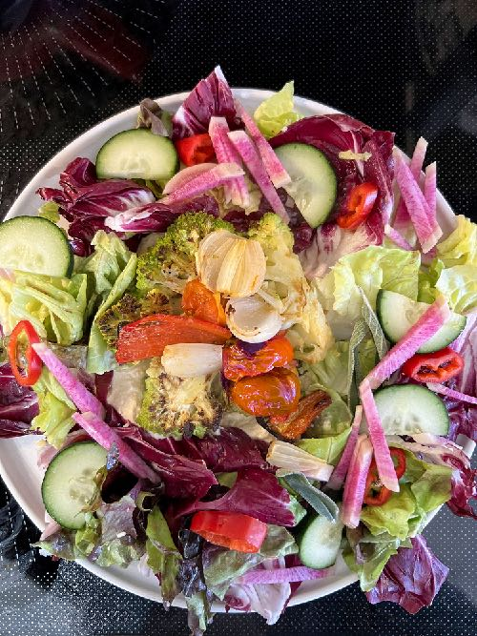
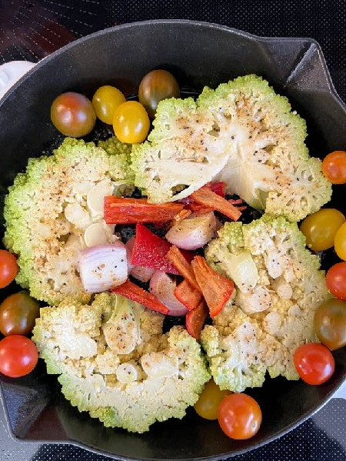
Roasted Veggie Hummus Bowl
INGREDIENTS
1 head of cauliflower or romanesco, sliced lengthwise in 4 slices
1 bell pepper, remove seeds, and cut into thick strips
1 cup cherry tomatoes cut in half
1 small onion cut into slices
1 tablespoon olive oil
pinch paprika
1 tsp cracked pepper
2 tsp Italian seasoning
4 cups lettuce
2 cups sliced cucumbers
1 cup sliced radishes
4 tablespoons light salad dressing
INSTRUCTIONS
Place the cauliflower or romanesco in an oven-proof skillet with the peppers, tomatoes, and onions. Sprinkle with olive oil and seasonings. Bake at 400 degrees for 15 minutes, turning the veggies once or twice. They are done when browned and crisp-tender.
Place the hummus in the center of 4 large plates. Surround it with the lettuce, radishes, and cucumbers.
Place the roasted veggies in the center of the plates on top of the hummus.
Sprinkle each plate with one tablespoon of light dressing.
Serve immediately. It is nice to have a lemon wedge and whole wheat pita half on the side of each plate as a garnish.
Serves 4. Each 1 cup serving: 168 calories, 9 g fat, 1.4 g saturated fat, 0 mg cholesterol, 0 mg trans fat, 164 mg sodium, 19 g carbohydrates, 6 g fiber, 9 g sugar, 5 g protein.

Slide 3
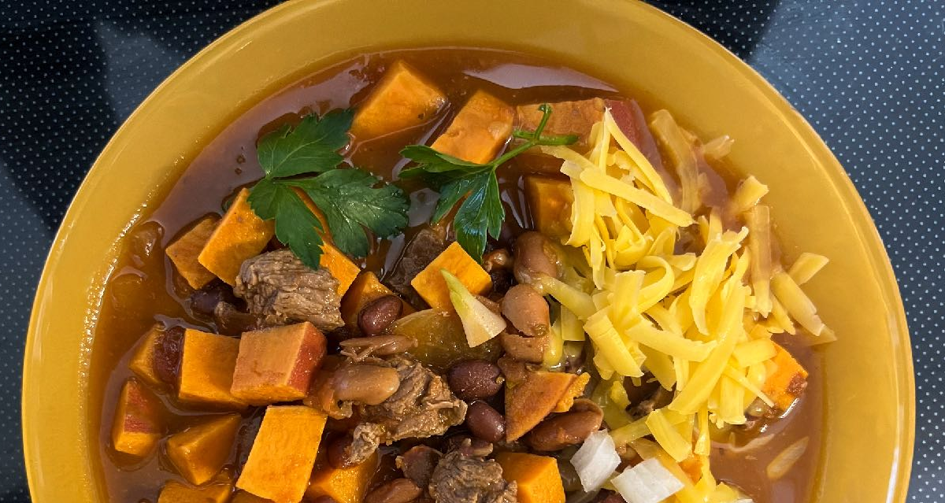
Buffalo Chili
Ingredients:
1 tablespoon olive oil
1 onion, chopped
2 cloves garlic, minced
8 ounces buffalo stew meat, cut in small pieces (or lean meat or poultry)
2 cans pinto beans, drained
1 can crushed tomatoes, no salt added
1 large red yam, cut in cubes
2 cups vegetable or beef broth, low sodium
2 tsp ground cumin
2 tsp chili powder
1 tsp oregano
1 tsp garlic powder
1 tsp red pepper flakes
1 tsp paprika
1 sprig parsley
Garnish: 1/2 cup shredded cheddar
Garnish: 1/2 cup diced raw onion or green scallion
Garnish: 4 tsp sour cream
Directions:
Place the olive oil in a Dutch oven pan. Sauté the onions and garlic.
Add the buffalo or lean beef and brown briefly.
Add the drained canned pinto beans, diced sweet potato, canned tomato, broth, and seasonings. Bring to a boil, then cover and lower to a simmer. Stir occasionally. Cook for 15-20 minutes or until the meat is tender up to 45 minutes.
Serve in 4 bowls. Garnish with cheese, sour cream, and onion.
Serves 5. Each 1 cup serving: 440 calories, 11 g fat, 4 g saturated fat, 41 mg cholesterol., 0 g trans fat, 350 mg sodium, 61 g carbohydrate, 14 g fiber, 26 g protein.

Slide 4
Melatonin Use Increasing in Children and Teens
Insomnia doesn’t just impact CEOs of big companies or parents of newborns. A new study from the University of Colorado at Boulder finds that nearly 20% of school-aged kids and preteens now use melatonin for sleep. In addition, some parents consistently provide the hormone to preschoolers, according to a new study published in the November 13th issue of JAMA Pediatrics.
Dietary supplements lack Food and Drug Administration (FDA) regulation, which concerns the researchers as the safety and efficacy of using these products are also limited.
Lead author Lauren Hartstein, PhD, a postdoctoral fellow in the Sleep and Development Lab at CU Boulder, notes, “We hope this paper raises awareness for parents and clinicians and sounds the alarm for the scientific community. We are not saying that melatonin is necessarily harmful to children. But much more research needs to be done before we can confidently state that it is safe for kids to take long-term."
Calls to Poison Control Centers on the Rise
The pineal gland produces melatonin naturally and tells the body that it’s time to sleep and manage its circadian rhythm- the physiological cycle over 24 hours.
The hormone is classified as a medication in many countries and is available by prescription only.
Yet, chemically created or animal-based melatonin is available over the counter as a dietary supplement in the US. It’s also increasingly available in kid-friendly gummies.
Written By Lisa Andrews, MEd, RD, LD

Slide 5
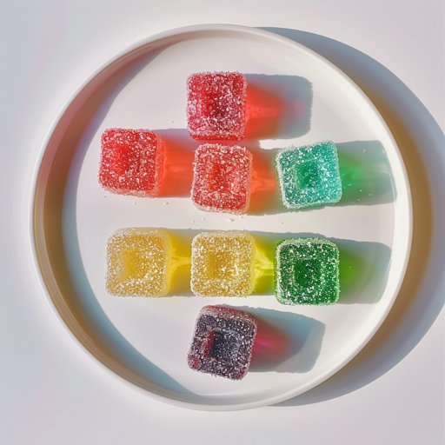
Melatonin Use Increasing in Children and Teens
Hartstein, who studies how environmental cues, including light at night and children's sleep quality and melatonin production, notes, "All of a sudden, in 2022, we started noticing many parents telling us that their healthy child was regularly taking melatonin”.
Between 2017 and 2018, roughly 1.3% of parents in the US reported that their children used melatonin.
Hairstein and colleagues questioned nearly 1,000 parents in the first half of 2023 to evaluate the current prevalence of melatonin use.
18.5% of children between the ages of 5 and 9 surveyed had been given melatonin in the past 30 days. In preteens between the ages of 10 and 13, the number increased to 19.4%. Almost 6% of preschoolers between the ages of 1 and 4 had been given melatonin in the previous month.
Grade-school-aged kids and preteens have used melatonin for an average of 18 and 21 months, while preschoolers who used it had been using it for roughly one year.
The dosage increased with the age of the child, with preschoolers using between 0.25 to 2 mg and preteens using up to 10 mg.
Caution Advised
A study published in April 2023 analyzed 25 gummy melatonin products and found that 22 contained various amounts of melatonin compared to what the label stated. One supplement contained over three times the amount on the label, while one had none at all.
Additionally, some melatonin supplements have been discovered to contain other substances of concern, including serotonin.
Written By Lisa Andrews, MEd, RD, LD

Slide 6
Melatonin Use Increasing in Children and Teens
Harstein is concerned that, "Parents may not actually know what they are giving to their children when administering these supplements,”
Other researchers are concerned that giving melatonin to children whose brains and bodies are still growing could impact the timing of the onset of puberty.
Inconsistent results have been seen in a few small-scale human studies investigating this.
Another concern is gummies, as they look and taste like candy. The authors note that from 2012 to 2021, reports of melatonin ingestion to poison control centers were up 530%, primarily in children under age 5. Over 94% were unintentional, and 85% were asymptomatic.
A Place for Appropriate Use
According to co-author Julie Boergers, Ph.D., a psychologist and pediatric sleep specialist at Rhode Island Hospital and the Alpert Medical School of Brown University, “when used under the supervision of a health care provider, melatonin can be a useful short-term aid, particularly in youth with autism or severe sleep problems.
"But it is almost never a first-line treatment," she said, noting that she often recommends that families look to behavioral changes first and use melatonin only temporarily. "Although it's typically well-tolerated, whenever we're using any kind of medication or supplement in a young, developing body, we want to exercise caution."
Her patient’s parents have noted that the supplement typically works well in the beginning, but over time, kids may require higher doses to get the same effect.
Harstein warns that using melatonin early in life could also have another unintended consequence. It could send a message that if you have trouble sleeping, pills are the answer.
According to the authors, this study was small and doesn’t necessarily represent nationwide usage.
However, "If this many kids are taking melatonin, that suggests there are a lot of underlying sleep issues out there that need to be addressed," Hartstein said. "Addressing the symptom doesn't necessarily address the cause."
Written By Lisa Andrews, MEd, RD, LD

Slide 7
Natural ways to improve sleep in children and preteens:
Set a consistent bedtime schedule, even on weekends.
Encourage a regular wake-up time during the week and also on weekends.
Reduce screen time, especially at night before bedtime.
Avoid caffeine consumption, mainly after 2 PM.
Teach children ways to relax, such as meditation or deep breathing.
Encourage regular exercise and getting outside, which aid in regulating the circadian rhythm
Avoid stressful discussions or arguments right before bed
Ask your doctor about using melatonin or other sleep aids before using them.
Reference:
1. Lauren E. Hartstein et al. Characteristics of Melatonin Use Among US Children and Adolescents. JAMA Pediatrics, 2023 DOI: 10.1001/jamapediatrics.2023.4749
Written By Lisa Andrews, MEd, RD, LD

Slide 8
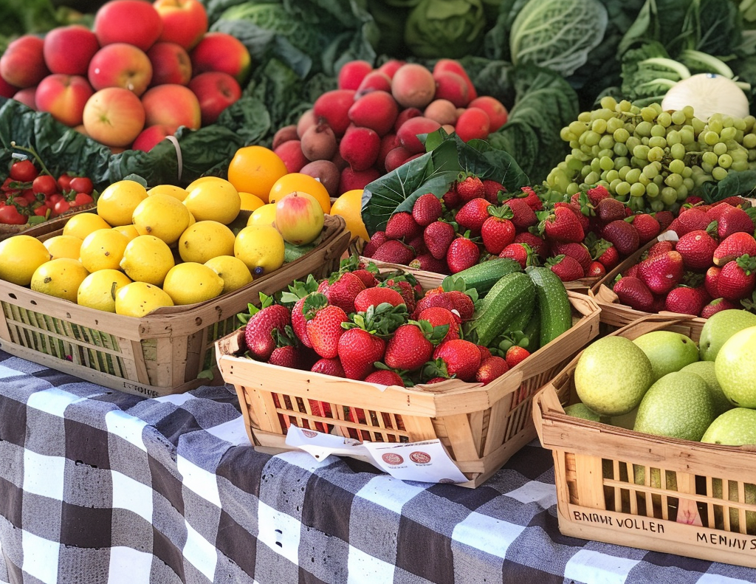
What Is A Vegan Diet?
A vegan diet is a type of vegetarian diet that excludes all forms of animal products, both meat and other animal-derived ingredients. People who follow a vegan diet, known as vegans, abstain from consuming meat, poultry, fish, dairy products, eggs, and honey. Additionally, they avoid other animal-derived ingredients in food like sugar and honey, as well as in other products like clothing and cosmetics.
A well-planned vegan diet can be nutritionally adequate and may offer health benefits such as lower risk of heart disease, certain cancers, and type 2 diabetes. However, it's essential for vegans to pay attention to key nutrients like vitamin B12, iron, calcium, and omega-3 fatty acids, ensuring they get an adequate intake through food or supplements.
Here are some key components of a vegan diet:
1. Plant-Based Foods:
Fruits and Vegetables: A variety of fruits and vegetables provide essential vitamins, minerals, and antioxidants. Here is where the vegan diet excels because there are so many fruits and vegetables available and they are all good for your health.
Whole Grains: Foods like quinoa, brown rice, oats, and whole wheat are staples for energy and fiber. Today’s stores make them accessible and easy to prepare.
Legumes: Beans, lentils, and chickpeas are excellent sources of protein, fiber, and various nutrients. There are many choices from canned to frozen or dried.
Nuts and Seeds: Almonds, walnuts, chia seeds, flaxseeds, and others offer healthy fats, protein, and micronutrients. Nut butters are often convenient.
Plant Oils: Olive oil, canola oil, avocado oil and vegetable oil are all available for cooking in place of lard or butter.

Slide 9
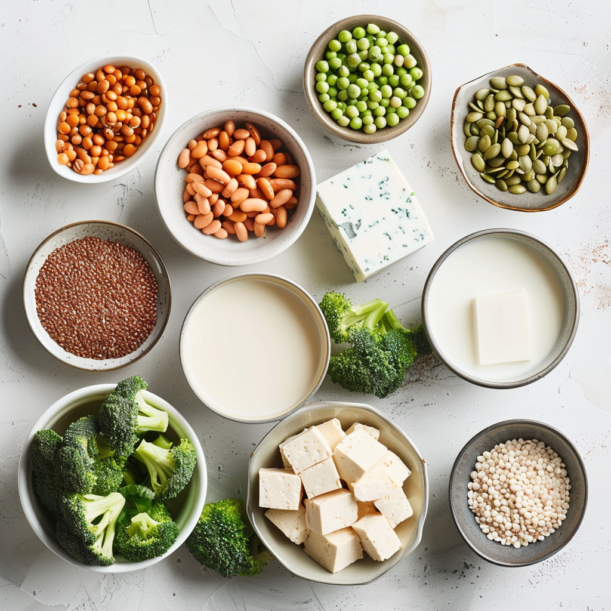
Plant Based Protein Ideas
2. Plant-Based Protein Sources:
This group of foods is talked about the most because it literally replaces all meat, fish, poultry, and any animal product. One thing to keep in mind is that you don’t want to load up on ultra-processed or sodium-laden foods. Always read the nutrition facts label and get a variety of vegetarian protein sources.
Legumes: Beans, lentils, and chickpeas are rich in protein. You can make many recipes like chili, soup, bowls, beans and rice, and ethnic dishes with beans. They are inexpensive and available in many forms.
Tofu and Tempeh: Soy-based products like tofu and tempeh are versatile protein sources. Many tempeh foods are even made from beans instead of soy. There are also many meat-analogues made with soy products like veggie burgers or sausages.
Seitan: Made from wheat gluten, seitan is a high-protein meat substitute.
Quinoa: A complete protein source, providing all essential amino acids.
Amaranth: A complete protein source, providing all essential amino acids.
Peanuts and other nuts and their butters
Flaxseed: can be mixed into smoothies and made into breakfast cereal
Chia Seeds: small black seeds that contain protein and fiber and many nutrients. They can be sprinkled on salads or incorporated into puddings and overnight oats.

Slide 10
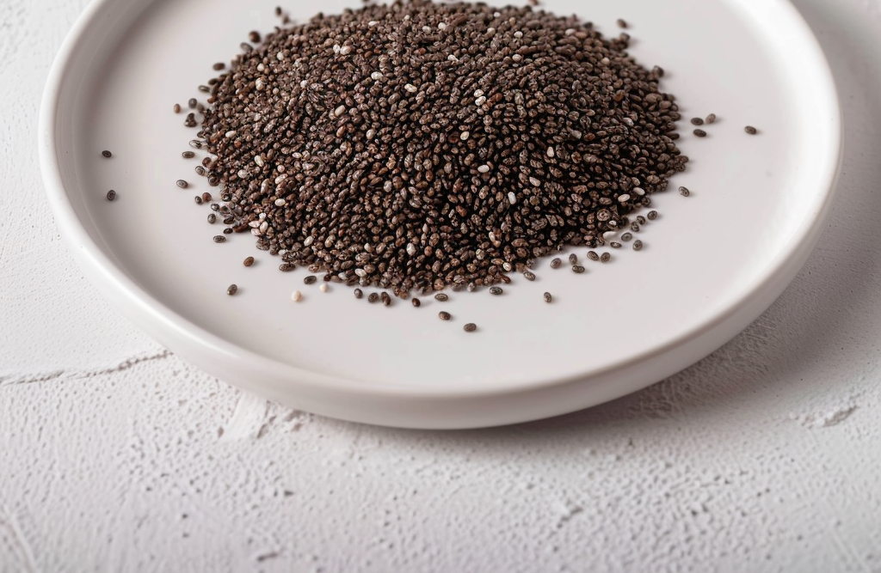
Vegan Diet Replacers
3. Plant-Based Dairy Alternatives:
Plant Milk: Soy milk, almond milk, coconut milk, and oat milk are common dairy alternatives. Read the label to ensure you are getting at least 30% DV for calcium in one serving. Some plant milks will also include nutrients of concern for vegans like B12 or iron.
Plant-Based Yogurt: Made from coconut, almond, or soy.
Cheese Alternatives: Vegan cheeses made from nuts, soy, or other plant-based ingredients.
4. Egg Replacements:
Flaxseeds and Chia Seeds: Often used as egg substitutes in baking.
Commercial Egg Replacers: Various commercial products are designed to replace eggs in recipes.
5. No Animal-Derived Additives:
Vegans avoid food additives derived from animals, such as gelatin (commonly found in desserts and candies), certain colorings, and some flavorings.
6. Honey Alternatives:
Vegans typically avoid honey and use alternatives like maple syrup, agave nectar, or other plant-based sweeteners.
7. Vegan-Friendly Products:
Vegans extend their lifestyle choices beyond diet, avoiding animal-derived ingredients in personal care products, clothing, and other items.
8. Supplements:
Some vegans may need to supplement certain nutrients that are more commonly found in animal products, such as vitamin B12, iron, and omega-3 fatty acids. However, this varies based on individual needs and dietary choices.
As with any diet, it's advisable to consult with a healthcare professional or a registered dietitian to ensure that nutritional needs are met and to address any potential deficiencies.

Slide 11
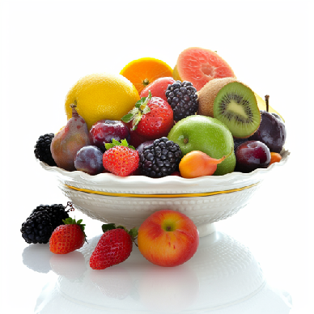
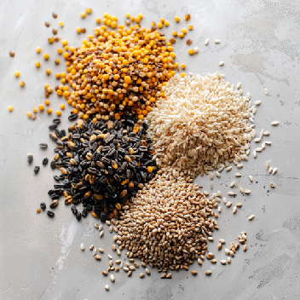
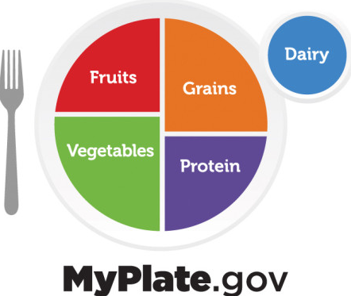
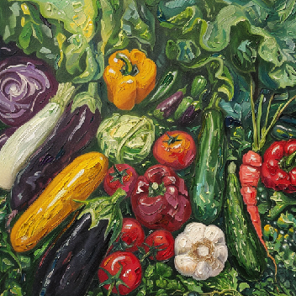
Going Vegan Or Vegetarian With MyPlate: MyPlate is Already 3/4 Plant-Based!

Slide 12
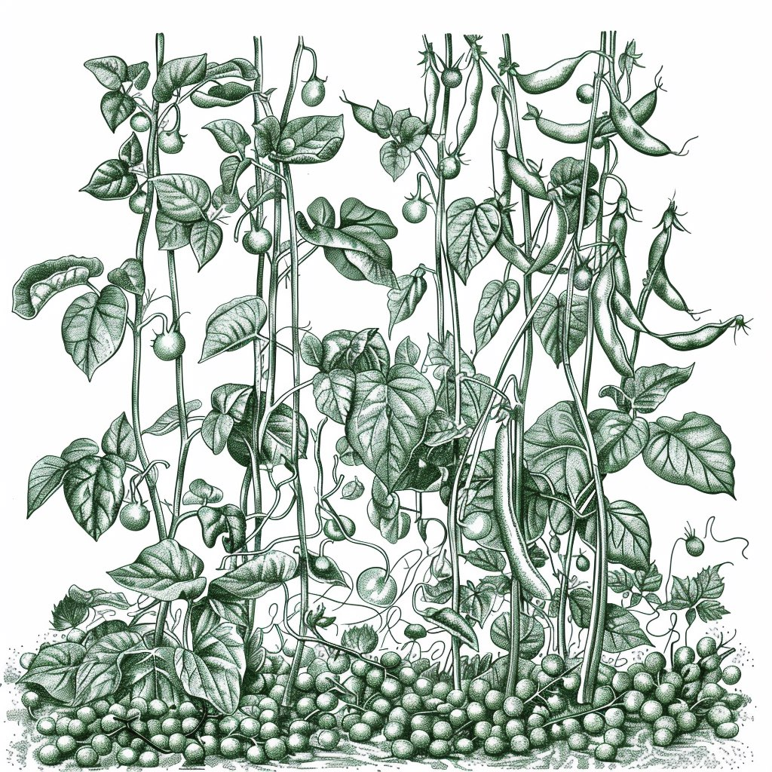
Changing To A Plant-Based Diet?
Focus on eating a variety of foods in the MyPlate Food Groups:
Vegetables
Fruits
Whole Grains
Plant-based Dairy (with calcium)
Plant-based Protein
By filling your plate 3/4 full with plants (fruits, veggies, and grains, you only have to worry about making 1/4 of it plant-based with the protein.
Here are tips for the journey:
Explore Plant-Based Recipes:
Experiment with new plant-based recipes to discover delicious and satisfying meals.
Look for plant-based alternatives for your favorite dishes.
Slowly reduce your intake of animal products rather than cutting them out all at once. Be flexible!
Consider eliminating one type of animal product at a time, such as red meat, poultry, or dairy.
Find Plant-Based Alternatives:
Explore plant-based alternatives for dairy products (almond milk, soy milk, etc.) and meat substitutes (tofu, tempeh, seitan).
Discover a variety of plant-based protein sources, such as legumes, beans, lentils, and quinoa.
Plan Your Meals:
Plan your meals ahead of time to ensure you have a variety of plant-based options available.
Keep healthy snacks on hand to avoid resorting to non-plant-based options when hungry.
Stay Hydrated:
Drink plenty of water to stay hydrated, as sometimes the increased fiber intake from plant-based foods may require more fluids.
Remember that everyone's journey to a plant-based diet is unique. Find what works best for you, and make adjustments as needed.

