Slide 1
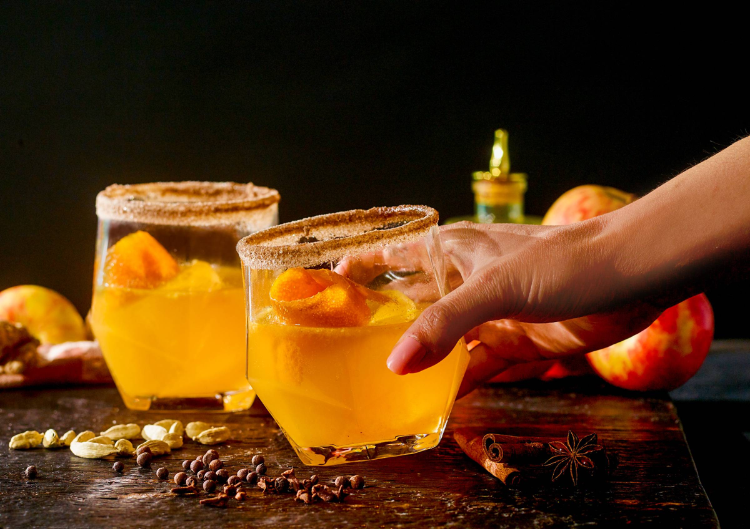
December 2023
Nutrition
NEWSLETTER
Inside:
Brought to you by:
Holiday Recipes (4)
Should Cravings Be Your Guide?
Swaps to Lower Sugar Intake
Green Light Go Foods
Mindful Eating to Lower Blood Pressure
Remission of Prediabetes Through Weight Loss

Slide 2
Apple Chai Spiced Mocktail
INGREDIENTS
1 cup apple cider (or unfiltered apple juice)
4 tablespoons apple cider vinegar
2 tablespoons honey
1 teaspoon of chai spice mix (or use pumpkin pie spice mix)
1/2 cup fresh squeezed orange juice (save the peel for garnish)
ice
orange peel garnish
Place the cider, vinegar, honey, and orange juice in a bar mixer or pitcher. Stir to mix well. Pour over ice and garnish with an orange peel. You can refrigerate it for later use for up to 8 hours.
INSTRUCTIONS
Rim the glass by dipping in apple juice and then rolling in chai spice sugar. To make chai spice sugar, mix equal parts of chai spice with sugar.
Place the cider, vinegar, syrup, juice, and bitters in a bar mixer or pitcher. Stir to mix well. Pour over ice and garnish with an orange peel. Sprinkle with a drop or two of bitters or orange turmeric shot over the top.
You can refrigerate it for later use for up to 8 hours.
Serves 4. Each 1/2 cup serving: 125 calories, 0g fat, 0 g saturated fat, 0 mg cholesterol, 0 g trans fat, 12 mg sodium, 28 g carbohydrate, 0 g fiber, 0 g protein.

Slide 3
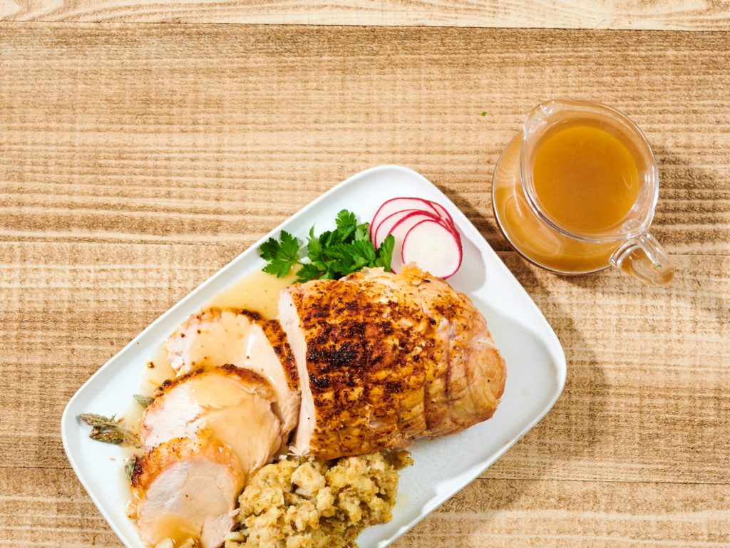
Roasted Turkey Breast
Ingredients:
3-pound turkey breast, boneless
1 tablespoon olive oil
2 tsp poultry seasoning
1 tsp paprika
1 cup gravy
0.5 cup water
Directions:
Preheat the oven to 350 degrees. Place the turkey on a roasting rack on a sheet pan or roasting pan. Rub it with olive oil and seasonings. Place a thermometer into the middle of the breast.
Bake until the turkey breast reaches an internal temperature of 165F.
Remove the breast from the oven.
Add water to the gravy to keep it thin.
Slice the breast into thin pieces and serve with hot gravy.
Serves 8. Each serving: 200 calories, 5g fat, 1 g saturated fat, 94 mg cholesterol., 0 g trans fat, 486 mg sodium, 2 g carbohydrate, 0 g fiber, 37 g protein.

Slide 4
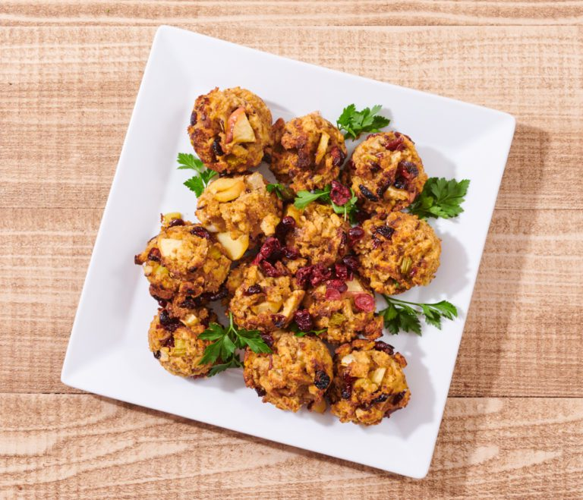
Apple Cranberry “Stuffins”
Ingredients:
1 bag stuffing mix
0.5 onions peeled and chopped
2 each stalks of celery chopped
1 each apple peeled, cored, chopped
0.25 cup dried cranberries or chopped fresh ones
1.75 cups water
4 tablespoons olive oil
Directions:
Saute the apples, onions, and celery with a little spray vegetable oil. Cover and cook until tender. Add the stuffing mix and olive oil. Mix well. Then add the water. Cover and cook on very low heat for a few minutes.
Grease the muffin tins. Scoop the stuffing into the tins.
Bake the stuffins for about 30 minutes or until they are heated through and a nice brown color on the top and sizes.
Serve on a platter. Garnish with a few more cranberries and some parsley
Serves 12. Each stuffing: 59 calories, 5g fat, 0.5 g saturated fat, 0 mg cholesterol, 0 g trans fat, 4 mg sodium, 4 g carbohydrate, 0.5 g fiber, 1 g protein.

Slide 5
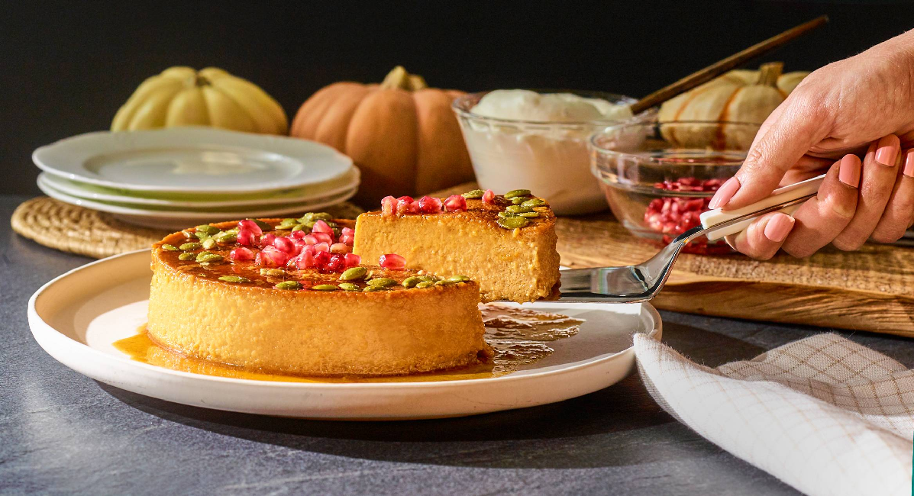
Pumpkin Flan
Caramel
1/2 cup sugar
1 tsp lemon juice
2 tsp water
Filling
1 can pumpkin puree
1 tablespoon pumpkin pie spice
5 eggs
1 can of evaporated milk
1 can sweetened condensed milk
INSTRUCTIONS
Prepare the flan mold. It should be a ceramic bowl or tart pan with straight sides about 8 inches in diameter. And it should be ovenproof. Lightly grease the sides.
Place the ingredients for the caramel in a stainless steel pot. Mix well and bring to a boil. Boil on high until the mixture is the color of iced tea.
Immediately pour the caramel into the bottom of the flan mold.
Prepare the custard by mixing the spices into the pumpkin with a whisk and then add the eggs one by one, mixing smoothly between each addition. Add the evaporated and condensed milk to the pumpkin/egg mixture and mix smoothly. Pour the custard into the tart pan. Bake in a 350-degree oven in a pan of water until the custard is firm in the center, about 45 minutes. Remove from the oven, cool briefly, then refrigerate overnight.
Run a knife around the edges of the flan and invert onto a plate.
Garnish with pumpkin seeds (pepitas) and pomegranate arils.
Creme Brulee version:
Skip the caramel sugar steps. Make the custard and bake in a tart pan in a water bath. Top with sugar and caramelize with a torch (omit lemon juice and water).
Serves 12. Each serving: 217 calories, 7g fat, 4 g saturated fat, 87 mg cholesterol, 0 g trans fat, 101 mg sodium, 32 g carbohydrate, 1 g fiber, 7 g protein.

Slide 6
Should Cravings Be Your Guide?
Research has shown that women of childbearing age are most likely to report intense food cravings. Chocolate is the most often reported craving for these women. Men are more likely to report cravings for meats and salty snack foods. Since nearly all craved foods by men and women are calorie-dense, it is not surprising to find overweight people reporting intense food cravings. Since dietary restraint in the form of calorie restriction or portion control invariably increases hunger and hunger increases the desire to eat all foods, it is not surprising that people on calorie restricted diets often end up bingeing on a highly preferred food or craved food.
Many people believe that a craving or desire for a specific food is an indication of nutritional need. Some researchers have suggested that since most cravings are for nutrient-poor foods high in fat, sugar, and/or salt, such cravings appear unlikely to have anything to do with real nutritional needs. These researchers note that it is food items which are highly palatable that are most likely to be craved. They hypothesize that most food cravings simply reflect a desire for pleasure; often people who are depressed, anxious, or lonely report the most intense food cravings.
Other researchers note that certain neurotransmitters increase the desire to eat certain types of food. For example, galanin increases the desire for fatty foods, while neuropeptide Y is associated with a desire for high-carbohydrate foods. Of course research also shows that the more fat in one’s diet, the more galanin is produced, and the more galanin that’s produced, the more one prefers or craves fattier foods. Indeed, research shows that eating less fat for several weeks reduces galanin levels and the desire to eat fatty foods. It is clear that the only way to reduce one’s desire for fatty foods is to not eat them. There is no evidence that avoiding a certain food will create a more intense craving or desire to eat that food. In fact, avoidance is the only proven way to reduce ones desire for a craved food item.
The bottom line: contrary to popular myth, food cravings do not reflect a real nutritional need and often undermine rational attempts to improve one’s diet. In general, the only way to reduce the desire for nutritionally undesirable craved foods is to avoid them for several weeks. With time, such cravings diminish and become easier to control.
James J. Kenney, PHD, RD, FACN

Slide 7
Swap Ideas to Lower Sugar Intake
Reducing sugar intake can have various health benefits, including better weight management and improved overall health. To eat less sugar, you can swap out high-sugar foods with healthier alternatives. Here are some of the best sugar swaps:
Fresh Fruit: Instead of reaching for sugary snacks or desserts, opt for fresh fruits like berries, apples, or oranges. They provide natural sweetness along with fiber and essential nutrients.
Unsweetened Applesauce: Use unsweetened applesauce as a substitute for sugar in baking recipes. It can add moisture and sweetness without the need for added sugar.
Stevia or Monk Fruit: Stevia and monk fruit are natural, calorie-free sweeteners that can be used as sugar substitutes in recipes, coffee, or tea.
Honey or Maple Syrup: When a recipe calls for sugar, try using natural sweeteners like honey or pure maple syrup in moderation. Keep in mind that these still contain sugar but provide additional nutrients compared to refined sugar.
Greek Yogurt: Swap out sugary, flavored yogurts for plain, unsweetened Greek yogurt, which you can sweeten with fresh fruit or a drizzle of honey.
Nut Butters: Instead of sugary spreads, use natural nut butters like almond or peanut butter. These add healthy fats and protein without the added sugars.
Cinnamon or Vanilla Extract: Enhance the flavor of your dishes with spices like cinnamon or a touch of vanilla extract. This can reduce the need for added sugar in recipes.
Dark Chocolate: If you have a sweet tooth, opt for dark chocolate with a high cocoa content (70% or higher). It contains less sugar than milk chocolate and provides antioxidants.
Whole Grains: Choose whole grains like oats or quinoa over sugary cereals and refined grains. Whole grains can be a satisfying and nutritious option for breakfast or snacks.
Homemade Smoothies: Make your own smoothies using unsweetened almond or coconut milk, fresh fruits, and a source of protein like yogurt or protein powder. This way, you can control the amount of added sugar.
Seltzer Water or Herbal Tea: Replace sugary soft drinks and juices with unsweetened seltzer water or herbal teas. You can add a slice of citrus or some mint for flavor.
Reduce Sugar Gradually: If you're used to adding a lot of sugar to your coffee or tea, try reducing the amount slowly over time until your taste buds adjust to less sweetness.
Remember that it's essential to read food labels and be mindful of hidden sugars in packaged and processed foods. Reducing sugar intake is a gradual process, and it's important to find a balance that works for your taste preferences and health goals.
Written By Judy Doherty

Slide 8
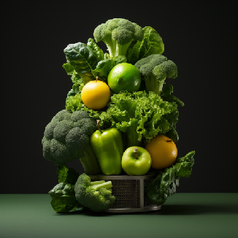
Go Foods for Better Weight Control
What do GO foods have in common?
High in water
High in fiber
Low in calorie density
Low in fat
No added sugar
GO foods are high in water content — this means that cooked whole grains like oatmeal, brown rice, barley, and whole grain pasta are better choices than lower moisture items like bread and crackers. Not that bread and crackers are bad — don’t make them the bulk of your preferences.
Fruits and vegetables are the best of all choices!! They are high in water content and fiber. And they are low in calorie density and fat.
GO! foods include fruits, vegetables, nonfat dairy, cooked whole grains, lean protein, and legumes.
What is calorie density?
Calorie density: the concentration of calories in a given weight of food.
Compare foods by grams, ounces, pounds or kilos:
Item | Calories per pound
lettuce | 77
Apple | 224
potato, baked | 320
cheese | 1824
potato chips | 2432
olive oil | 4000
See how the more refined and higher-fat foods are higher in calorie density than the unprocessed ones.
The GO foods are the base of MyPlate, too. They are right in line with all of the recommendations from the Dietary Guidelines for Americans By James J. Kenney, PHD, RD, FACN

Slide 9
Mindful Eating to Lower Blood Pressure?
In a study examining individuals with elevated blood pressure, those who engaged in an eight-week mindfulness-based blood pressure reduction program demonstrated substantial enhancements in both self-awareness and their commitment to following a heart-healthy diet, in contrast to a control group. These findings were reported in JAMA Network Open. The participants in the program displayed marked progress in adhering to a heart-healthy diet, a key factor affecting blood pressure, along with notable improvements in self-awareness.
The study involved the comparison of two cohorts, with a combined total of 201 participants. The first group, consisting of 101 individuals, participated in the 8-week MB-BP program, encompassing personalized feedback and education concerning hypertension risk factors, mindfulness training addressing hypertension risk factors (including mindful eating), and support for behavioral changes. The "usual care" control group, on the other hand, received educational brochures on managing high blood pressure. Both groups were equipped with home blood-pressure monitoring devices and received training on their usage, as well as the possibility of being referred to primary care physicians. The program used the DASH Diet. After six months, the mindfulness group showed a 0.34-point improvement in the DASH diet score.
Practicing mindful eating can help you reduce your salt intake by making you more aware of the foods you consume and how much salt is in them.
Here are some tips for mindful eating to adopt the DASH diet and lower your salt intake:
Pay attention to your cravings and habits: Recognize when and why you reach for salty foods. Are you eating out of boredom, stress, or habit? Identifying the triggers can help you make more conscious choices.
Read food labels: Always check the nutrition labels on packaged foods to be aware of their salt content. Pay attention to the sodium levels and serving sizes to make informed decisions.
Cook at home: Preparing your meals at home gives you complete control over your ingredients. You can choose low-sodium options and season your food with herbs, spices, and other flavor-enhancing ingredients instead of relying on salt.
Use herbs and spices: Experiment with various herbs and spices like basil, oregano, garlic, ginger, and turmeric to add flavor to your dishes without the need for excess salt.
Limit processed and fast foods: These types of foods often contain high levels of hidden sodium. Reducing your consumption of fast food, frozen meals, and packaged snacks can significantly lower your salt intake. By planning ahead you can avoid a hunger rush to the fast food location!
Eat whole, unprocessed foods: Fresh fruits, vegetables, lean proteins, and whole grains are naturally low in salt. Focusing on whole foods in your diet can help you consume less salt.
Avoid the salt shaker: At the table, try not to reach for the salt shaker automatically. Taste your food first, and if needed, use it sparingly.

Slide 10
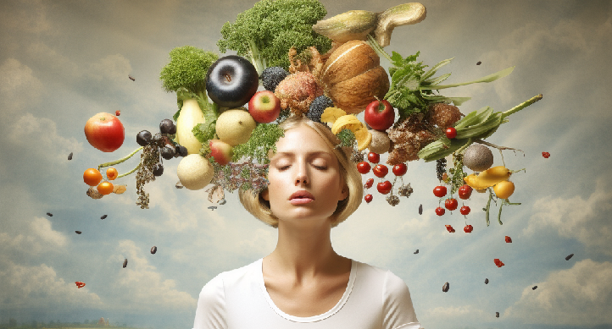
Mindful Eating to Lower Blood Pressure?
8. Slow down and savor your meals: Eat mindfully by taking your time to enjoy each bite. Chewing your food thoroughly and savoring the flavors can make you more satisfied with less salt.
9. Drink plenty of water: Staying hydrated can help reduce your cravings for salty foods. Sometimes, your body may mistake thirst for hunger.
10. Plan your meals around fruits and vegetables in season: Create meal plans and grocery lists in advance to ensure that you have healthier, lower-sodium meal plans and snacking options readily available. This can prevent last-minute, high-sodium food choices.
11. Be mindful of portion sizes: Even low-sodium foods can contribute to high salt intake if consumed in excessive amounts. Pay attention to portion sizes to maintain a healthy sodium balance.
12. Educate yourself about high-sodium foods: Learn which foods are typically high in salt, such as processed meats, canned soups, and some condiments, and try to limit their consumption.
Practicing mindful eating and making gradual changes to your diet can help you reduce your salt intake over time. It's important to focus on long-term habits rather than quick fixes to maintain a lower-sodium diet and support your overall health.
Reference:
Eric B. Loucks, Ian M. Kronish, Frances B. Saadeh, Matthew M. Scarpaci, Jeffrey A. Proulx, Roee Gutman, Willoughby B. Britton, Zev Schuman-Olivier. Adapted Mindfulness Training for Interoception and Adherence to the DASH Diet. JAMA Network Open, 2023; 6 (11): e2339243 DOI: 10.1001/jamanetworkopen.2023.39243
Written By Judy Doherty

Slide 11
Remission of Prediabetes Through Weight Loss
My clients with pre-diabetes often think they need to drop loads of weight to prevent developing diabetes. A current study that supports previous research on weight loss and diabetes proves them wrong. 1, 2
A recent study published in The Lancet Diabetes & Endocrinology found that a small weight loss puts prediabetes in remission and may protect against type 2 diabetes. In addition, it’s linked with better kidney and vascular function. 3
The study from the University of Tübingen in Germany was led by Arvid Sandforth, M.D, and colleagues evaluated how weight loss induced remission in people with prediabetes. The study included subjects in the Prediabetes Lifestyle Intervention Study (PLIS) and the Diabetes Prevention Program (DPP) study who were randomly assigned to participate in a lifestyle intervention or placebo and lost at least 5 percent of their body weight.
Subjects whose blood sugar returned to normal fasting levels had normal glucose tolerance and hemoglobin A1c (HbA1c) below 39 mml/mol after a year of lifestyle intervention or placebo or control intervention were considered responders.
The investigators discovered that in PLIS, over 25 percent of participants had a weight loss of 5 percent or more of their body weight from the start, and of these, 43 percent were responders
Within the 683 DPP subjects who lost a minimum of 5 percent of their body weight at baseline, 19 percent were responders. Despite BMI reduction being similar between responders and non-responders, responders had increased whole-body insulin sensitivity compared to non-responders.
Secretion of insulin was not different within groups over time or between the groups. Both responders and non-responders had reductions in intrahepatic lipid content, but visceral adipose tissue was reduced more in responders. Within two years of the intervention, a 73% lower risk of developing type 2 diabetes was observed compared to non-responders.
Written By Lisa Andrews, MEd, RD, LD

