Slide 1
April 2023
Nutrition
NEWSLETTER
Inside:
Brought to you by:
Orange Stir Fry Chicken, by Judy Doherty, MPS, PC II
Carrot Bunny Muffins, by Judy Doherty, MPS, PC II
Functional Foods: Dietitian’s Insight by Lynn Grieger, RDN, CDCES, CHWC, CPT
Functional Ingredients by Lynn Grieger, RDN, CDCES, CHWC, CPT
Functional Foods by Lynn Grieger, RDN, CDCES, CHWC, CPT
Snack A Meal by Lisa Andrews, MEd, RD, LD
Healthy Snacks by Lisa Andrews, MEd, RD, LD
Tips To Reduce Ultra-Processed Foodsby Hollis Bass, MEd, RD, LD

Slide 2
Orange Chicken Stir-fry
Ingredients:
Chicken:
1 pound chicken breasts
1 cup all-purpose flour
1 cup cornstarch
Salt and pepper
2 eggs beaten
1/4 cup canola oil
Sauce:
1 tablespoon grated ginger
1 tablespoon oil
1 tablespoon minced garlic 1 tablespoon soy sauce
Zest of 1 lemon and one orange
1 cup orange juice
Directions:
Cut the chicken in 1” pieces. Mix the cornstarch and all-purpose flour in a bowl and add the salt and pepper. Beat the eggs and water in another bowl.
Dip the chicken in the eggs and then into the flour. Place the floured chicken pieces on a sheet tray in a single layer.
Mix the ingredients for the sauce, whisk, and bring to a boil. Turn off heat.
Heat a large wok over medium-high. Add part of the 1/4 cup of oil. Cook the chicken in 2 batches with the oil until it is done.
When the chicken is done, place it all back in the pan. Add the sauce, bring to a boil and serve hot. It goes great with rice and steamed veggies.
Nutrition Facts:
Serves 4. Each 1 cup serving: 377 calories, 20 g fat, 1.8 g saturated fat, 54 mg cholesterol, 400 mg sodium, 27 g carbs, 1 g fiber, 5 g sugar, 21 g protein.

Slide 3
Carrot Bunny Muffins
Here is a way to make fun and healthy carrot muffins with a spring or Easter twist. Everyone will love the ears!
Ingredients:
1- 1/2 cups flour
1/2 cup rolled oats (dry)
2 teaspoons baking powder
1 tsp baking soda
1 teaspoon cinnamon
pinch salt
3/4 cup brown sugar
1 cup vegetable oil
2 large eggs
1- 1/2 cups shredded carrots
1/4 cup plain yogurt
Garnishes: 4 oz whipped cream cheese, 1 carrot, slicing tips on mandolin to create ears
Directions:
Measure the dry ingredients and sugar into a large mixing bowl. Preheat the oven to 365 degrees. Line a muffin pan with muffin cups.
Mix the wet ingredients in another bowl. Add them to the dry ingredients. Mix them together and mix smoothly without over-mixing.
Scoop the muffin batter into the cups using an ice cream scoop or measuring cup to keep them uniform in size.
Bake in the oven for 25 minutes or until they are done. They are done when they spring back when touched in the center or a toothpick inserted in the center comes clean.
Whip the cream cheese and pipe a star on the top of each muffin.
Shave the bottom of the carrots on a bias on a mandolin to make ears. Watch the video to see how.
Stick the carrot ears in the cream cheese to make ears for the muffins.
Serve or refrigerate until later.
Makes 12 muffins. Each muffin: 203 calories, 12 g fat, 2.5 g saturated fat, 35 mg cholesterol, 220 mg sodium, 23 g carbs, 1 g fiber, 15 g sugar, 2.7 g protein

Slide 4
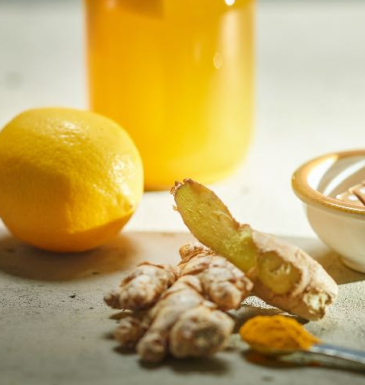
A Dietitian's Insight For Functional Ingredients
There are hundreds of functional ingredients, and more are identified each year. Food manufacturers are eager to find additional ways to promote health qualities in a range of foods, especially foods that aren’t generally considered healthy — think cookies, muffins, and crunchy/salty/savory snacks. Functional ingredients are a potentially huge market, with global sales of fortified or functional foods at $292 billion in 2021, up from $274 billion in 2020. Functional food and beverage sales in the United States were $83 billion in 2021, a 6.8% increase from 2020.
This brings up an important and yet unanswered question: do indulgent foods like cookies and crunchy snacks that contain functional ingredients actually promote health, or is the inclusion of functional ingredients more of a marketing strategy?
Just because a food label states that it is a “superfood” or that it contains important-sounding ingredients doesn’t mean that the food provides additional health benefits – or even any health benefits. Savvy consumers will look past the marketing on the front of food packages and look instead at the list of ingredients (listed in descending order from what is present in the largest amount by weight) and the Nutrition Facts label. This helps them know exactly what the food provides. Building an eating plan based on whole foods that naturally contain a wide range of nutrients — fruit, vegetables, whole grains, legumes, and nuts and seeds — is the foundation of a healthy diet. Periodically enjoying a food with functional ingredients because you like the flavor fits into an overall healthy eating plan; just don’t count on any additional health benefits.
Written By Lynn Grieger, RDN, CDCES, CHWC, CPT
References:
Government of South Australia. Introduction to Functional Foods and Ingredients. https://www.pir.sa.gov.au/__data/assets/pdf_file/0007/287683/Functional_Foods_Guidance_-_What_are_Functional_Foods.pdf accessed 2-2-23
Food Industry Executive. Functional Ingredients: What Consumers Want. https://foodindustryexecutive.com/2019/05/functional-ingredients-what-consumers-want/ Carol Wiley, 5-13-2019. Accessed 2-2-23
The Food Institute. 7 Functional Ingredients to Watch. https://foodinstitute.com/focus/7-functional-ingredients-to-watch/ posted 5-16-22; accessed 2-2-23
Steven M. Gendel, Potential functional food ingredients: Insufficient ingredient descriptions, Journal of Functional Foods, Volume 86, 2021, 104721, ISSN 1756-4646, https://doi.org/10.1016/j.jff.2021.104721. https://www.sciencedirect.com/science/article/pii/S1756464621003704
IFT. Top 10 Functional Food Trends. https://www.ift.org/news-and-publications/food-technology-magazine/issues/2022/april/features/top-10-functional-food-trends. A. Elizabeth Sloan 4-1-22; accessed 2-3-23

Slide 5
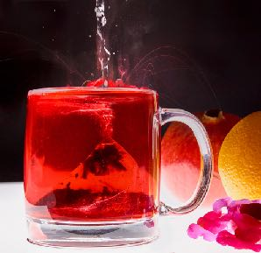
What Are Functional Ingredients?
Have you heard about functional foods? These provide additional health benefits beyond basic nutrition.
Many foods naturally contain these additional health benefits — think fermented foods like kefir or sauerkraut that contain probiotics. Or berries that are high in antioxidants. Including functional foods as part of your daily food choices is an excellent strategy to improve overall health.
Food manufacturers are more frequently adding ingredients to foods to enhance their health benefits, and these additives are also known as functional ingredients. A functional ingredient is a bioactive compound obtained from a variety of sources, including fruits and vegetables, marine sources, microorganisms, and inorganic raw materials. Food industry research published in 2019 showed that a large percentage of consumers are interested in foods that enhance mood, increase energy, help with weight loss, improve digestion, reduce risk of heart disease, and promote sleep.
References:
Government of South Australian. Introduction to Functional Foods and Ingredients. https://www.pir.sa.gov.au/__data/assets/pdf_file/0007/287683/Functional_Foods_Guidance_-_What_are_Functional_Foods.pdf accessed 2-2-23
Food Industry Executive. Functional Ingredients: What Consumers Want. https://foodindustryexecutive.com/2019/05/functional-ingredients-what-consumers-want/ Carol Wiley, 5-13-2019. Accessed 2-2-23
The Food Institute. 7 Functional Ingredients to Watch. https://foodinstitute.com/focus/7-functional-ingredients-to-watch/ posted 5-16-22; accessed 2-2-23
Steven M. Gendel, Potential functional food ingredients: Insufficient ingredient descriptions, Journal of Functional Foods, Volume 86, 2021, 104721, ISSN 1756-4646, https://doi.org/10.1016/j.jff.2021.104721. https://www.sciencedirect.com/science/article/pii/S1756464621003704
IFT. Top 10 Functional Food Trends. https://www.ift.org/news-and-publications/food-technology-magazine/issues/2022/april/features/top-10-functional-food-trends. A. Elizabeth Sloan 4-1-22; accessed 2-3-23
Written By Lynn Grieger, RDN, CDCES, CHWC, CPT

Slide 6
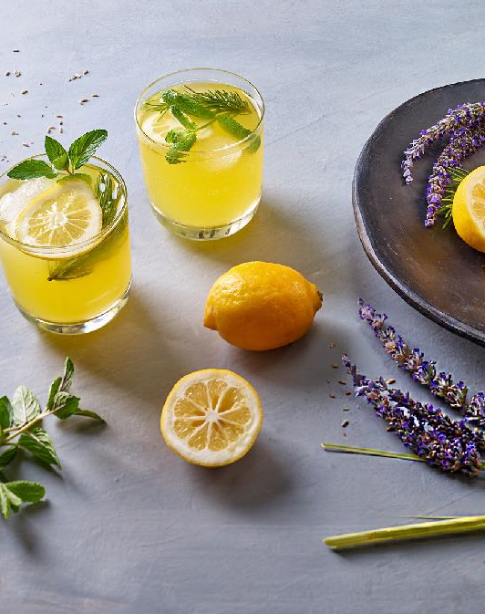
What Are Functional Ingredients?
What are some functional ingredients?
There are hundreds of functional ingredients! 2021 food industry research highlights seven that generate high interest from consumers:
Functional Ingredient Consumer interest
Turmeric Improved digestive health and reduced inflammation
Collagen Bone, joint and brain health
Green Coffee Extract Increased energy
Electrolytes Hydration and energy
Lavender Improved mood and sleep
Beta Glucans Improved immunity
Probiotics Gut health and improved immunity
Just because consumers believe that these functional ingredients promote health doesn’t mean that science necessarily supports these beliefs. Functional ingredients have the potential to play an important role in human health, but reaching that potential depends on accumulating a large body of scientific research that proves both benefits and safety. An analysis of over 100 recent papers that reported potential health effects from plant-derived functional ingredients in multiple journals showed that few provided sufficient information to allow the research to be replicated and very few had tested multiple batches of an ingredient.
Written By Lynn Grieger, RDN, CDCES, CHWC, CPT

Slide 7
Snack-A-Meal
While scrolling Instagram the other day, I saw an ad that read, “Can a cookie replace your dinner?” It was promoting a “healthy” cookie with fake fiber, sugar alcohols, and protein powder. Is this what we’ve come to? Hard pass.
I get it. Now that the pandemic isn’t as big a threat to our health, Americans have returned to “life as usual.” The popularity of taking time to cook meals at home has waned as people have resumed their busy schedules. Rather than full meals, many have turned to convenience, and grab-n-go items are on the rise. CNN reports that snack sales have increased 50% over the past five years. Co-founder and director of The Food People (a UK-based think tank that analyzes food trends and new product developments) Charles Banks notes that consumers are looking for more sustainable food sources and inexpensive, convenient items. One such trend is having snacks for dinner. These snacks don’t need to be unhealthy or even heavily processed. When I think of snacking, I think of the small foods I graze on throughout the day: fruit, nuts, yogurt, cottage cheese, etc. Snacking instead of sitting for a meal is on the rise, so let’s take a look at the pros and cons of this approach…
Pros:
Snacks can help build a better nutrition outcome. One study found that fruit and vegetable consumption improves if snacks are eaten earlier in the day.
Snacks can be convenient. Non-perishable items like half a peanut butter sandwich, a trail mix, or a protein bar are all great snacks. One study found that a 200-calorie nut-based protein bar did not impact the risk for weight gain.
Snacks are a better alternative than completely skipping a meal. A 2020 food and health survey found that 25% of Americans skip lunch.
Kids can make up for missing nutrients in their diet (such as calcium, iron, and fiber) through snacking.
Cons:
If you reach for high-calorie or high-sugar snacks too often, you could face undesirable weight gain or elevated blood sugar.
Similarly, ultra-processed, low-nutrient-quality snacks add fat, sugar, sodium, and calories, but not much nutrition. They may also alter taste buds and increase your preference for these foods.
Snacks can be expensive. Protein bars can cost anywhere from $1.50 to $4.00 each. Consider cost if you adopt this approach.
Sitting down for family meals reduces depression, substance use, and chances of risky behavior. Snacking for a meal could mean less time spent on family meals.
Written By Lisa Andrews, MEd, RD, LD

Slide 8
Snack-A-Meal
8 Nutritious Grab-N-Go Snack Ideas:
Trail mix of lightly salted nuts or seeds, Cheerios, raisins, and dried cherries.
Protein bar (look for ones with ten or more grams of protein, 3 grams or fewer of saturated fat, and 8 grams or fewer of added sugar)
Light string cheese and whole grain crackers
Greek yogurt and grapes
Apple, grapes, banana, pesches, plums, or berries with cheese or nuts
A turkey and cheese roll-up in a whole wheat tortilla
Hummus and olives with whole-grain pita chips
Dates with peanut or almond butter
References:
A global food trends and ideas agency | thefoodpeople
Barrington WE, Beresford SAA. Eating Occasions, Obesity and Related Behaviors in Working Adults: Does it Matter When You Snack? Nutrients. 2019 Oct 1;11(10):2320. doi: 10.3390/nu11102320. PMID: 31581416; PMCID: PMC6835708.
Njike VY, Kavak Y, Treu JA, Doughty K, Katz DL. Snacking, Satiety, and Weight: A Randomized, Controlled Trial. Am J Health Promot. 2017 Jul;31(4):296-301. doi: 10.4278/ajhp.150120-QUAN-676. Epub 2015 Nov 11. PMID: 26559707.
International Food Information Council. 2020 Food & Health Survey. 10 June 2020. https://foodinsight.org/2020-food-and-health-survey/. Accessed Sept 28, 2020.
Harrison ME, Norris ML, Obeid N, Fu M, Weinstangel H, Sampson M. Systematic review of the effects of family meal frequency on psychosocial outcomes in youth. Can Fam Physician. 2015;61(2):e96-e106.
Written By Lisa Andrews, MEd, RD, LD

Slide 9
Tips for Reducing Ultra-Processed Foods
In light of the apparent link between ultra-processed food and leptin resistance in women, you may need to check in with your audience about their eating patterns.
Unsure about what exactly healthcare providers should advise? Consider the following…
Limit intake of ultra-processed foods such as fast food, chips, commercial pastries, and other low nutrient quality food.
Include a variety of fruits and vegetables daily.
Add beans or lentils to salads and soups to increase dietary fiber.
Try a variety of whole grains such as barley, bulgur, farro, and quinoa.
Encourage fermented foods such as cottage cheese, kefir, kimchi, sauerkraut, and yogurt.
Use brown rice instead of white rice. Try whole grain breads and cereals.
Reference:
Fernandes AE, et al. Differences in the gut microbiota of women according to ultraprocessed food consumption. Nutr Metab Cardiovasc Dis. 2022;doi:10.1016/j.numecd.2022.09.025.
By Lisa Andrews, MEd, RD, LD

